Slide 1
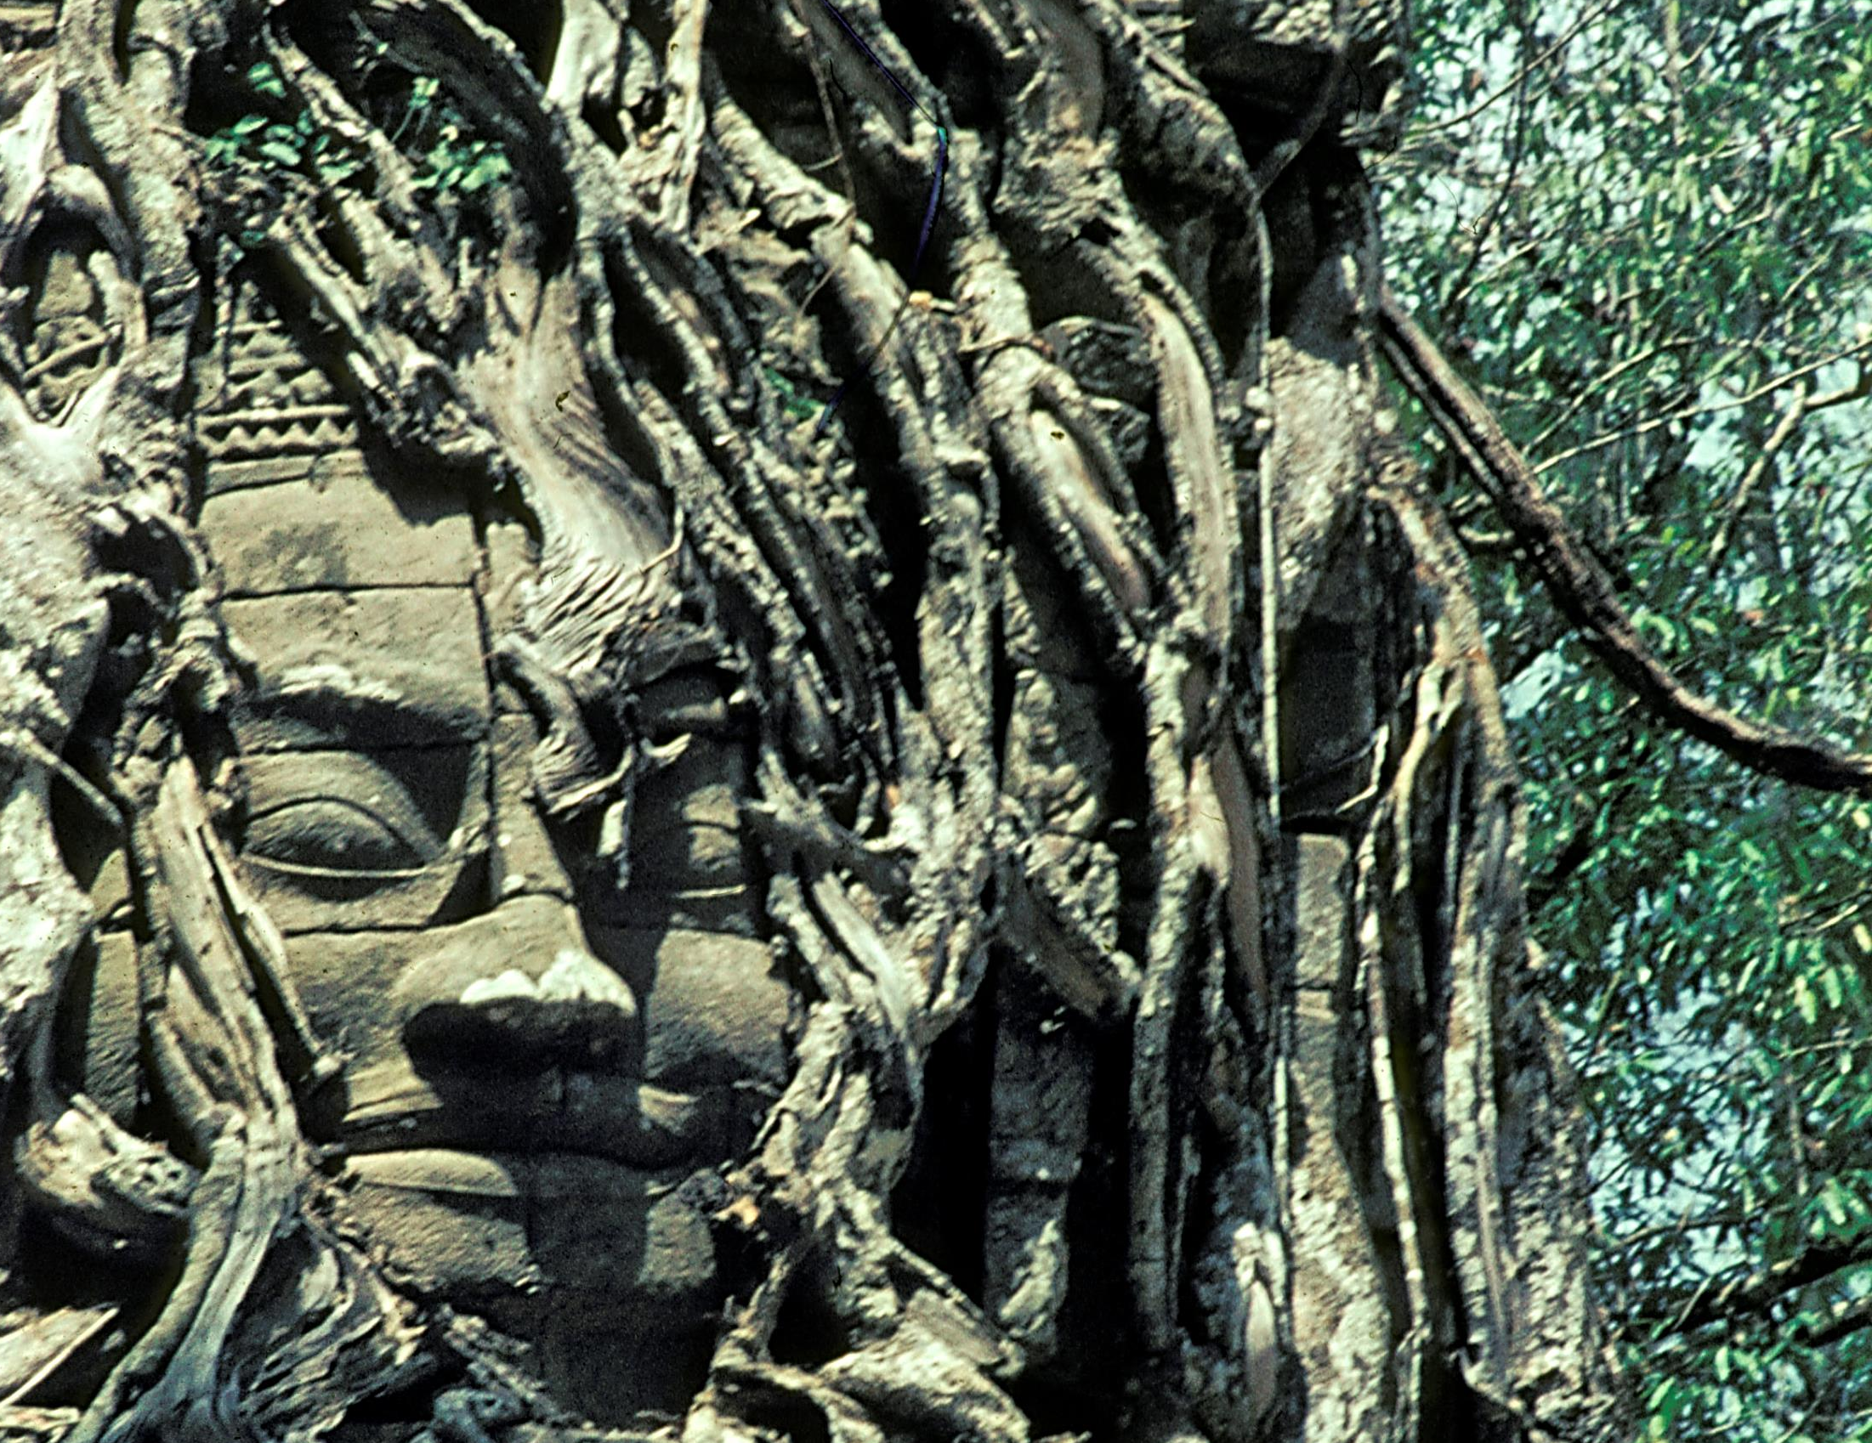
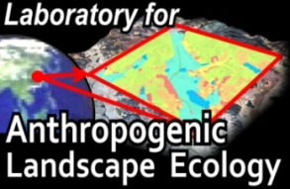

Anthropogenic Biomes
Global Ecology for the Anthropocene
Erle Ellis
Geography & Environmental Systems
University of Maryland, Baltimore County
Sustainable Human Environments
DIMACS
Rutgers, NJ
April 23, 2014
http://commons.wikimedia.org/wiki/File:Angkor-031_hg.jpg

Slide 2
Anthropogenic Biomes: Global Ecology for the Anthropocene
  When did the Anthropocene Begin?
Emergence of the Anthropogenic Biosphere
The Anthrome Mosaic: Used + Novel | Wild
The Biosphere in the Anthropocene
  Urbanization as Planetary Opportunity
  Planetary Stewardship – Locally?

Slide 3
Potential Vegetation
Ramankutty & Foley 1999
Ecosystems = f(C)
C = Climate
The Wild Biosphere

Slide 4
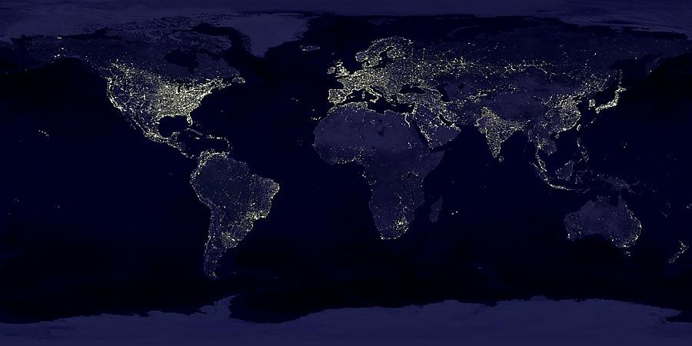
Anthropocene the human epoch

Slide 5
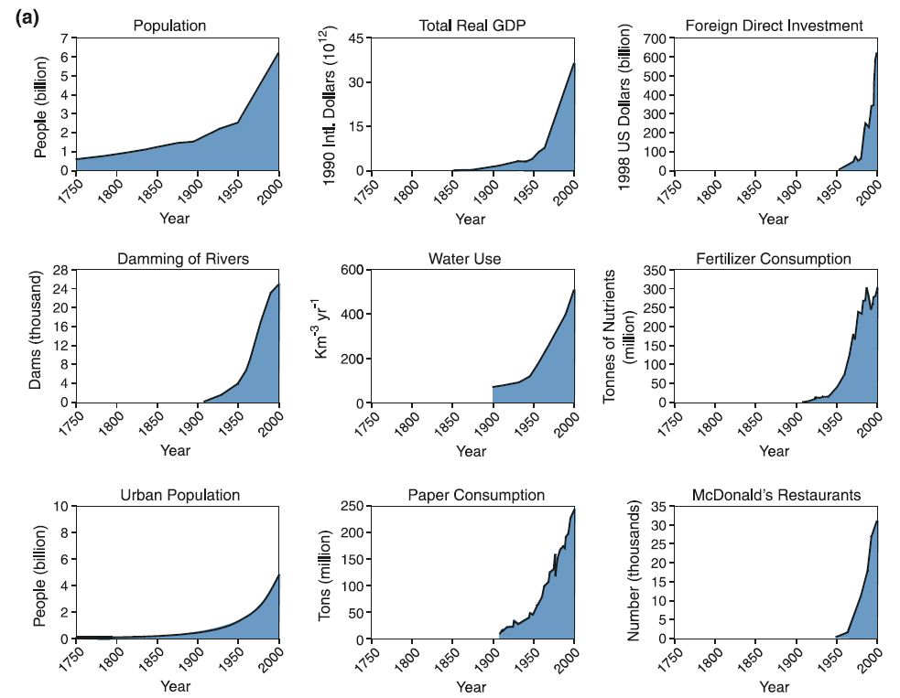
When did the Anthropocene Begin?
The Great Acceleration: > 1950 BP
Steffen et al., 2007, 2011

Slide 6
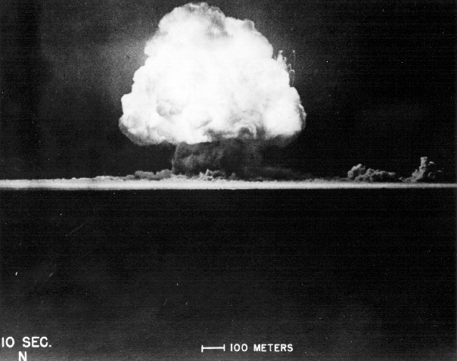

Slide 7
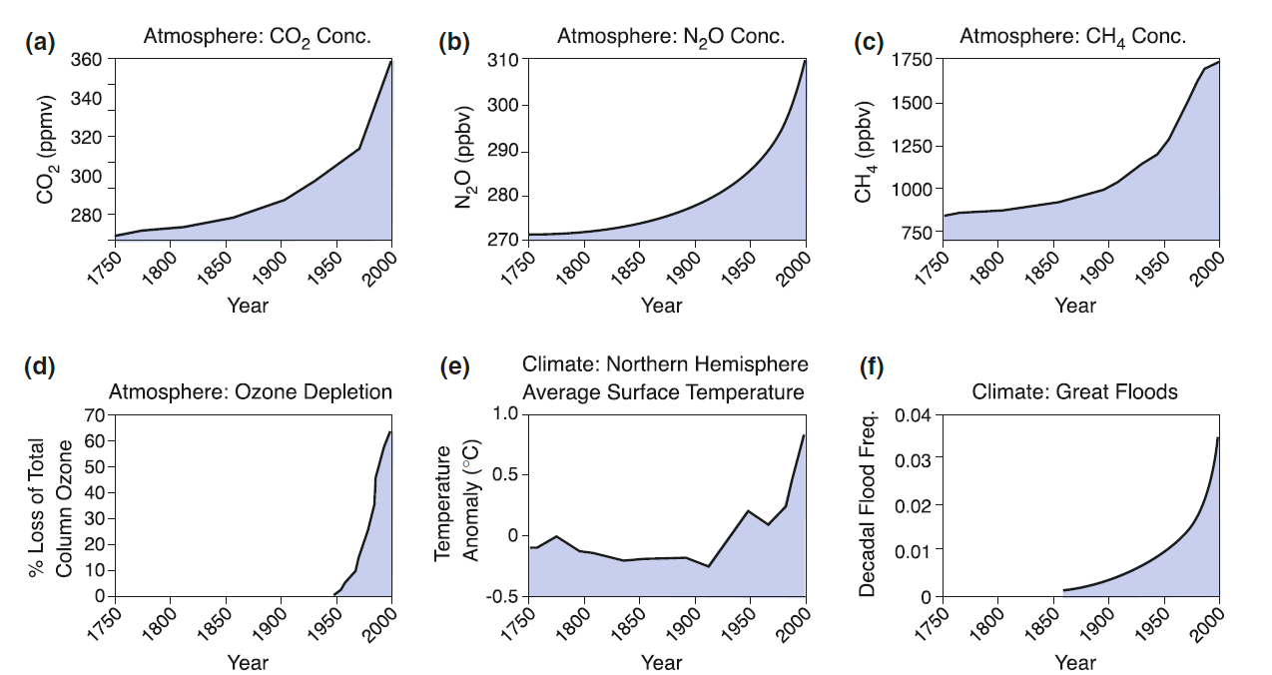
When did the Anthropocene Begin?
The Industrial Revolution: > 1800 BP
Steffen et al., 2007, 2011

Slide 8
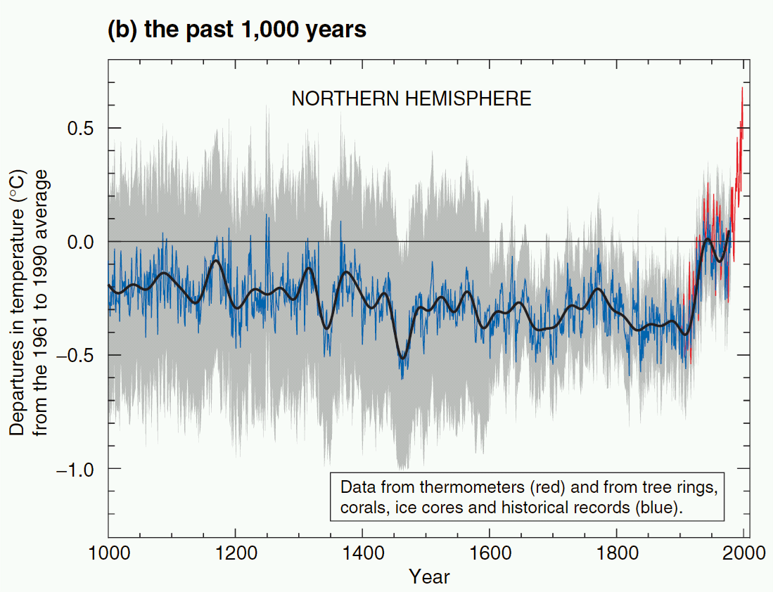
IPCC 2001

Slide 9
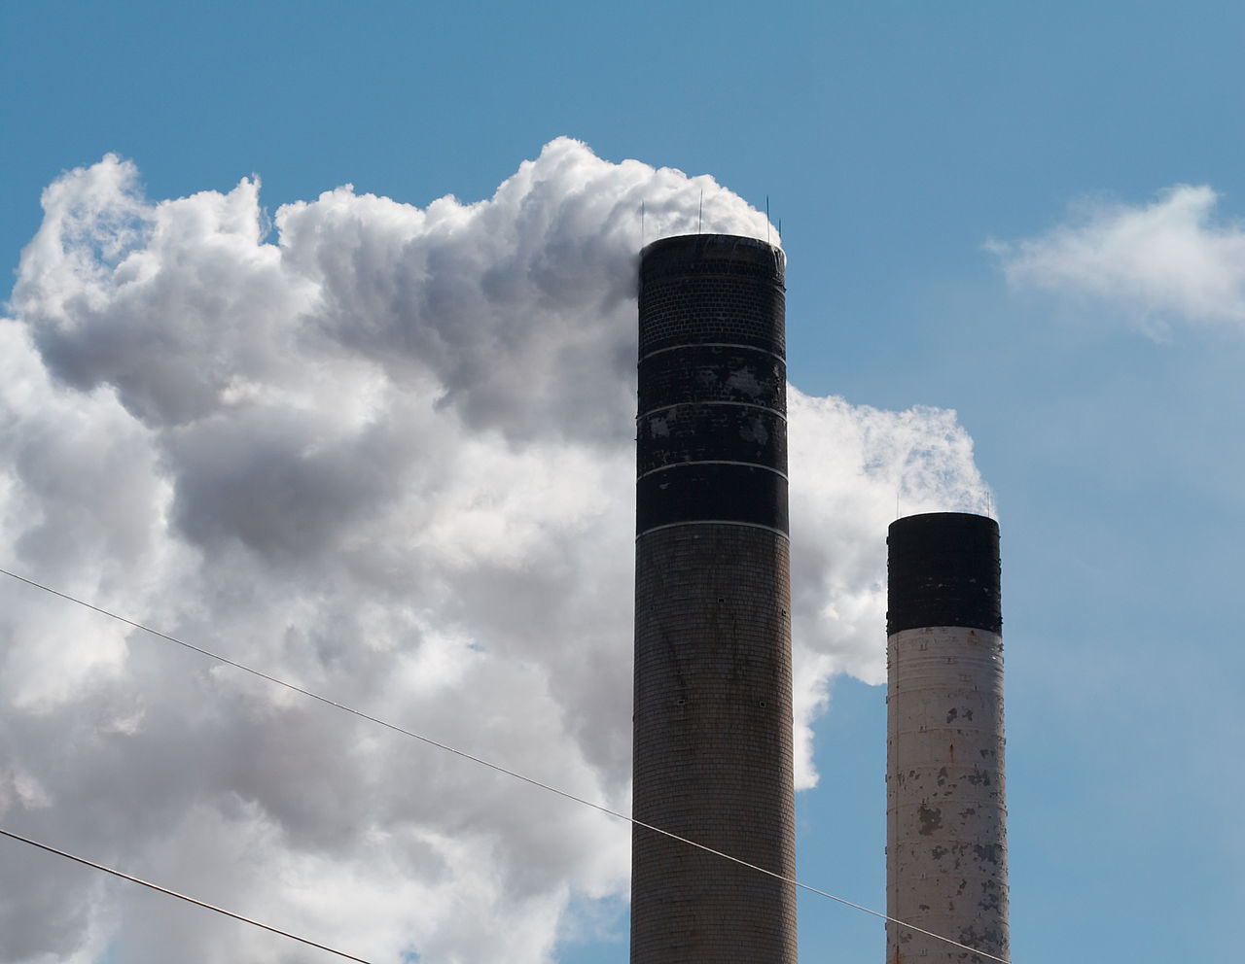

Slide 10
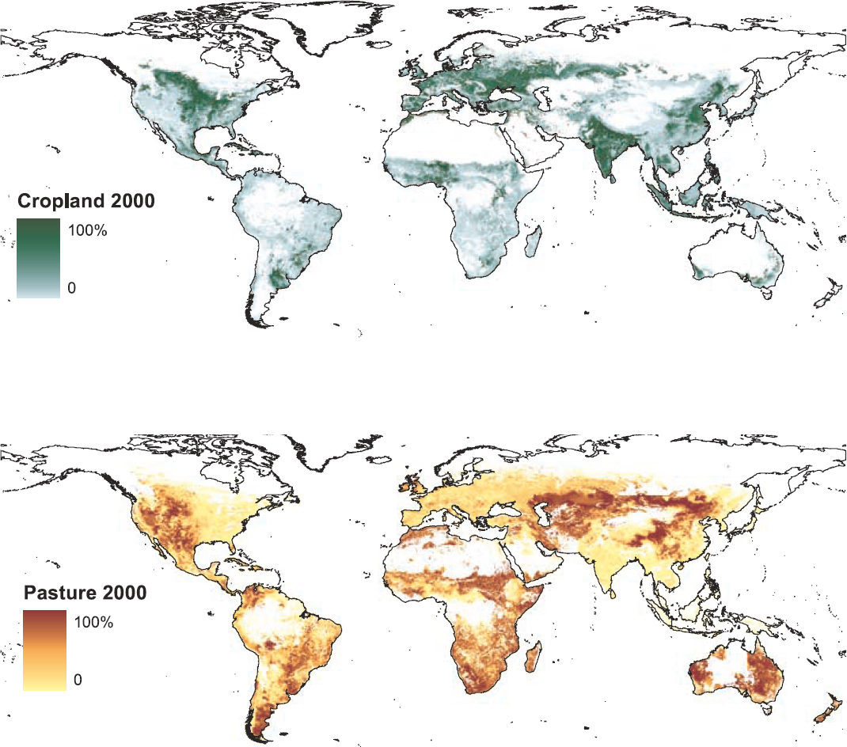
Ramankutty, N., A. T. Evan, C. Monfreda, and J. A. Foley. 2008. Farming the planet: 1. Geographic distribution of global agricultural lands in the year 2000. Global Biogeochemical Cycles 22:GB1003.
Cropland and Pasture 2000
Cropland
15 million km²
12% of ice free land
Pasture
28 million km²
22% of ice free land

Slide 11
Anthropogenic Biomes
ecosystem processes are mostly a function of human populations and their ecosystem interactions (land use)
Ecosystem processes = f(P,T)
P = Population density
T = Land use (how land & resources are used)
Ellis & Ramankutty, 2008

Slide 12
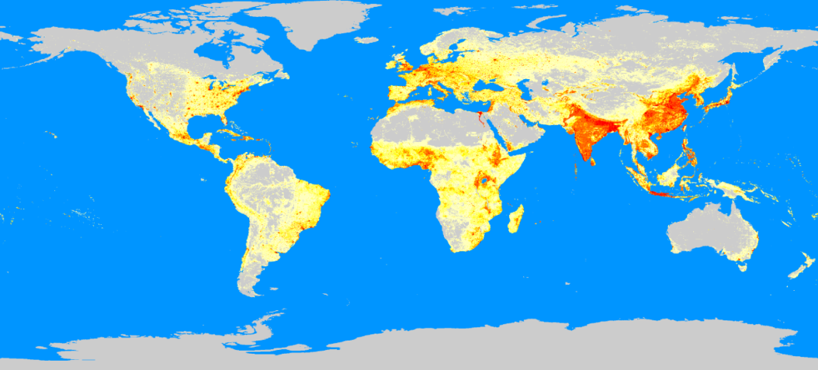
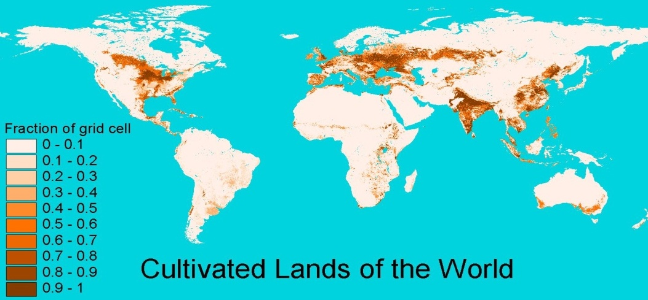
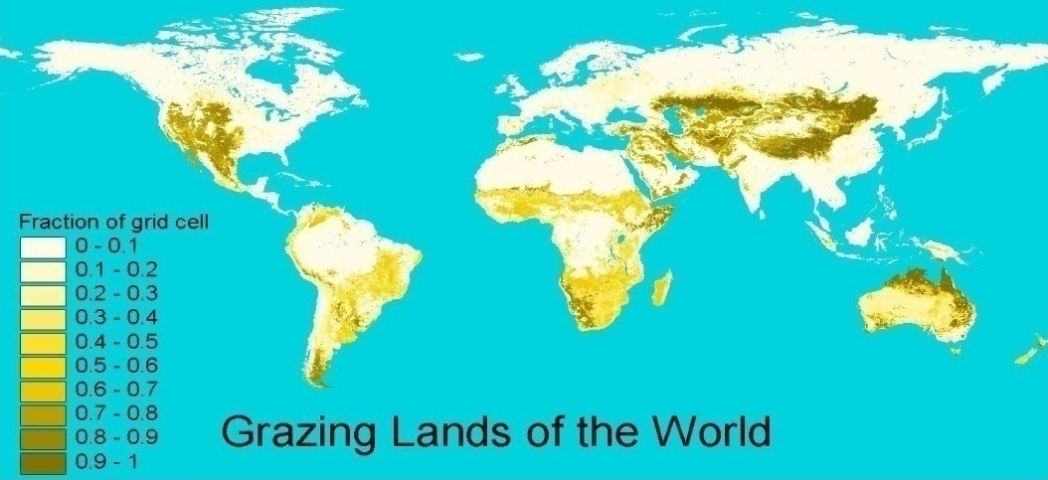
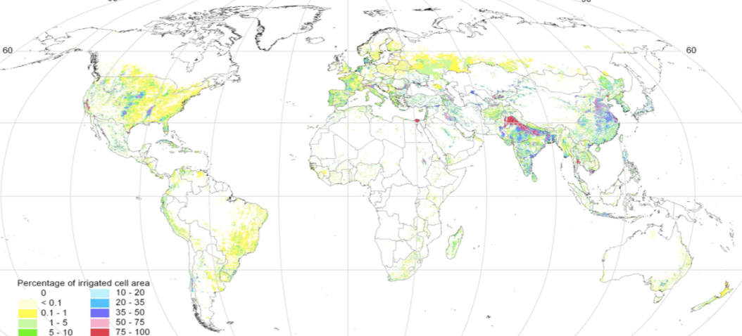
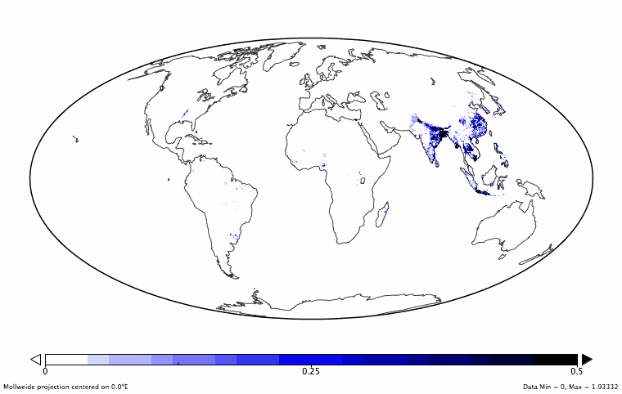
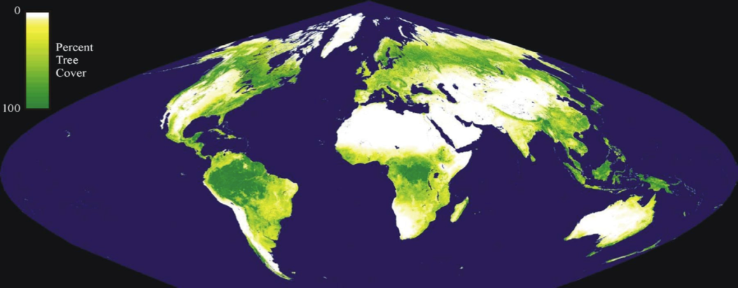
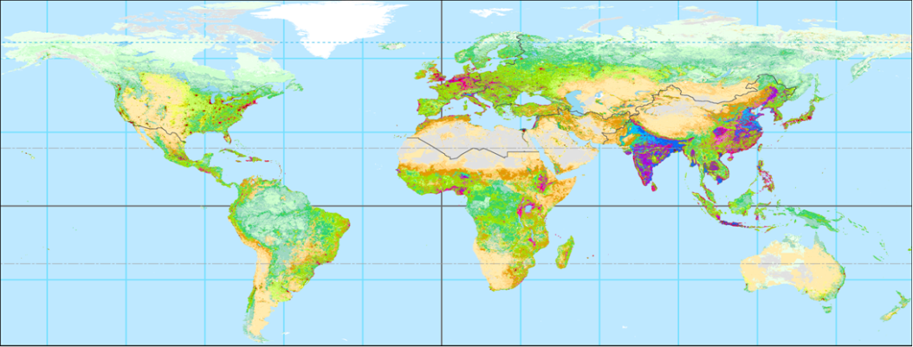
Anthropogenic Biomes: An Empirical Approach
Population density (urban, rural)
Croplands
Pastures
Irrigation
Rice
Tree & bare cover
(Vegetation Continuous Fields)
Anthropogenic Biomes
Cluster
Analysis
Ellis & Ramankutty, 2008

Slide 13
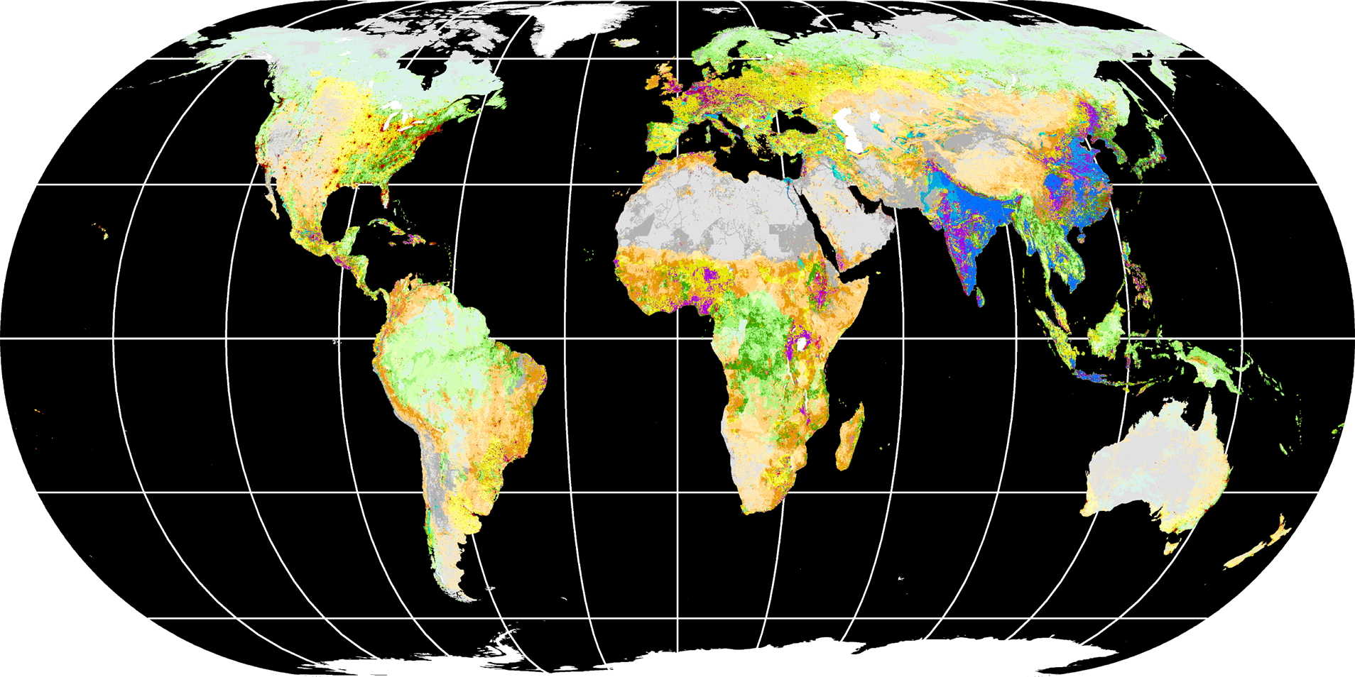
Anthropogenic Biomes (v2)
Ellis et al., 2010
Ecosystems = f(P,T)
P= Population Density
T= Land Use
The Human Biosphere
Anthropogenic Biomes
Used
Seminatural
Wild
Dense
Settlements
Villages
Croplands
Rangelands
Seminatural
Wildlands
Urban
Dense
settlements
Rice
Rainfed
Pastoral
Residential
Populated
Residential
Remote
Woodlands
Treeless
& Barren
Woodlands
Treeless
& Barren
Irrigated
Irrigated
Rainfed
Remote
Populated
Residential
Remote
Populated

Slide 14
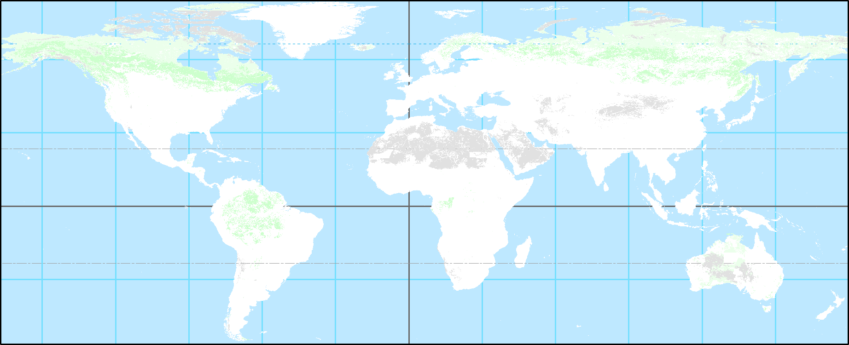
Anthropogenic Biomes of the World
29 million km²
no people!
19% global tree cover
Wildlands
Lands without evidence of human population or land use
Wild forests
Sparse trees
Barren
Ellis & Ramankutty, 2008

Slide 15
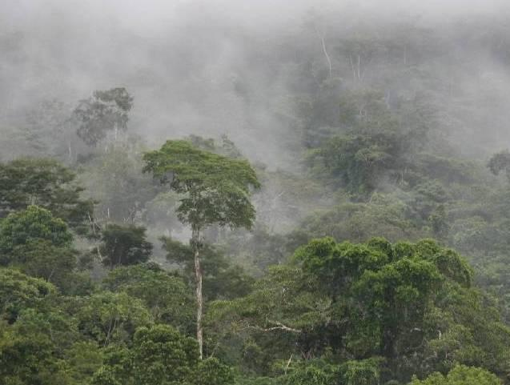
Wildlands
Peruvian Amazon, Peru
Credit: © Wendee Holtcamp. <http://www.wendeeholtcamp.com/amazon.htm>

Slide 16
Croplands
Atlas Mountains, Morocco
Wildlands
Alaska, USA

Slide 17
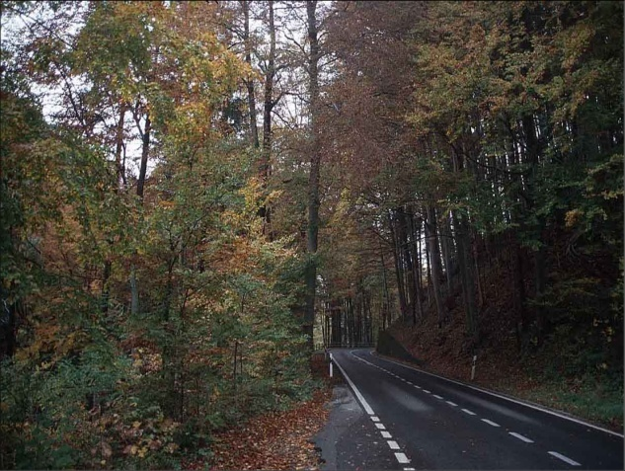
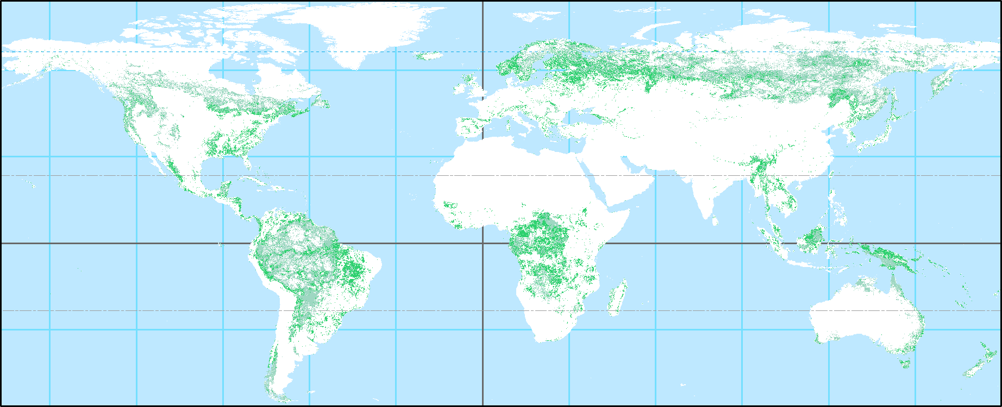
Anthropogenic Biomes of the World
25 million km²
0.04 billion people
Seminatural
45% global tree cover
Forested
Forests with people and agriculture
Populated
Remote
Ellis & Ramankutty, 2008

Slide 18
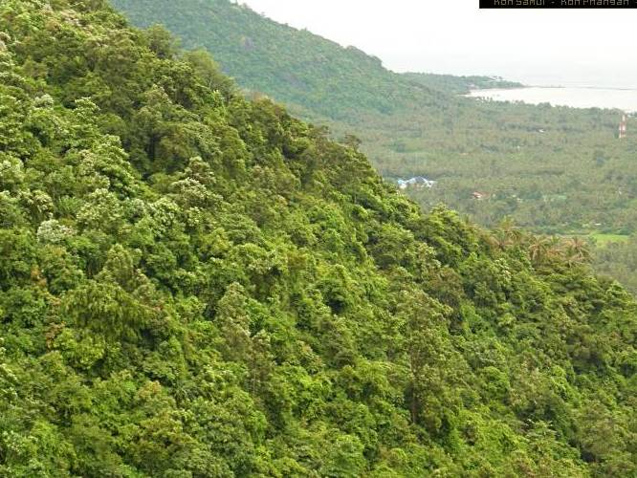
Seminatural
Populated Forest
Koh Samai, Thailand
Credit: © Yenit Company Ltd. <http://www.kohsamui.org/seaview.jpg>

Slide 19

Seminatural
Populated Forest
New England, USA

Slide 20
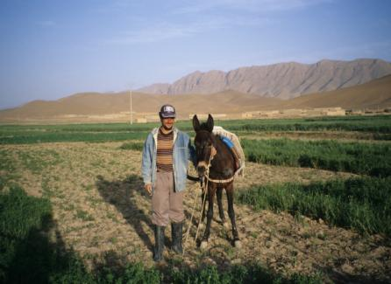
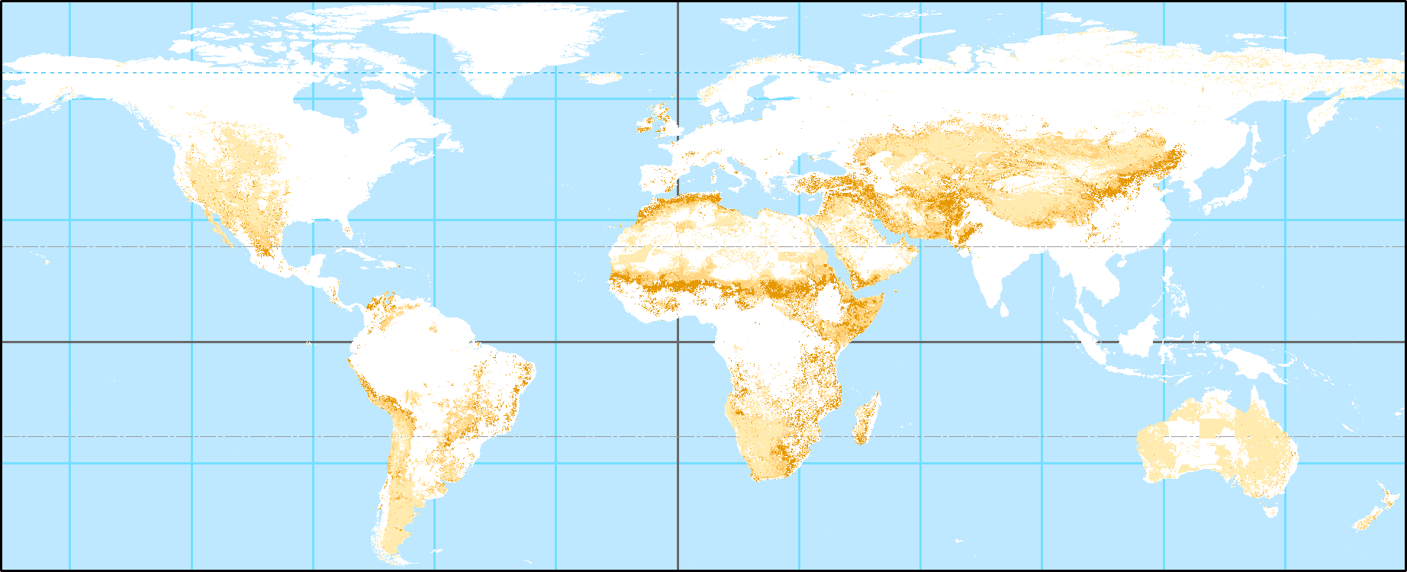
Anthropogenic Biomes of the World
40 million km²
0.3 billion people
Rangelands
6% global tree cover
Grazing land, minimal crops
and forests
Residential
Populated
Remote
Ellis & Ramankutty, 2008

Slide 21
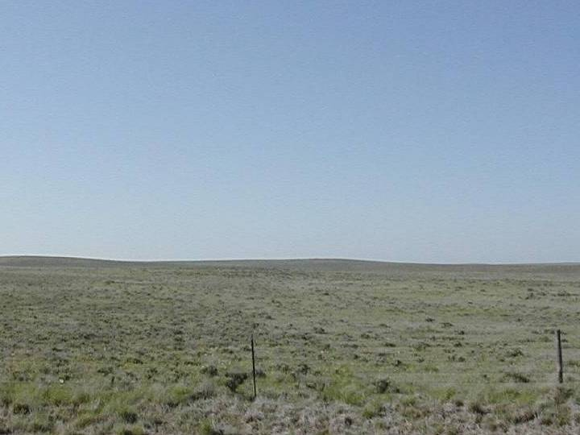
Croplands
Atlas Mountains, Morocco
Remote Rangelands
South Dakota, USA
Credit: © Alexander Smart. <http://ars.sdstate.edu/faculty/smarta/Range415/Image035.jpg>

Slide 22

Populated Rangelands
Atlas Mountains, Morocco

Slide 23
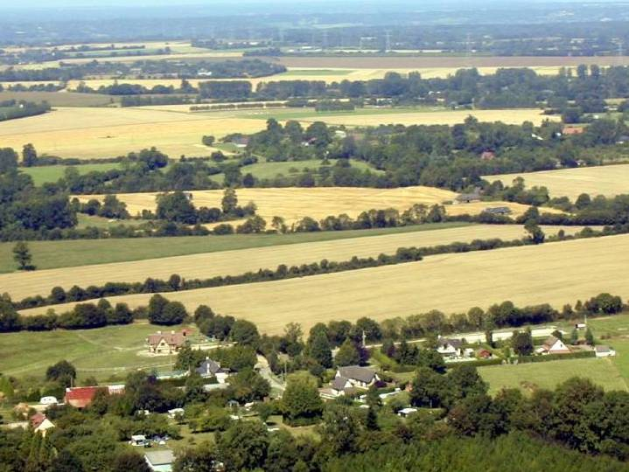
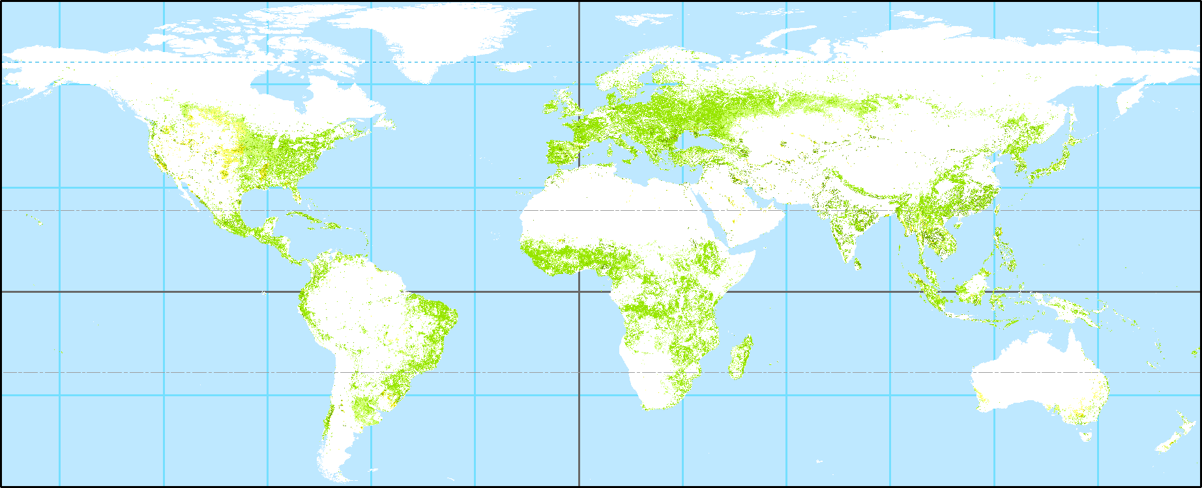
Anthropogenic Biomes of the World
27 million km²
0.9 billion people
Croplands
25% global tree cover
Crops mixed with other land uses
Residential irrigated
Populated rainfed
Residential rainfed mosaic
Remote
Populated irrigated
Ellis & Ramankutty, 2008

Slide 24
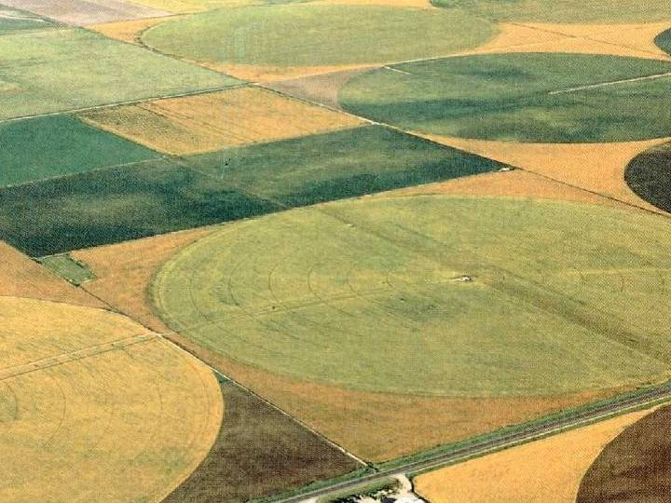
Remote Croplands
Colombia Basin, Washington, USA
Credit: © GWMA <http://www.gwma.org/images/CroplandAdjusted.jpg>

Slide 25
Croplands - Residential Rainfed Mosaic
Normandy, France
Credit: © JH.Bernard. <http://pagesperso-orange.fr/rmc14/images/IMAGES-RMC/RMC-6.JPG>

Slide 26
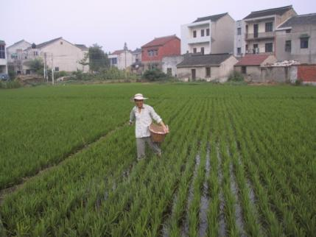
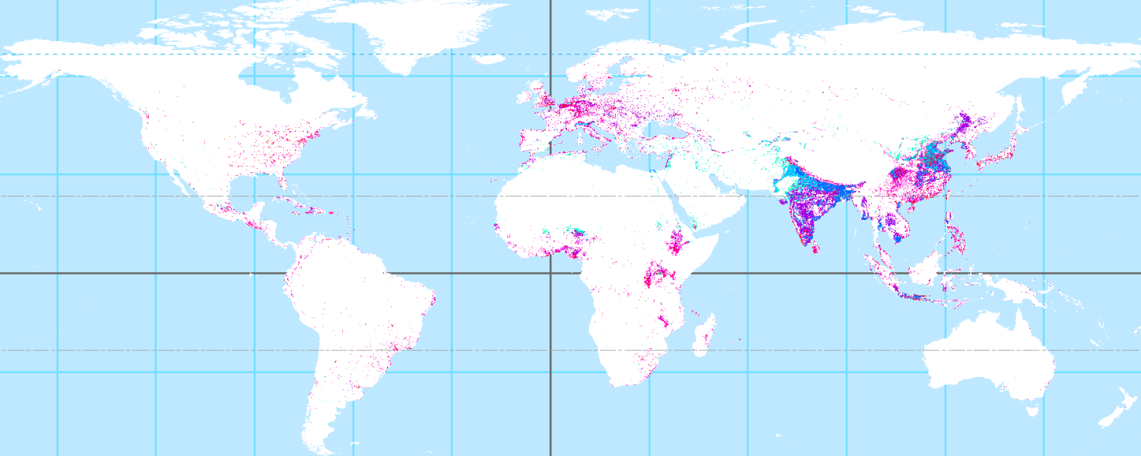
Anthropogenic Biomes of the World
8 million km²
2.6 billion people
Villages
4% global tree cover
Densely populated agricultural areas
with rural population >100 person km⁻²
Rice
Pastoral
Irrigated
Rainfed
Cropped & pastoral
Rainfed mosaic
Ellis & Ramankutty, 2008

Slide 27
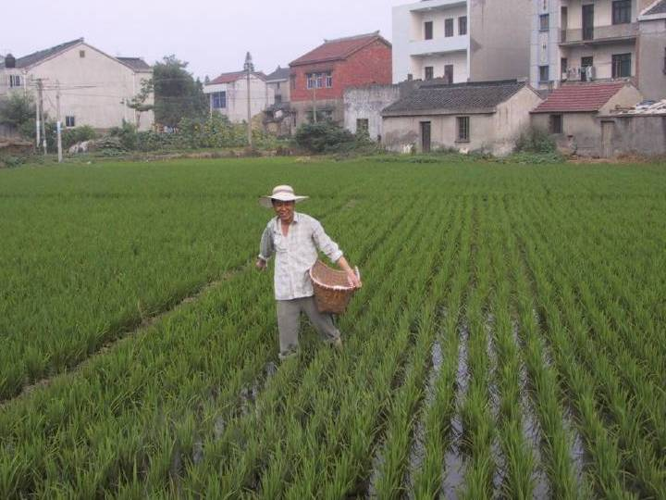
Rice Villages
Danyang County, Jiangsu Province, China

Slide 28
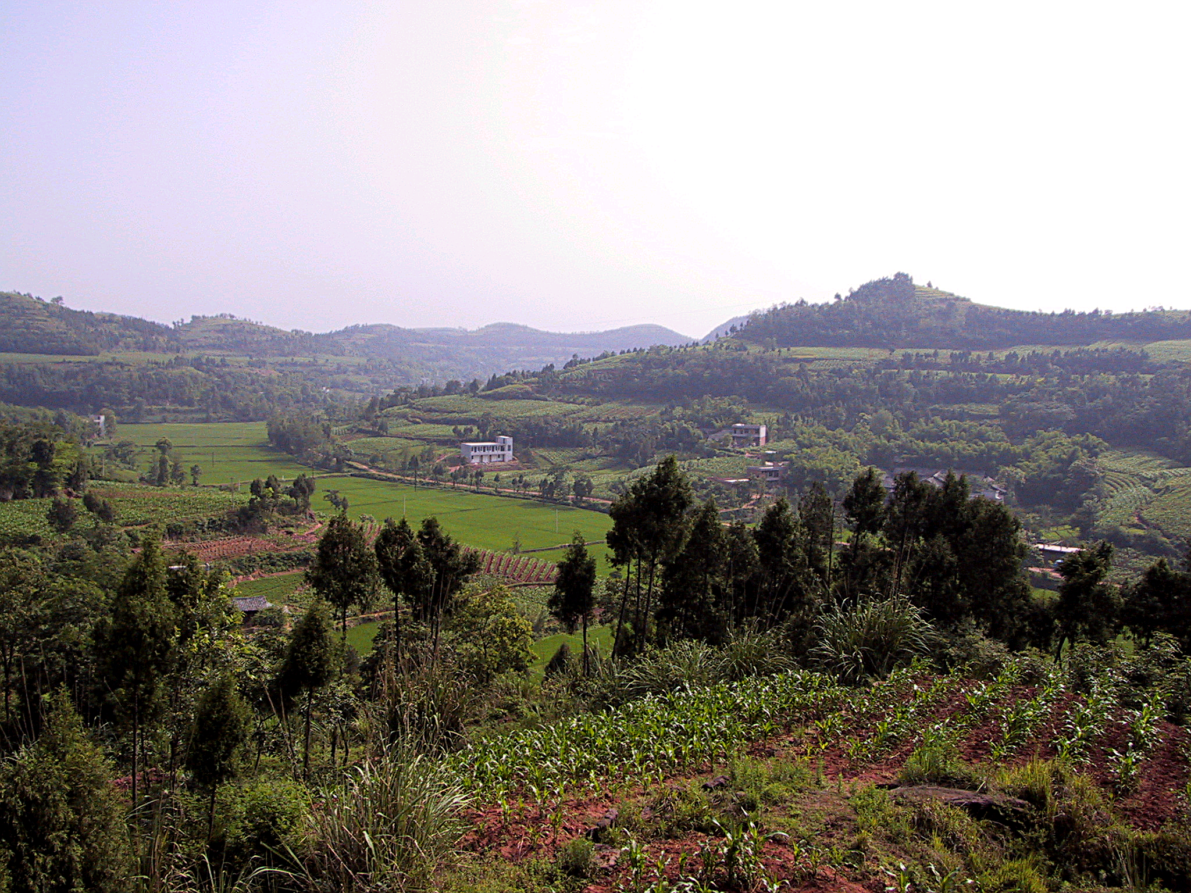
Rainfed Villages
Jintang County, Sichuan Province, China
© Erle C. Ellis, 2005

Slide 29
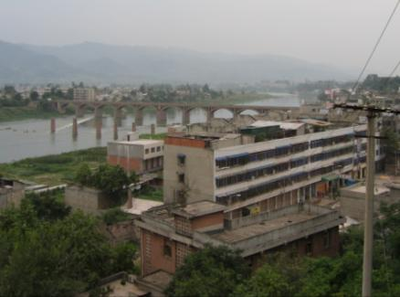
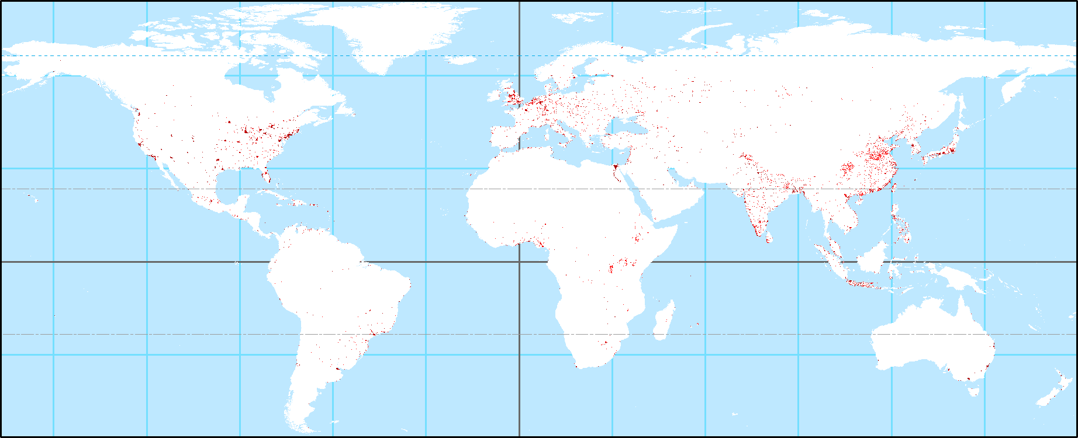
Anthropogenic Biomes of the World
1.5 million km²
2.6 billion people
0.7% global tree cover
Urban & Dense
Densely populated settlements
Urban
Dense settlements
Ellis & Ramankutty, 2008

Slide 30
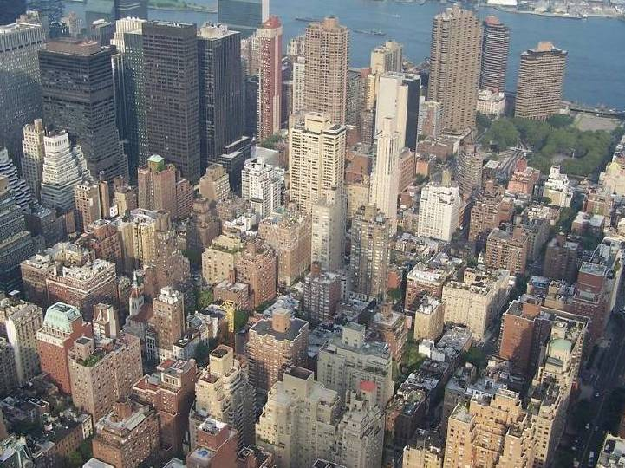
Urban
Manhattan, New York, USA

Slide 31
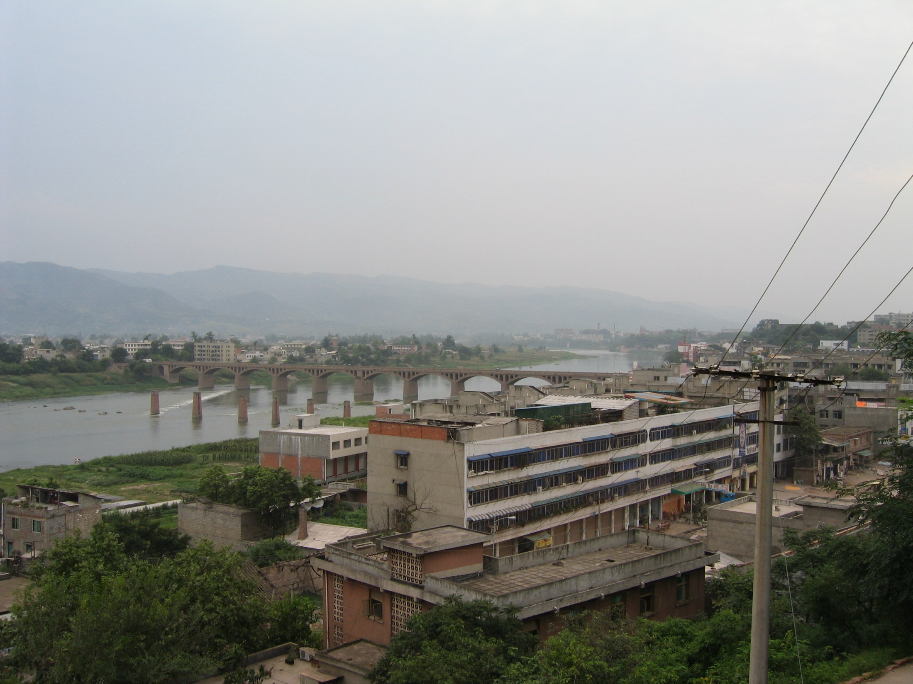
Urban
Huaikou City, Sichuan Province, China

Slide 32
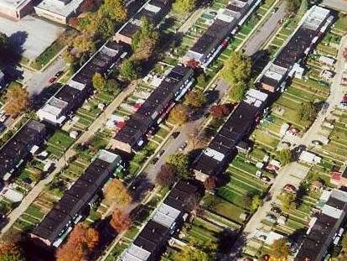
Urban
Baltimore County, Maryland, USA

Slide 33
Anthropogenic Biomes
Globally
Anthromes 1
Ellis & Ramankutty 2008
Anthromes 2
Ellis et al., 2010
People 80% in urban and village anthromes
Land 23% Wildlands, 77% Anthropogenic Biomes
  Wild forest area < densely populated anthromes (villages + urban)
NPP 11% Wildlands, 89% Anthropogenic
  Wild forest NPP < densely populated anthromes
  < 20% of Earth’s Tree Cover is within Wildlands
  > 25% of Earth’s Tree Cover is embedded in Croplands
Terrestrial Ecosystems
  40% Used Lands (agricultural, urban)
  37% Novel Ecosystems (Unused lands embedded in used lands)
  23% Wild (mostly Cold and Dry Xeric Biomes)
Net Primary
Production

Slide 34
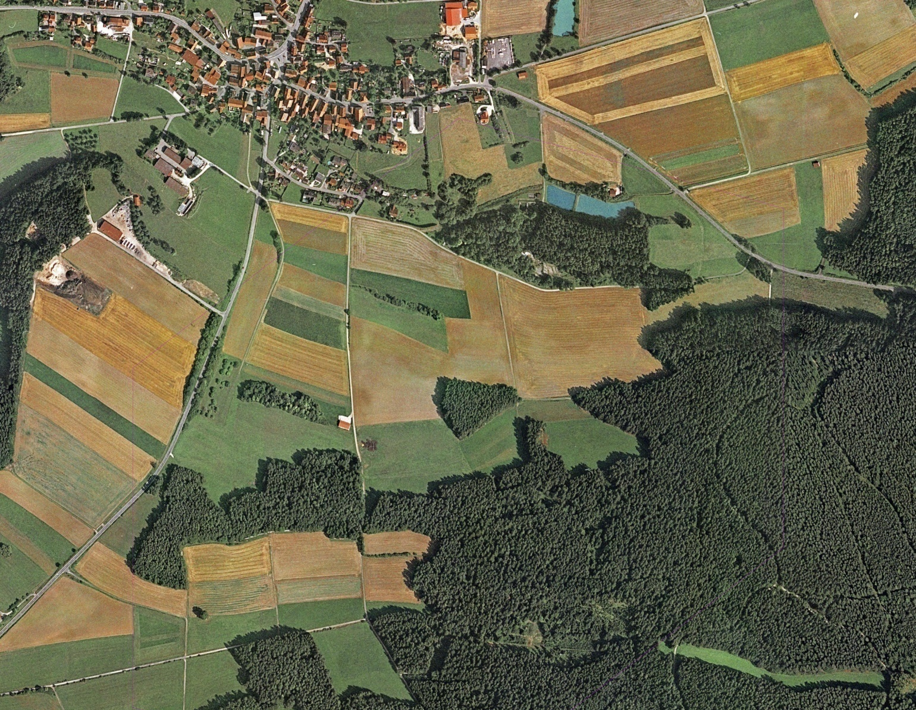
Used
Anthromes are mosaics.
Novel
Residential Croplands
Germany

Slide 35
A Global Human Ecology
The Biosphere we have:
  40% Used Lands
  37% Novel Ecosystems
  23% Wild

Slide 36

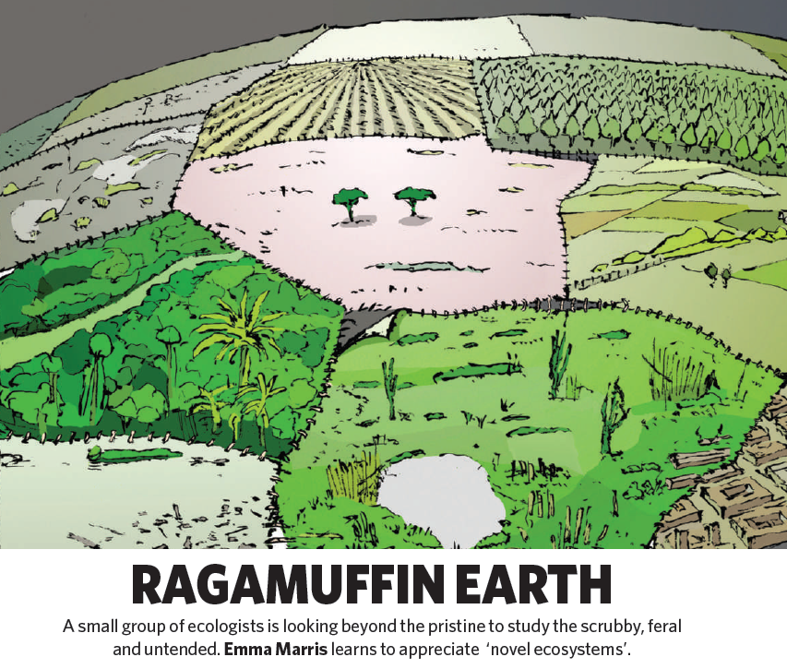
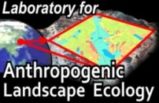
Anthromes 2
How did the biosphere become anthropogenic?
Anthropogenic Transformation of the Biomes
Novel Ecosystems (37%)
Unused Land Area in Anthromes (%)
Ellis et al. 2010

Slide 37
Anthromes 2
How did the biosphere become anthropogenic?
Ellis et al. 2010
Anthropogenic Transformation of the Biomes
Age of Novel Ecosystems (years)
Years of Human Residence or Use

Slide 38
Anthromes 2
How did the biosphere become anthropogenic?
Ellis et al. 2010
Anthropogenic Transformation of the Biomes
Anthrome Context of Novel Ecosystems
Anthromes with Unused Lands covering >20% of total area

Slide 39
Anthropogenic Forests / Woodlands
Trees embedded within Anthromes
Used Lands
Managed Forests & Plantations
Agroforests trees in agroforestry systems
Ornamental Trees parks, yards, street trees
Novel Ecosystems
Remnant Forests fragmented within used lands
Recovering Forests recovering from prior use of land
Shifting Cultivation fallows in farming systems
Farm Woods woodlots, hedgerows

Slide 40
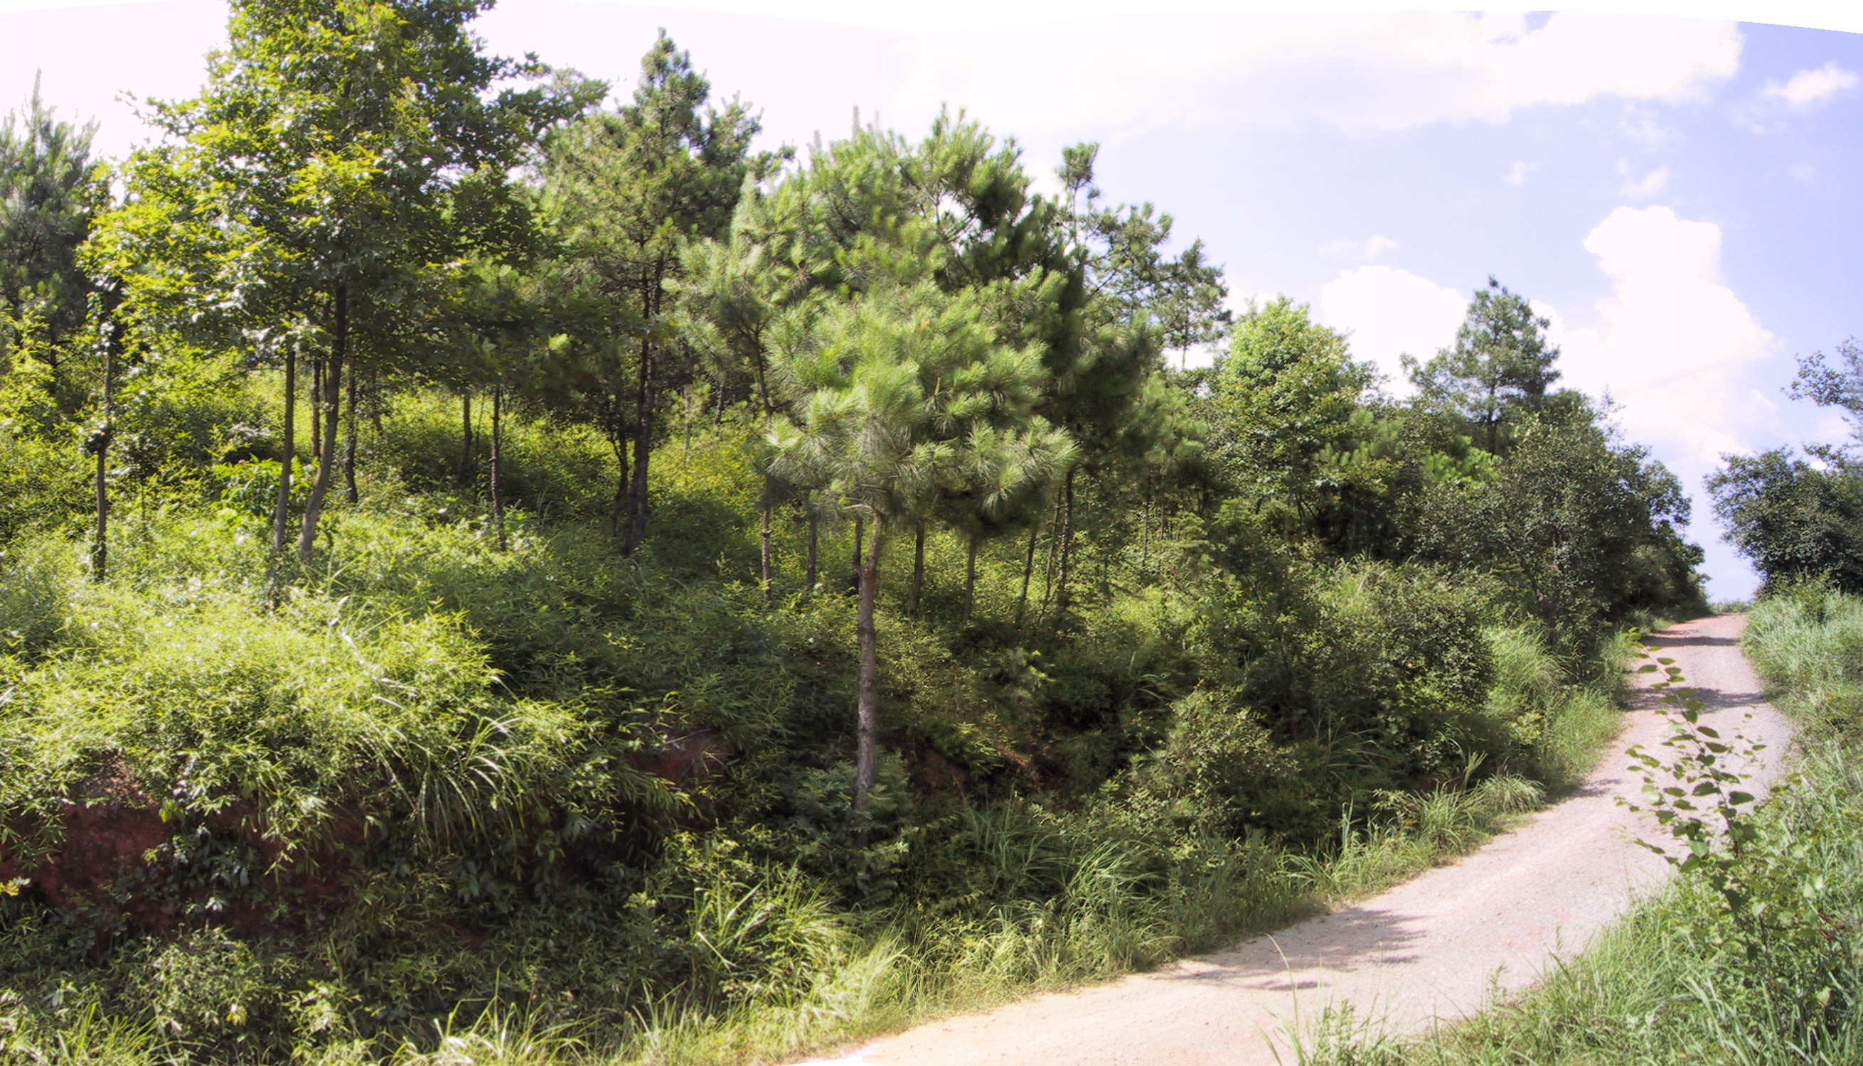
Seminatural
Residential Woodlands
Hunan, China

Slide 41
The Anthropocene Biosphere
Anthropogenic Succession
Ellis (2013)

Slide 42

Conserving Biodiversity in an Anthropogenic Biosphere
Anthropogenic
Species gains exceed losses by
  5% of N over 47% of biosphere
Native
Vascular Plant Species Richness
2000
Decline
Increase
Erle Ellis, Holger Kreft, and Erica Antill (2012)
Anthropogenic

Slide 43
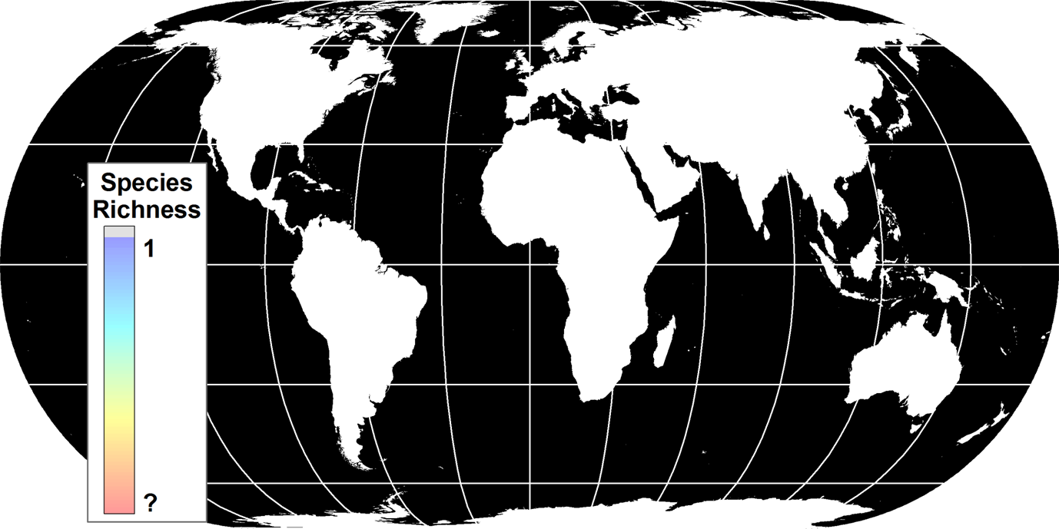
Conserving Biodiversity in an Anthropogenic Biosphere
2050?

Slide 44
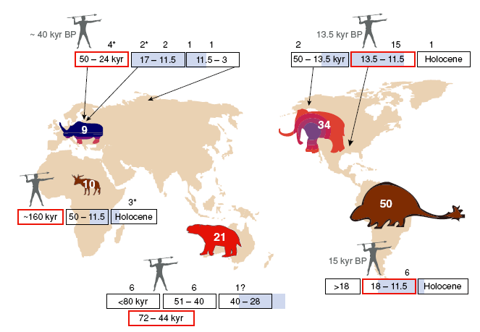
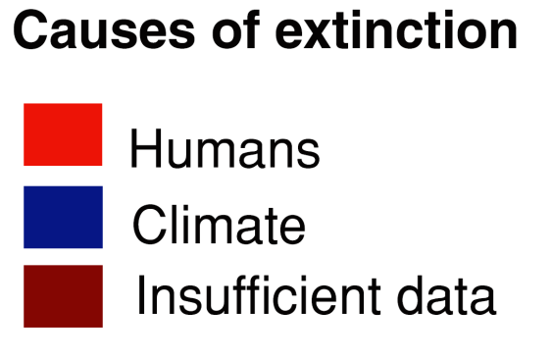
When did the Anthropocene Begin?
Megafaunal Extinctions: > 15 kyr BP
Koch & Barnosky 2006

Slide 45
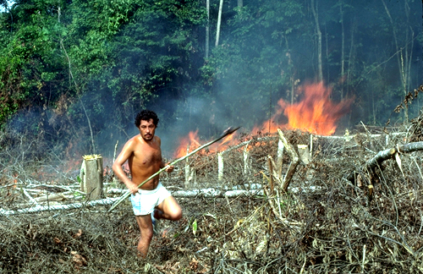
Socially-Transmitted
Adaptive Intensification of Land Use
Human Niche Construction

Slide 46
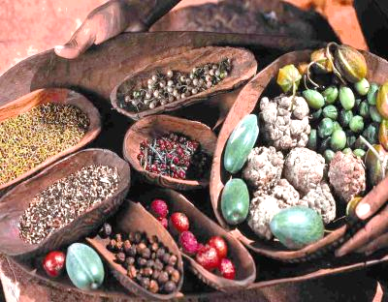
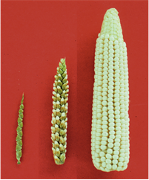
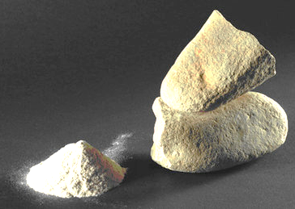
Pleistocene >>> Holocene
Land Use Intensification by Hunter-Gatherers
Adaptive technologies to sustain growing populations on limited land
Pre-Agricultural
Proto-Agricultural
Dietary Broadening
Burning for Hunting/Foraging
Propagating Favored Species
Food Processing
Domestication
Ellis et al. 2013 PNAS

Slide 47
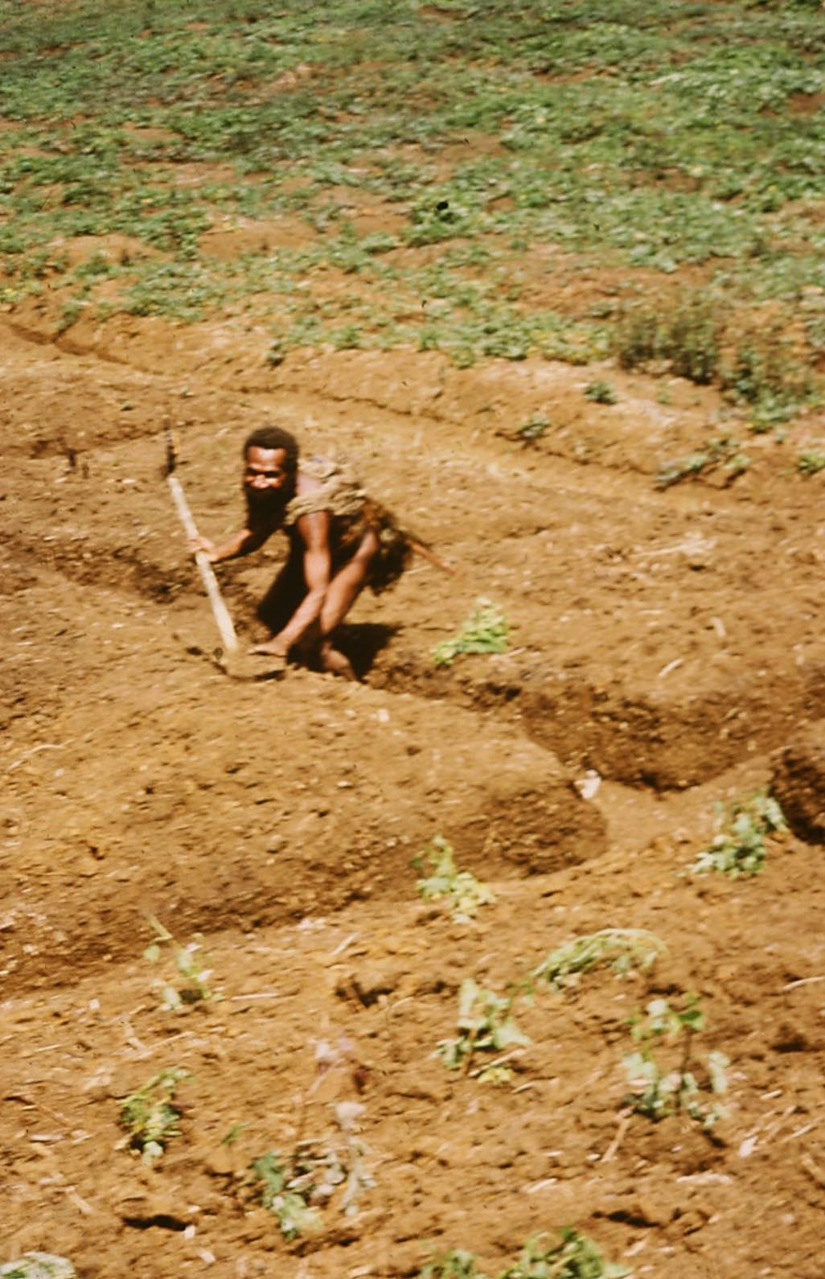
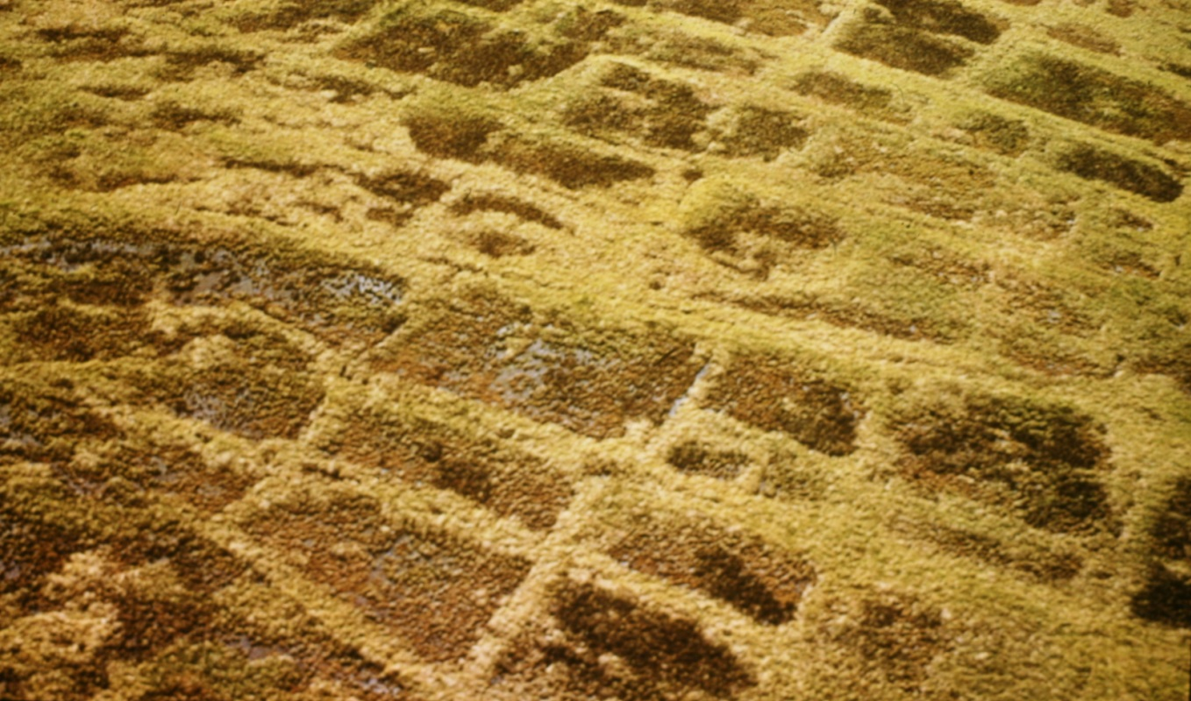
Cultivation 6 ka BP
Archaeological fields at
Kuk Swamp, New Guinea
Courtesy Dorian Fuller

Slide 48


Slide 49


Manuring
Irrigation

Slide 50


Slide 51
Land Use Intensification
Increasing population density drives intensification of land use
Ester Boserup (1965)
Foraging
Long
Fallow
Short
Fallow
Annual
cropping
Multicropping
ha/person 2 - 6 1 - 2 0.3 – 0.6 0.05 - 0.3
Cropping cycle 1:20 - 1:7 1:7 - 1:3 1:2 - 1:1 2:1 - 5:1
(crops:years)
Population density <15 5 – 65 65 - 250 >250
(persons/km²)
Robert Netting (1993) Smallholders, Householders

Slide 52
Land Use Intensification: A General Model
After Billie Turner II
Ellis et al. 2013 PNAS

Slide 53
A Tale of Two Planets: Two different models of global land use history

Slide 54



Cumulative Carbon Release from Land Use
(6000 BP - )
Land use = f(population)
KK10 empirical
HYDE constant
Kaplan et al. ()

Slide 55

Early Land Use: Global Climate Change
He et al 2013 GRL

Slide 56
Age of the Anthropogenic Biosphere
Ellis et al. 2013 PNAS

Slide 57

chem fertilizer appl picture
>25% of Global Nitrogen Fertilizer Use
© Erle C. Ellis, 2002

Slide 58

Village well water slide
© Erle C. Ellis, 2005

Slide 59


Tai Lake
May 7, 2007
Wang & Shi 2008

Slide 60

Brodie, P. 1990. Crescent over Cathay: China and ICI, 1898 to 1956. Oxford University Press, New York.

Slide 61



Slide 62

http://peacefulanarko.files.wordpress.com/2010/04/0522_mz_farming2.jpg

Slide 63

Forest Recovery: The Forest Transition

Slide 64

Smith & Smith 2001

Slide 65

Planetary Stewardship
Can we manage Multifunctional Landscapes?
Globally?
Managing Anthrome Mosaics
Used
Novel

Slide 66

http://www.fhwa.dot.gov/publications/publicroads/09septoct/03.cfm

Slide 67


http://commons.wikimedia.org/wiki/File:Chongqing_yangjiaping_2007.jpg

Slide 68
© Erle C. Ellis, 2005

Slide 69


Slide 70

http://www.facebook.com/note.php?note_id=469716398919

Slide 71
Bias in Ecological Field Research Sites
Ecological Research Sites Top 10 Ecology Journals: 2004 – 2009
2/3 in “protected areas”
Temperate Zone Bias, Wealthy Nation Bias
Just 1/6 in agricultural & settled lands
Martin, Blossey & Ellis. 2012. Mapping where ecologists work: biases in the global distribution of terrestrial ecological observations. Frontiers in Ecology and the Environment 10:195–201

Slide 72



GLOBAL COLLABORATION ENGINE
Understanding Local Ecologies Globally
globe.umbc.edu

Slide 73




www.projectnoah.org
http://www.today.ucla.edu

Slide 74


User-Deployed Remote Sensing
Ecosynth.org
Dandois & Ellis (2013)

Slide 75

http://www.conservationnw.org/news/updates/legislature-reinvests-in-i90-wildlife-and-connectivity

Slide 76


http://hal_macgregor.tripod.com/kennel/wolves.html
http://ec.europa.eu/environment/nature/conservation/species/carnivores/images/map_wolf_2000.png

Slide 77

peterlippmann.com

Slide 78
Anthropogenic Landscapes: Planetary Opportunities of the Anthropocene
Humans are a Niche Constructing Species
  Humans began transforming ecosystems long before agriculture
Land use intensification enabled a single species to change a planet
Land use intensification is continuing
  Can we harness intensification to shape a better Anthropocene?

Slide 79


A narrative for the Anthropocene…
“Ecologies embedded within human systems”
The classic nature story…
“An ecology disturbed by humanity”

Slide 80
  Anthropogenic Landscapes
Observing
Stewardship Heritage
Engineering Function
Design Desire
Emergence Freedom
Evolution
Wildness

Slide 81


Slide 82

http://www.utaot.com/wp-content/uploads/2013/01/69349915_fc5eb5d5f5_b.jpg

Slide 83

http://www.stefanoboeriarchitetti.net/?p=207
BOSCO VERTICALE

Slide 84


Pleistocene Rewilding
Oostvaardersplassen, Netherlands

Slide 85
Engaging landscapes towards a better Anthropocene
Anthropogenic Landscapes
Sustaining Humanity
Sustaining Nature
Producing
∞
Conserving
Restoring
Observing
Structures | Tradeoffs | Opportunities
Negotiating
Stakeholders | Resources | Natures
Engaging
Stewardship | Engineering | Design | Emergence
Scaling
∞
Local Global

