Slide 1
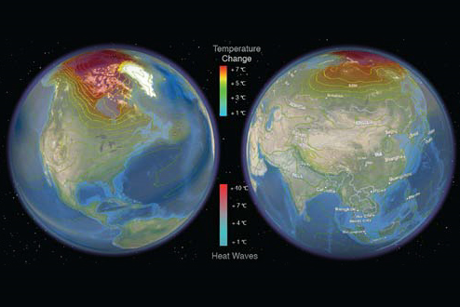
Can machine learning help translate the science of climate change to information relevant for preparedness and policy?
Auroop R. Ganguly, PhD
Associate Professor
Civil and Environmental Engineering
437 Snell Engineering Center
Northeastern University
360 Huntington Ave
Boston, MA 02115
a.ganguly@neu.edu
Till recently at the Oak Ridge National Laboratory
Contributors acknowledged on websites:
NSF “Expeditions in Computing” on climate data mining:
http://climatechange.cs.umn.edu/
Northeastern “Climate Extremes and Water Sustainability” Lab:
http://www.northeastern.edu/sds/CEWS

Slide 2
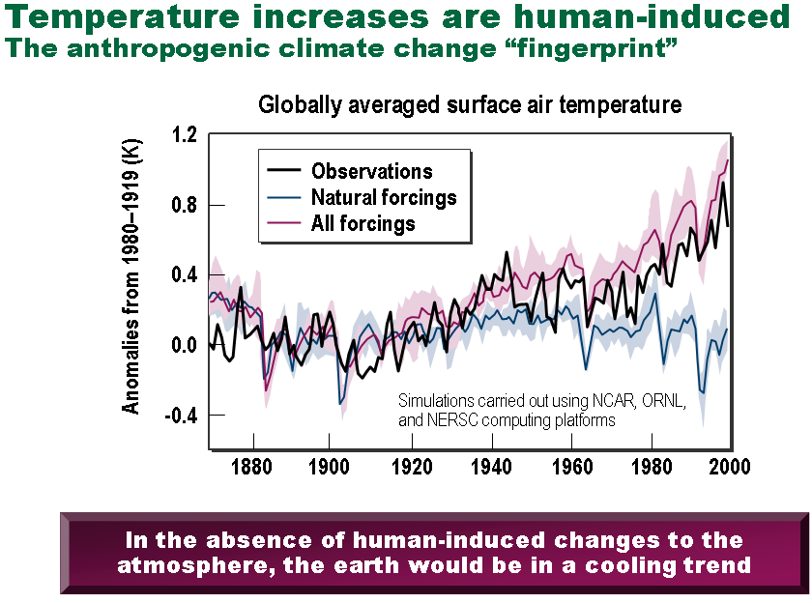
Climate change has been called “the defining issue of our era”
The planet is warming
  Multiple lines of evidence
  Credible link to human GHG (green house gas) emissions
Consequences can be dire
  Extreme weather events
  Regional climate and ecosystem shifts
  Abrupt climate change
  Stress on key resources and critical infrastructures
There is an urgency to act
  Adaptation: “Manage the unavoidable ”
  Mitigation: “Avoid the unmanageable ”
The societal cost of both action and inaction is large
Anomalies from 1880-1919 (K)
Figure Courtesy: ORNL
Key outstanding science challenge: Actionable predictive insights to credibly inform policy
Adapted from presentation to NSF panel for “Expeditions in Computing”
(Vipin Kumar, Auroop Ganguly, Nagiza Samatova, Arindam Banerjee)
Notes:
2

Slide 3
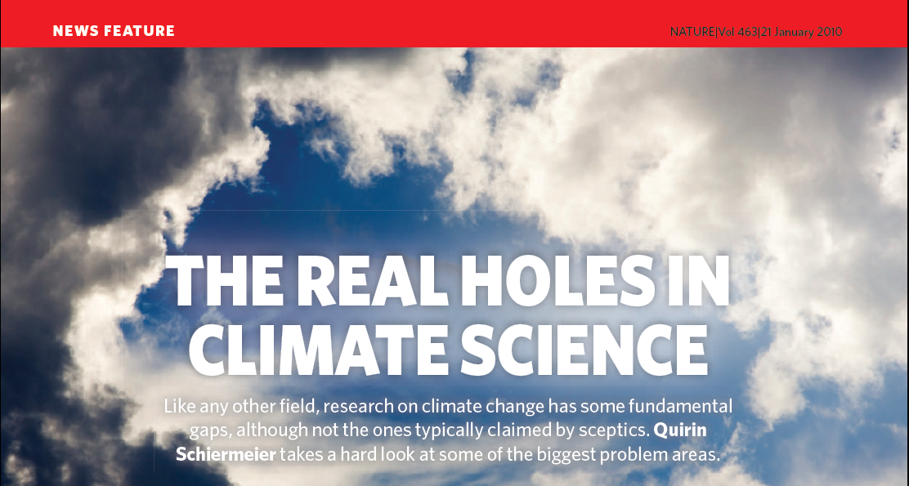
Four “real holes”:
Regional climate prediction
Precipitation
Aerosols
Paleoclimate

Slide 4
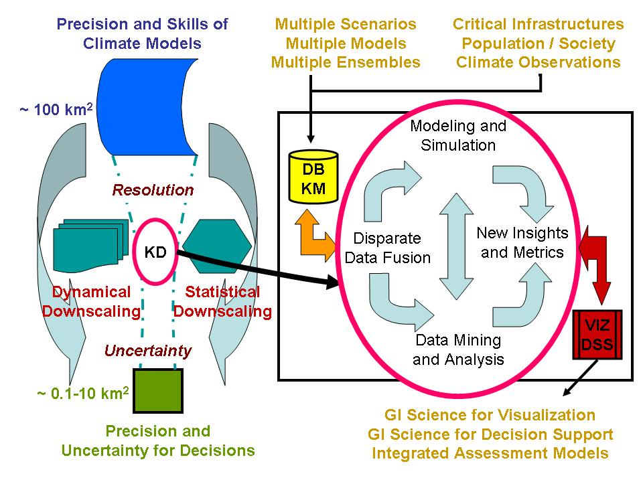
A research challenge is to translate climate model simulations to decision and policy tools
An inclusive definition of “climate extremes”:
severe hydrological or weather events or large shifts in regional climate patterns
caused or exacerbated by climate change and/or natural climate variability
leading to extreme stresses on natural, engineered and human systems
Arguably the largest knowledge gap in climate science relevant for informing adaptation and policy

Slide 5
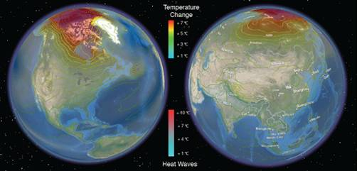

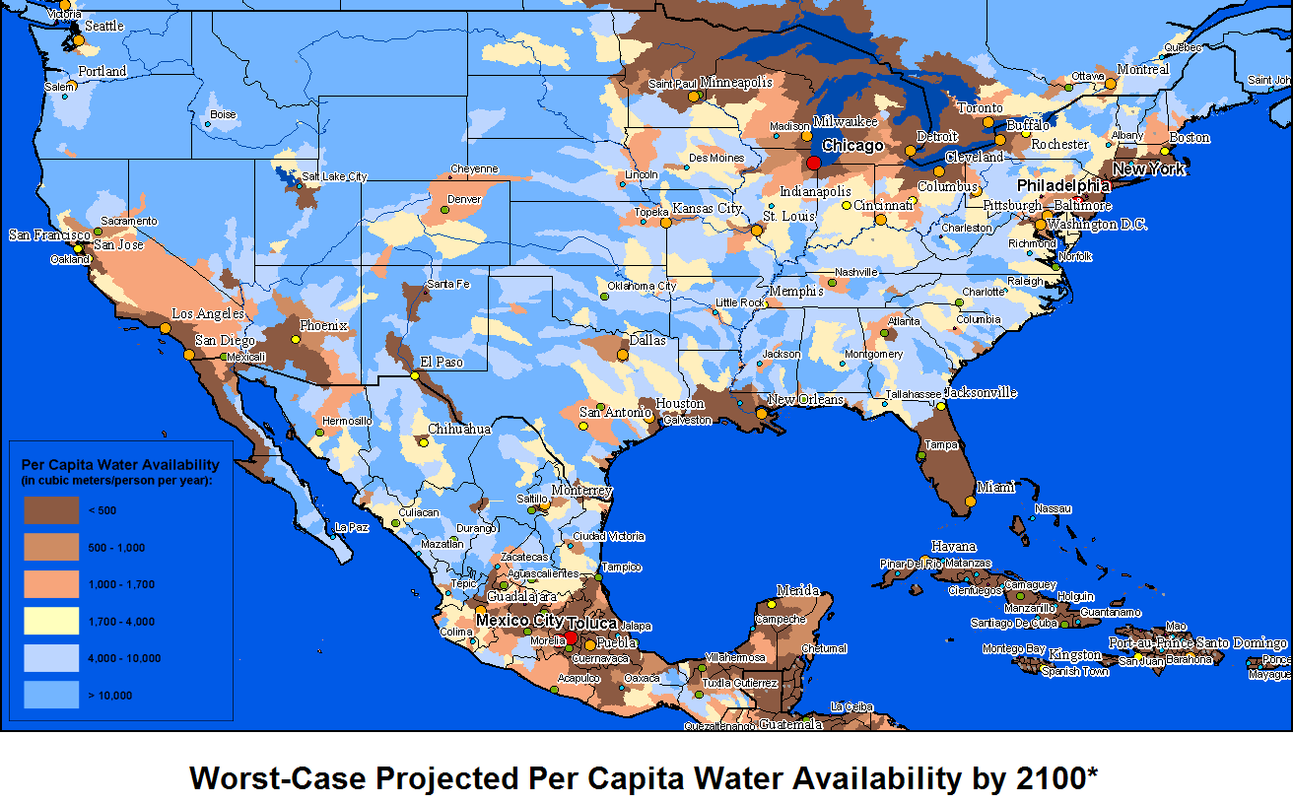
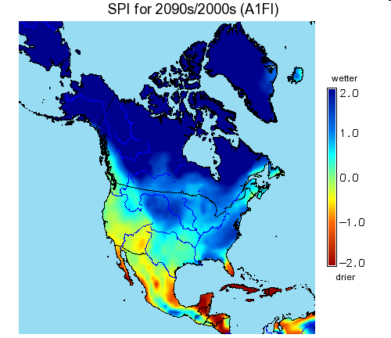
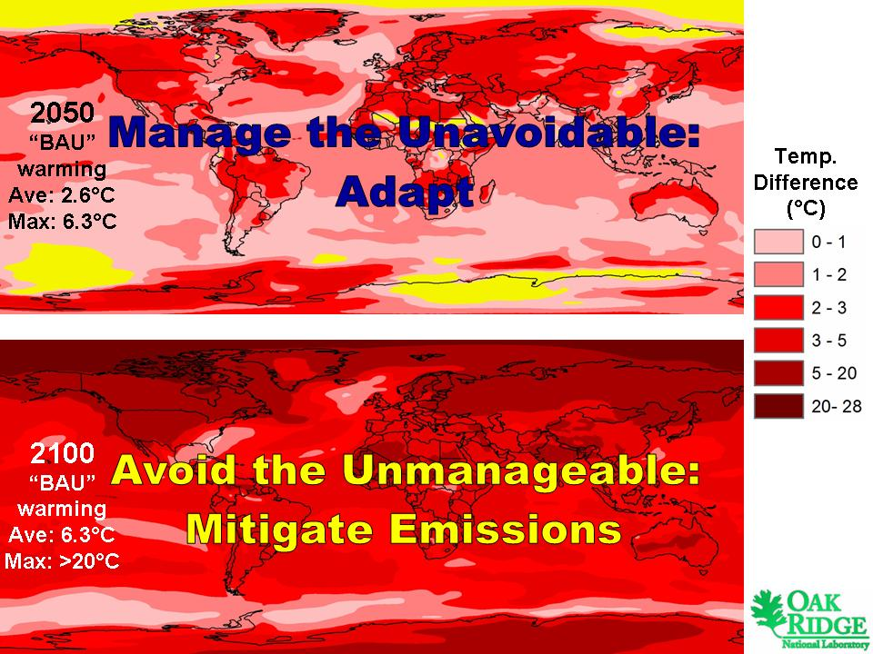






Climate extremes: Science, impacts, policy
Science
  Extremes characterizations
  Uncertainty assessments
  Enhanced predictions
Impacts
  Natural resources
  Hazards risks
  Regional preparedness
Policy Relevance
  Emissions policy
  Preparedness decisions
  National security concerns
Temperature and Heat Waves (Ganguly, 2009)
State of US Water Resources
Drought Index
Emissions
Negotiations
Threat and Adaptation

Slide 6



Temperature extremes are projected relatively credibly but large uncertainties remain
Fossil-fuel intensive scenario as a new business-as-usual
Statistically significantly higher trends in warming with worsening trends of heat waves
Larger uncertainties than previously thought especially at regional scales
Higher trends but larger uncertainty and geographic variability in 21st century temperature and heat waves
Auroop R. Ganguly, Karsten Steinhaeuser, David J. Erickson III, Marcia Branstetter, Esther S. Parish, Nagendra Singh, John B. Drake, Lawrence Buja
Ganguly et al. 2009: PNAS
Regional warming and intense heat waves concurrent with larger uncertainty point to the need for both urgency and caution in preparedness and mitigation
Notes:
6

Slide 7


Cold extremes projected to persist even under 21st-century warming scenarios
Kodra et al. 2011: GRL
Nine global climate models and observations reveal
Cold snaps will be at least as severe and long-lasting as current conditions although frequency will decrease
Even as we prepare for global warming, adaptation to extreme cold events cannot be compromised
The persistence of extreme cold events under global warming scenarios is counter-intuitive but may have explanations based on influence of ocean currents, topography and atmospheric circulation
Notes:
7

Slide 8
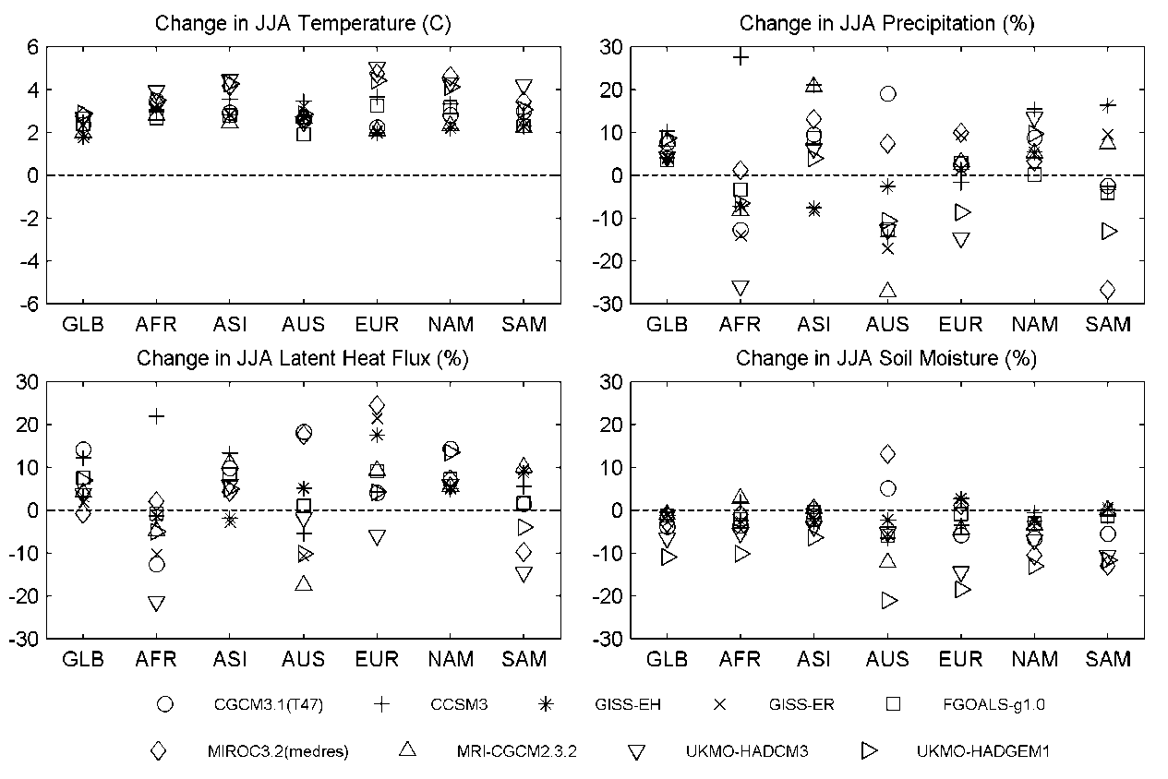
Climate models disagree on hydrologic variables at 30-year, continental scales
Temperature projections from multiple climate models agree at continental scales but hydrological variables do not even agree on the sign of the change
Figure courtesy: Kodra, Ganguly and Entekhabi

Slide 9
Precipitation is not well projected but their extremes have a temperature dependence
Central Tendency (median) of Return Levels based on All Land Grids
40-year extremes in 1930s ➔ 30-year extremes in 2000s
30-year extremes in 2000s ➔ 5-year extremes in 2100s per BAU
Observed trends match modeled trends (Correlation: NCEP: 0.89; ERA40: 0.97)
Observed trends suggest even worse extremes than the worst case from CCSM3
Best case and commit project much less, showing the value of mitigation policies
Kao and Ganguly 2011: JGR

Slide 10


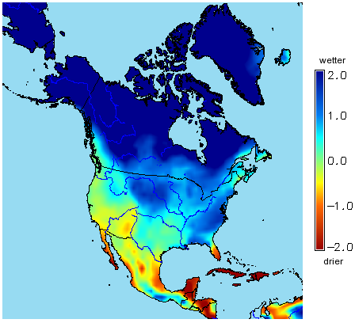
Despite knowledge gaps or intrinsic uncertainty informing preparedness and policy is critical
An International Climate Change War Game
Four negotiation areas
Water and food resources
Hazards & humanitarian aid
Migration & population shifts
Reduction of GHG emissions
Informing policy
Nature Blogs
The so-called “Angry Red Chart”
Informing preparedness
Assessment of Regional Threat
Assessments of Preparedness Levels
“…examine the capabilities of the armed forces to respond to the consequences of climate change, in particular, preparedness for natural disasters from extreme weather events … inside the United States and overseas”
FY08 National Defense Authorization Act: Sec. 951
Drought Index: 2100 (BAU)

Slide 11
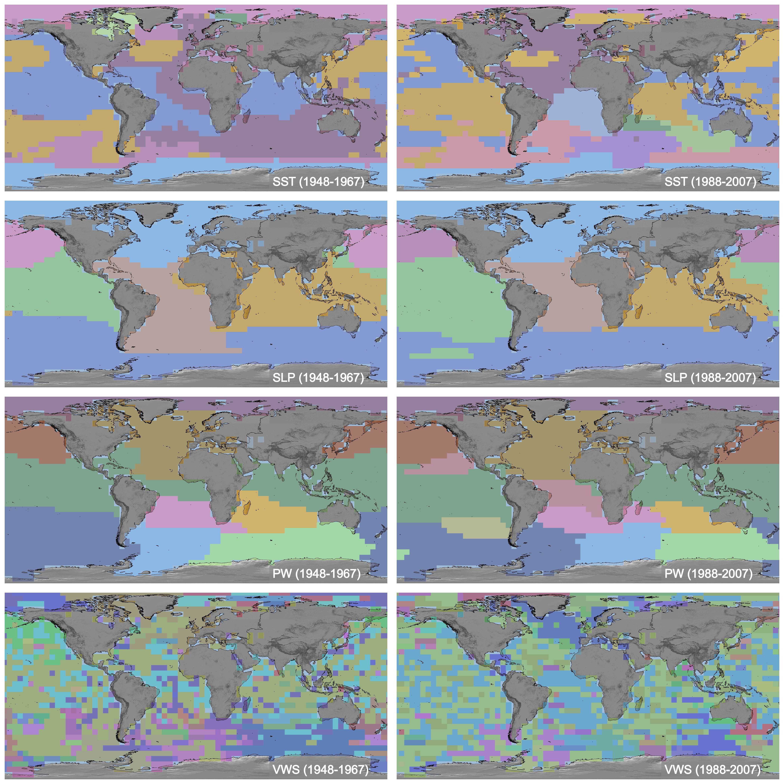
Computational data sciences can improve science understanding and enhance predictions
Unified framework for descriptive and predictive analysis
New insights into complex multivariate dependence patterns in space and time
Improvements in regional predictions with possibility of enhancing model projections
Steinhaeiser et al. 2011: SADM and Climate Dynamics

Slide 12
Climate physics uncertainties may not dominate in studies of impacts, adaptation, vulnerability

Slide 13
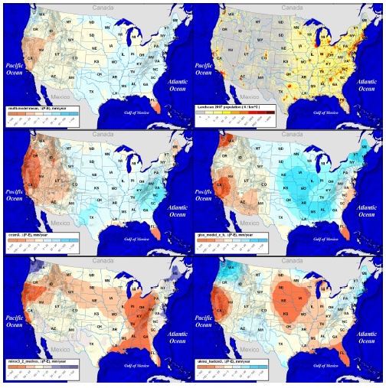
Decision support and policy needs assessment versus climate model and process diagnostics suggest:
Physics-based Models are Essential but Not Adequate
Even next-generation climate models are not expected:
  to keep pace with the urgency of requirements
  to adequately address critical gaps (cloud physics and teleconnections)
“The sad truth of climate science is that the most crucial information is the least reliable” (Schiermeir, Nature, 2010)
Disagreement between IPCC models
Models make relatively reliable predictions at global scale for ancillary variables:
  Sea Surface Temperature (SST); Atmosphere temperature/humidity profiles over land; Wind speed
They provide least reliable predictions for variables that are crucial for impact assessment:
  Regional precipitation and extremes; Hurricane intensity and frequency; Droughts and floods
Regional hydrology (“P–E” changes in 2030s) exhibits large variations among major IPCC model projections
Figure courtesy: Ganguly et al. (in revision)
Hypothesis-driven “manual” conceptual models
Hurricane models (Emanuel et al, BAMS, 2008)
Regional-scale precipitation extremes (O’Gorman &Schneider, PNAS, 2008; Sugiyama et al, PNAS, 2010)
We need a systematic approach to semi-automatic data-driven model inference.

Slide 14
Can machine learning help translate the science of climate change to information relevant for preparedness and policy?

Slide 15
Climate Models:
Necessary but not Sufficient
IPCC AR4 Suite of Models
  Global and century scale projections & attributions
  Regional and decadal projections not adequate
  Extreme events not accurately projected
Next-Generation: AR5 and Beyond
  More precise (space-time resolution)
  Better resolved processes (e.g., mesoscale systems)
  But, precision does not necessarily imply accuracy
Notes:
15

Slide 16
Massive, Disparate Data:
A Fact of Life
Massive volumes of sensor-based observations
  Remote sensors: Satellites, Airplanes, Radar
  In-situ sensors: DOE ARM, NEON, CUAHSI
  Reanalysis: Merged multi-sensor data with model fit
  Learn functional relations from observations?
Massive volumes of model simulations
  IPCC suite of models; SRES scenarios; Ensembles
  1 run: 850 GB of compressed data; 1 month on Jaguar
  Ancillary model outputs with value-added information?
Notes:
16

Slide 17
Geographical Data Mining or SSTDM:
To the Rescue?
Massive data motivate mining
  Traditional KDD/DM assume IID processes
  However, learning samples are not independent
Climate data are geographical / spatio-temporal
  First law of geography: Spatial / temporal correlation
  Spatial and spatio-temporal data mining suggested
Notes:
17

Slide 18
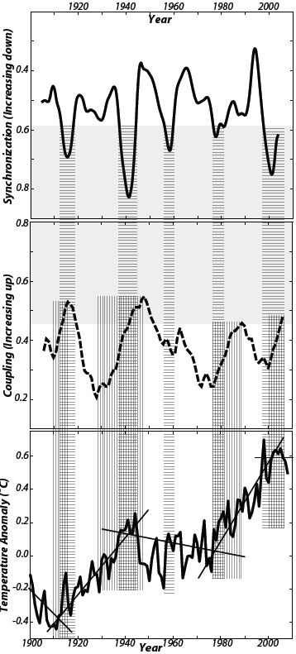
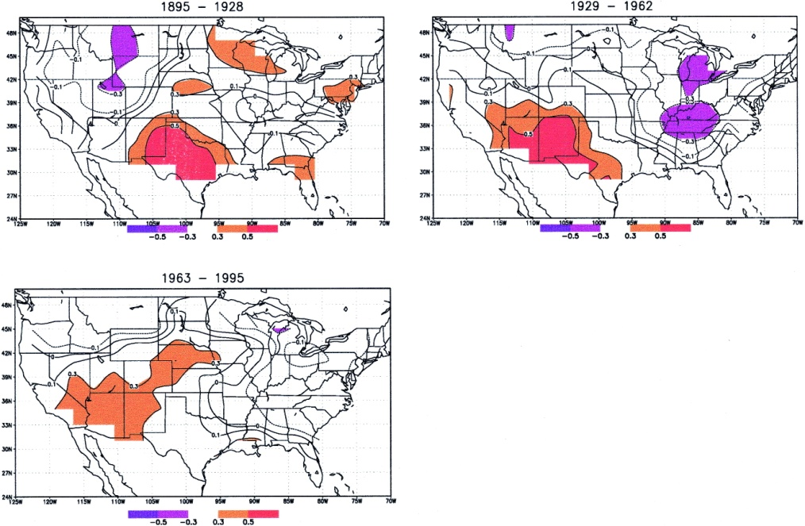
Beyond SSTDM: Non-stationary patterns
Non-stationary environment
  Predictive extrapolation may be misleading
  Functional relations may change unless backed by physics
Rajagopalan, B., E. Cook, U. Lall, and B.K. Ray, 2000: Spatiotemporal Variability of ENSO and SST Teleconnections to Summer Drought over the United States during the Twentieth Century. Journal of Climate, 13, 4244–4255.
Swanson, K.L., and A.A. Tsonis, 2009: Has the climate recently shifted? Geophysical Research Letters, 36 (6), April.
Notes:
18

Slide 19
Beyond SSTDM: Complex dependence
Complex Dependence
  Nonlinear processes, even chaotic synchronizations
  Low-frequency, even 1/f, variability or noise
  Long range spatial dependence: Teleconnections
  Long-memory temporal processes
Khan, S., Ganguly, A.R., Bandyopadhyay, S., Saigal, S., Erickson, D.J., Protopopescu, V., and G. Ostrouchov 2006: Nonlinear statistics reveals stronger ties between ENSO and the tropical hydrological cycle
Geophysical Research Letters, 33, L24402.
Hurrell, J.W., 1995: Decadal trends in the North Atlantic Oscillation: Regional temperatures and precipitation
Science, 269 (5224), 676-679.
Notes:
19

Slide 20
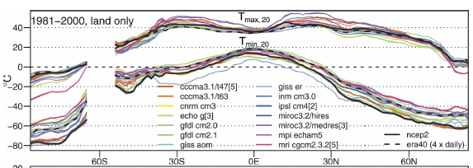
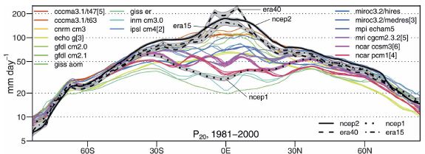
Beyond SSTDM: Recurrent extremes
Recurrence of Extremes
  Not necessarily a spatio-temporal outlier or anomaly
  Dynamical systems may have recurrence patterns
Kharin, V.V, Zwiers, F.W., Zhang, X., and G.C. Hegerl, 2007: Changes in temperature and precipitation extremes in the IPCC ensemble of global coupled model simulations. Journal of Climate, 20, 1419–1444.
Notes:
20

Slide 21
The “New” Challenges
Nonlinear dynamics with sensitivity to initial condition (even chaos) combined with low frequency (even 1/f) variability
Non-stationarity processes coupled with long lead time of projections
Long memory processes in time and long-range dependence in space
The importance of detecting, characterizing and predicting rare events or abrupt change

Slide 22
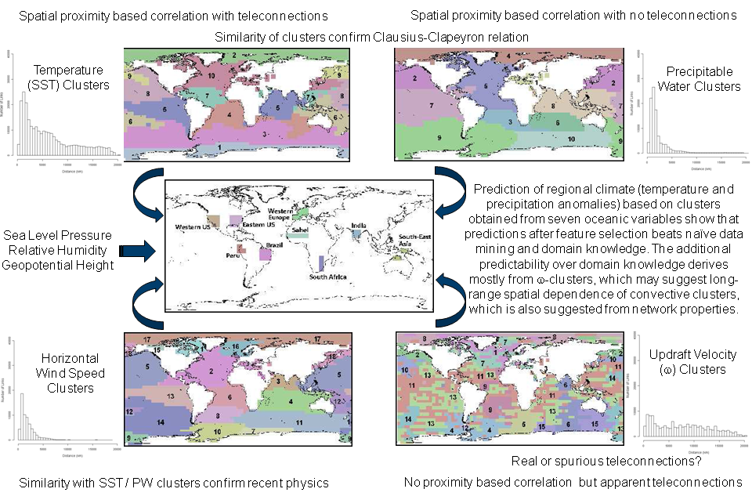
Uncertainty reduction may be possible by combining physics models with computational data sciences
Step1: Conceptual physics models (O’Gorman and Schneider 2009) and relationship mining identify variables in 3D (space, time, vertical) neighborhoods with information relevant for predicting precipitation
Step 2: Precipitation mean and extremes are projected with ancillary variables in 3D neighborhoods with predictive modeling
Step 3: Complex networks are constructed over oceans using relationship mining
Step 4: Complex networks develop proxies for global and regional scale ocean dynamics leading to set of potential predictors
Figure adapted from Steinhaeuser et al. 2011: SADM
Step 5: Teleconnections are developed to predict regional precipitation change and their extremes based on both relationship mining and predictive modeling
Step 6: The (Step 2) 3D neighborhood-based predictions are combined with teleconnection based predictions with fusion of predictive modeling
Step 7: Regional precipitation prediction gains are run through cross-validation and interpreted with climate science

Slide 23
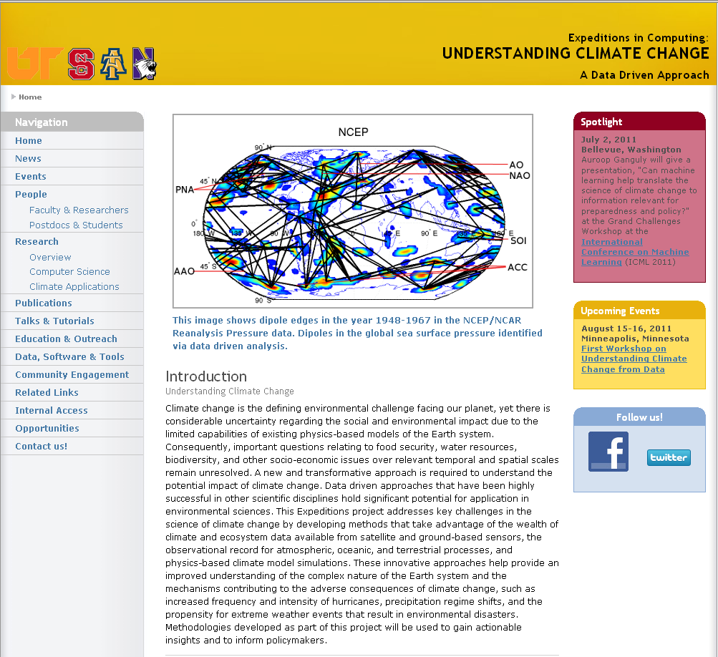
NSF “Expeditions in Computing” (2010)
http://climatechange.cs.umn.edu
First workshop at UMN last month
Long-term metric: Part of suite of tools for climate science as well as IPCC and policy makers
Looking for international collaborations in both climate science and computer science

