Slide 1

Computer Science
Research Opportunities in Sustainability
Randal E. Bryant
http://www.cs.cmu.edu/~bryant

Slide 2
Background
Workshop on the Role of Information Sciences and Engineering in Sustainability
  Sponsored by NSF, run by Computing Community Consortium
  February 3-4, 2011
  ~ 60 participants
  Organizers: Randal Bryant, Doug Fisher, Erwin Gianchandani, Carla Gomes, William Rouse, Prashant Shenoy, Robert Sproull, David Waltz, and Krishna Kant
Report
  Available at: http://cra.org/ccc/seesit_report.php

Slide 3
NSF SEES Program
Science Engineering and Education for Sustainability
  Spans entire NSF
Budget
  FY 2012 request: $998 million
  CISE request: $46 million

Slide 4
Sustainability
“Development that meets the needs of the present without compromising the ability of future generations to meet their own needs”
-- Brundtland Commission of UN, 1987

Slide 5
Some Dimensions of Sustainability
Buildings
Low Power IT
Smart Grid
Energy
Electricity
Renewable energy
Transportation
Electric Vehicles
Ride Sharing
Environment
Traffic Optimization
Climate
Habitat Preservation
Adapting to
climate change

Slide 6
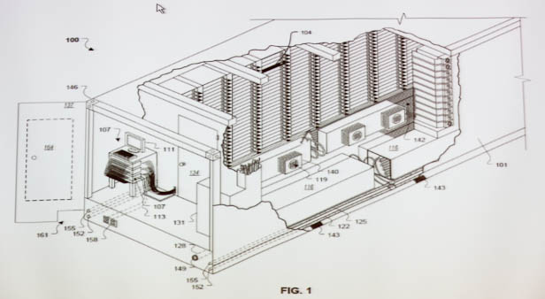
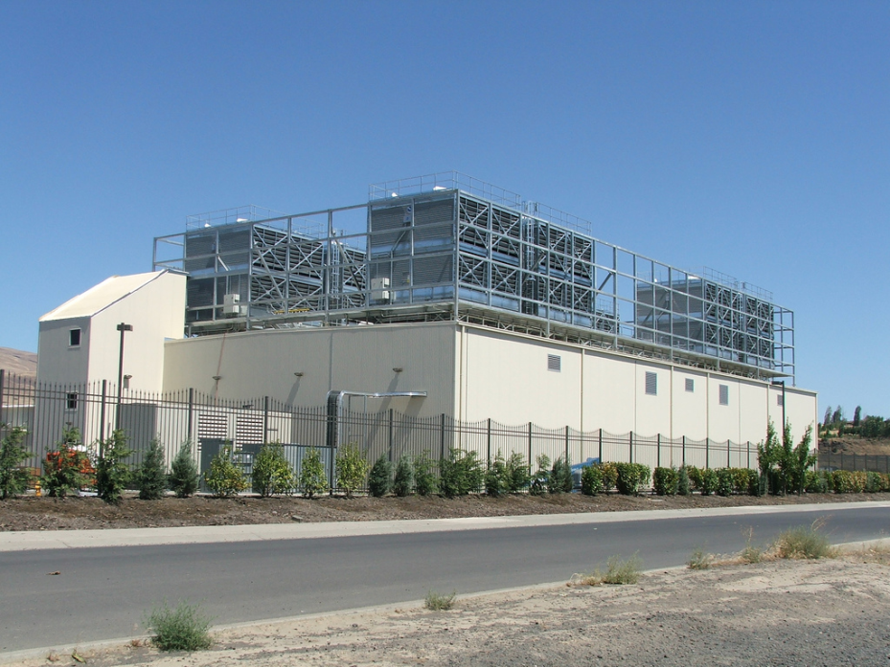
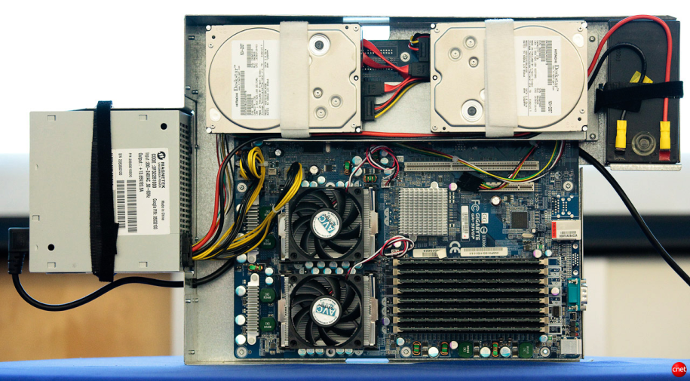
Google Data Centers
Dalles, Oregon
  Hydroelectric power @ 2¢ / KW Hr
  50 Megawatts
    Enough to power 60,000 homes
  Engineered for maximum modularity & power efficiency
  Container: 1160 servers, 250KW
  Server: 2 disks, 2 processors
Notes:
One of the biggest users of cluster computing is Google. They have set up dozens of data centers around the world, containing more computer power than just about anyone else.
Here’s a picture of their data center in Dalles, Oregon. It cost them $600M and requires around 50 megawatts of power. (For reference, that much power would supply the residential electricity needs of 6,000 households in the U.S.). They located the data center near the Columbia River to take advantage of low-cost electricity.
Imagine what our intelligence sources could do if they had facilities on this scale to store and process satellite imagery, voice signals, and feeds from media outlets.

Slide 7
IT and Energy
Data Center Power
  The research topic of choice for many computer scientists
  Interesting problems, lots of progress
  ~2% of US power consumption
Beyond Data Centers
  How can IT fundamentally improve the processes of electricity generation, transmission, and consumption?
  Other aspects of sustainability
  How can computer scientists contribute?
    With ideas & approaches that our counterparts in electrical engineering, mechanical engineering, & civil engineering would not think of
  Computational thinking for sustainability

Slide 8
Advanced IT’s Role in Sustainability
Systems that continuously monitor themselves, and adapt, repair and optimize
Systems designed as large networks of loosely coupled agents
Serving the needs and characteristics of people
Trustworthy modeling and simulation

Slide 9
Self Monitoring, Adapting, Repairing, and Tuning
Sensors Everywhere
Adaptive Systems
  Building occupancy
  Localized energy usage
  Energy generation
  Traffic flow
  Environmental monitors
  Turn HVAC & lights on & off
  Diagnose faulty appliances
  Adjust wind farms to weather patterns
  Route around congestion
  Detect and report environmnetal risks

Slide 10
Sensor-Rich Systems
Challenges (and Research Opportunities)
  Configuring
    Need systems to self-identify and configure themselves
  Ensuring Reliability
    What happens when sensor is faulty?
  Maintaining Privacy
    Will collect data about people that should not be released
      Where people are
      What they are doing

Slide 11



Agent-Based Systems
“I need 10KWh by 7am tomorrow”
Utility
Company
Home
Energy
Manager
“OK, will provide 2KW from 12:00 to 5:00 at $0.07/KWh.”
Systems continuously negotiate supply & demand with each other
Millions of agents working together

Slide 12
Agent-Based Systems
Motivation
  Only way to ensure scalability
  Enables individuals to make their own choices
    Vs. centralized control schemes proposed by utilities
    E.g., utility can provide cost incentives to reduce electricity usage during peak loads, rather than shutting down appliances
Challenges
  Ensuring robust operation
    Despite unexpected events, software errors, …
  Minimize vulnerability to malicious attack

Slide 13
The Role of People
Individuals
  Motivating them to conserve
    Typical household pays more for TV cable service than for electricity
    Most individuals do not want to expend lots of time & effort managing resource usage
    Systems must be highly automated and easy to use
      Learn individual preferences and apply them
Groups
  Social networking technology can support conservation
    Exerting subtle forms of peer pressure
    Sharing of resources, e.g., carpooling

Slide 14
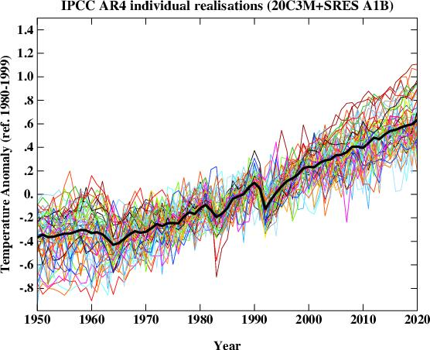
Reliable Modeling & Simulation
Modeling & Simulation Critical Tools
  Predicting effects of decisions
Current Methods Error-Prone and Lack Transparency
  What are effects of simplifying assumptions

Slide 15
Reliable Modeling & Simulation (cont)
Current Methods Error-Prone and Lack Transparency
  Modeling decisions embedded in complex software
  Fail to consider adaptations by people
    E.g., building more freeways causes people to move further away from work
  Must gain trust of citizens & policy makers
Constructing Models Labor Intensive
  E.g., deriving building performance model from construction diagrams
  Information rapidly becomes out of date
Opportunities
  Automatically matching model parameters to sensed data

Slide 16
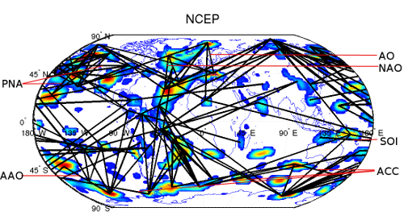
Ongoing Research Projects
Understanding Climate Change: A data-driven approach
  Vipin Kumar, U Minnesota. NSF Expedition
  Analyze climate-related data from satellites, ground-based sensors
  Relate to predictions generated by climate simulations

Slide 17

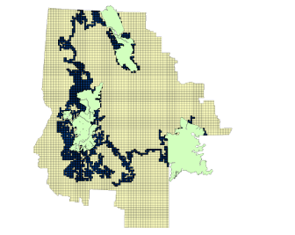
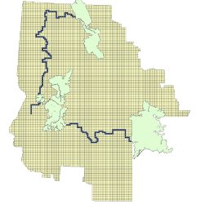
Ongoing Research Projects (cont.)
Institute for Computational Sustainability
  Carla Gomes, Cornell. NSF Expedition
  Using data mining & optimization techniques to optimize resource management
Glacier Park
Salmon-Selway
Yellowstone

Slide 18
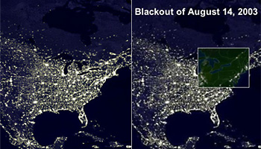
Ongoing Projects (cont.)
Center for Computational Learning Systems
  David Waltz, Columbia. Mostly industry funding
  Applying machine learning / data mining to real-world problems
  Close working relationship with Consolidated Edison
    Data mining of maintenance records
    Placement of EV charging stations
    Analysis of 2003 blackout

Slide 19
Some Characteristics of Successes
Use-Inspired Research
  How CSE can be applied to non-IT problems
  Close engagement with specific problems
Close Collaboration with Domain Experts
  Academics in other fields
  Industry
  Federal agencies
Scale of Operations
  Easier to do as part of large-scale, interdisciplinary center
  But, there are instances of success at single-PI level

Slide 20
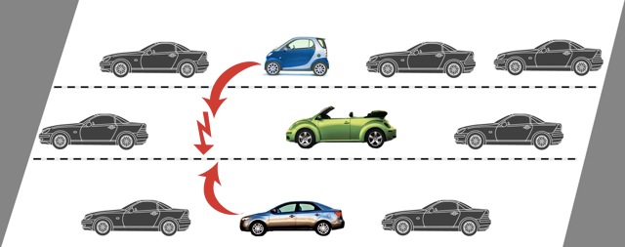
Smaller-Scale Examples
Formally Verifying Distributed Vehicle Control System
  Andre Platzer, CMU
  Based on model of system to control braking, acceleration, and lane changes by autonomous vehicles

Slide 21
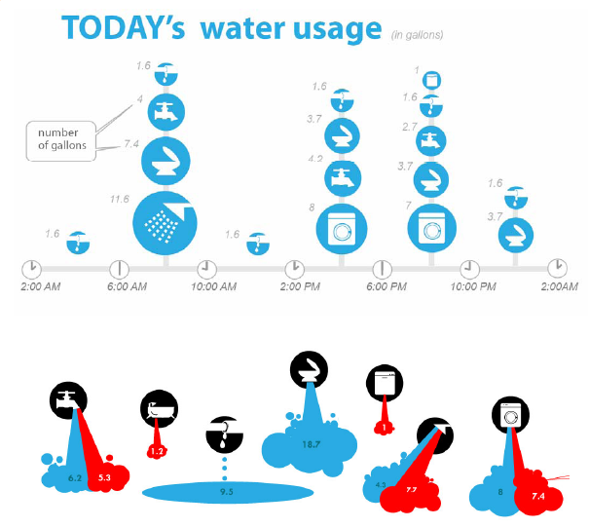
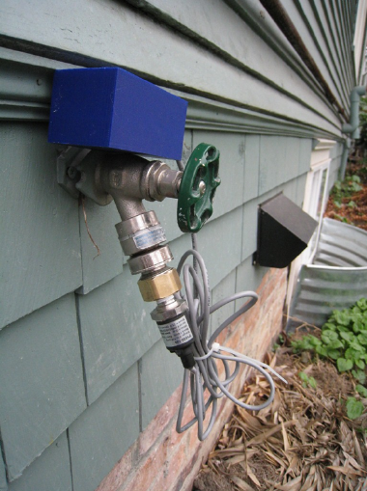
Smaller Scale Examples (cont.)
Low-cost sensors for monitoring home resource utilization
  Shwetak Patel, U Washington
  Sensors + Machine learning + HCI

Slide 22

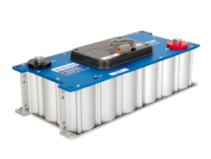
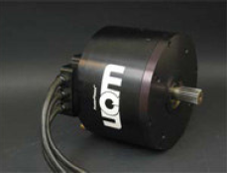
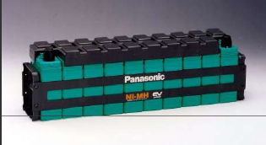
Smaller Scale Examples (cont.)
Improved Power Control for Electric Vehicles
  Illah Nourbakhsh, CMU
  Use machine learning & crowd sourcing to optimize energy management
Motor / Generator
Batteries
Super Capacitor

Slide 23
Exploiting Super Capacitor
Controller
Batteries
Motor /
Generator
Super
Capacitor
Super Capacitor acts as Power Cache
  Absorbs short-term fluctuations in charge / discharge
  Reduces stress on batteries
Control Strategy
  Want to charge when braking for stop sign / discharge when start
  How can vehicle predict upcoming charge / discharge needs?

Slide 24
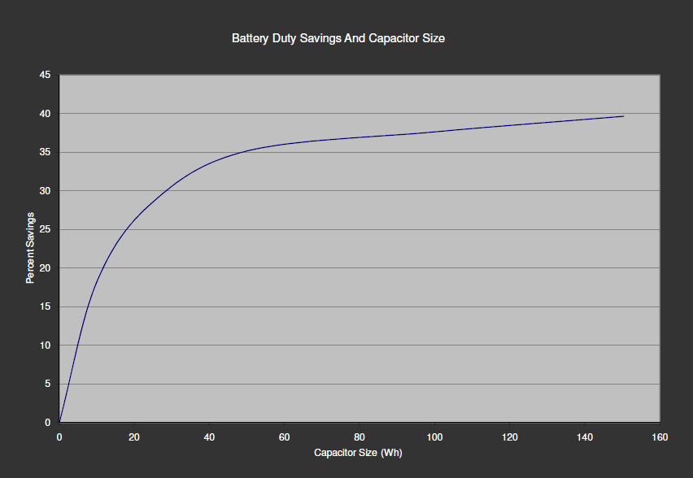
Benefits of Super Capacitor
  100 W/h storage ≈ 11ml gasoline
  Yields 37% savings on battery duty

Slide 25
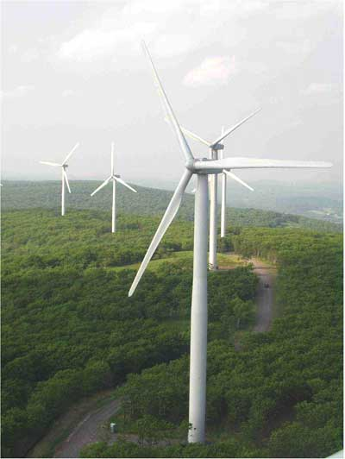
Working with U.S. Industry
Highly fragmented
  E.g., Somerset County, PA windfarm
    Developed by Atlantic Renewable Energy Corp & Zikha Renewable Energy LLC
    GE Wind turbines
    Operated by Florida Power & Light
    Supplied into grid by FirstEnergy Solutions
  Who could manage comprehensive overhaul?
Low R&D Investment
  Regulated monopolies have limited incentive to innovate
  High capital costs & safety concerns limit willingness to make drastic changes

Slide 26
Conclusions
Research Opportunities Across Many Areas of CSE
  Cyberphysical systems
  Systems engineering
  Machine learning & data mining
  Optimization
  Agent-based systems
  Modeling & simulation
  Human-computer interaction
Seek Participation From Across CSE Community
Report
  http://cra.org/ccc/seesit_report.php

