Slide 1
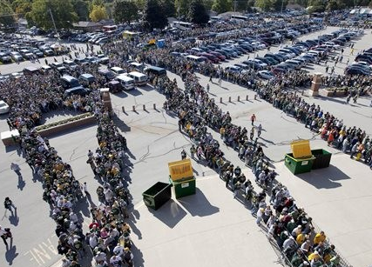
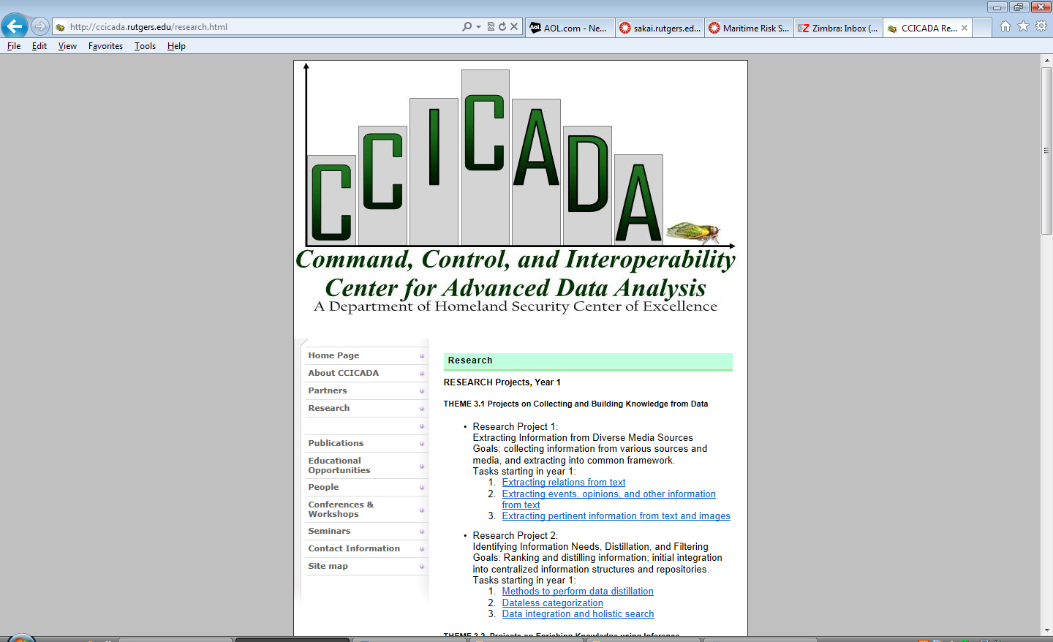
Stadium Security:
Leveraging
Partnerships with
the Academic
Community
Fred S. Roberts
Rutgers University
Director CCICADA
Lambeau Field – Mike Roemer/AP
NFL Security Seminar
June 17, 2014

Slide 2
Engaging with the Academic Community
Goal is to illustrate how work with the academic community can:
  Provide new ideas and tools to stadium security directors and others
  Assist in decision making about security procedures
  Potentially save money and time
Will illustrate with examples from my own experience

Slide 3
CCICADA - Overview
The CCICADA Center
The Command, Control, and Interoperability Center for Advanced Data Analysis (CCICADA) is a US DHS University Center of Excellence based at Rutgers University.
We work on problems involving data, modeling, simulation, and decision making.
We work on a variety of topics in conjunction with DHS and its partners in the public and private sector
Our work on stadium security has been strongly supported by DHS

Slide 4
















CCICADA Partners
Alcatel-Lucent Bell Labs
AT&T Labs - Research
City College of NY
Howard University
Princeton University
Rensselaer Polytechnic Inst.
Texas Southern University
University of Massachusetts, Lowell
Applied Communications Sciences
Carnegie-Mellon Univ.
Geosemble Technologies
Morgan State University
Regal Decision Systems
Rutgers University (Lead)
Tuskegee University
University of Illinois, Urbana Champaign
University of So.California

Slide 5
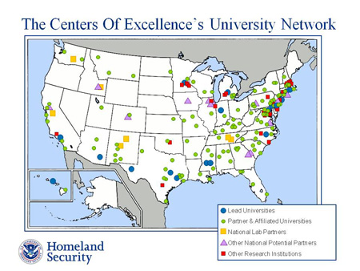
DHS University Programs
CCICADA is one of a network of DHS university centers of excellence (COEs)
12 COEs
Over 200 universities involved
COEs specialize
– Explosives
  Food protection
  Borders
  Risk and
  economic
  assessment of
  terrorism events

Slide 6






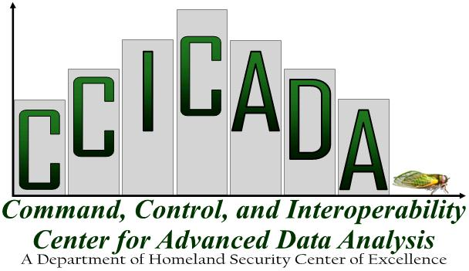

Historical Overview of CCICADA Role
DHS University Programs partnership with Stadium Security efforts has a long history
Special efforts at MetLife Stadium

Slide 7
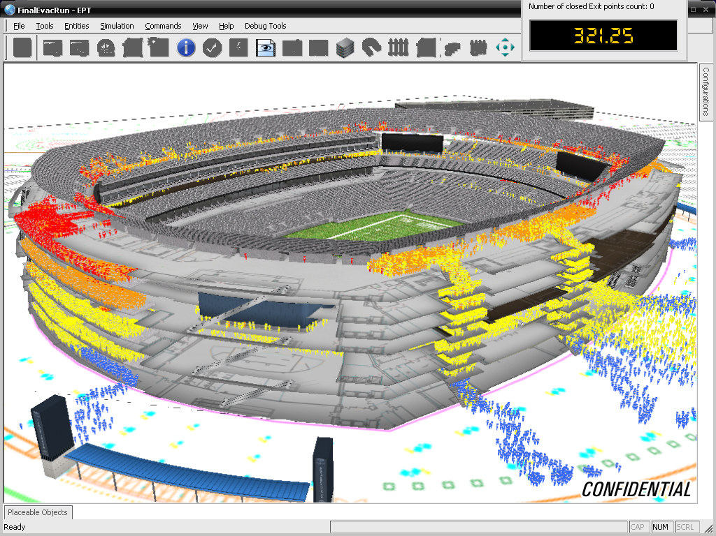
Evacuation Planning Tool
Small CCICADA component of the work:
behavioral aspects of stadium evacuation

Slide 8
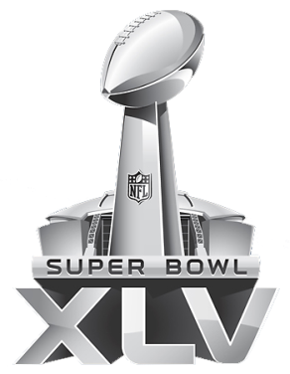






















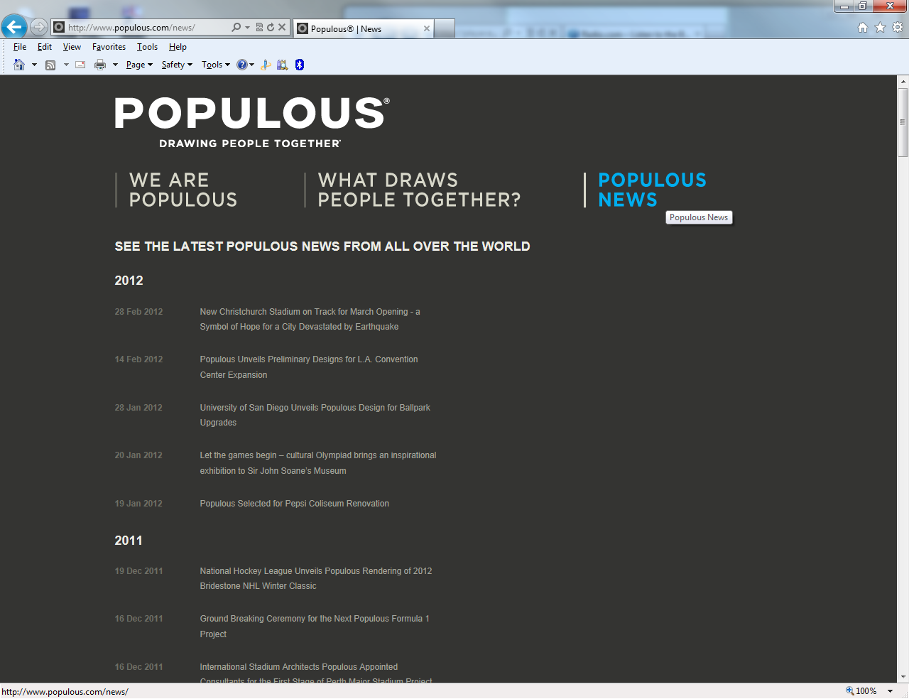

We Work with all Major Sport Leagues
Notes:
Our expertise has been providing evacuation planning, recovery and mitigation strategies, engineering, logistics, and configuration management services.

Slide 9
Other NFL Work at CCICADA
Engagement with stadiums and Super Bowl through “sport evac” process led to connections to stadium security.
Inspection processes at MetLife Stadium
“Best Practices for Stadium Security” with DHS Office of SAFETY Act Implementation (OSAI)
SAFETY Act: Metrics, Effectiveness, Randomization, Economics (OSAI)
Crowd Management
Prevention of Human Trafficking – Engagement with FBI, local agencies in connection with
Super Bowls

Slide 10
Other Stadium Security Work at CCICADA
Working on all aspects of stadium security:
  Risk Assessment
  Staffing: Leadership, Organization, Authority
  Information Management
  Operations
  Training and Evaluation

Slide 11
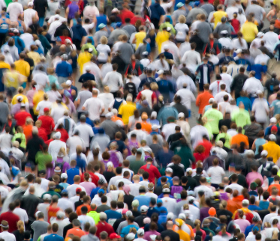
Crowd Dynamics Research
Crowd Management
Emergency Situations
Crowd behaviors
Mass Panic vs. Social Comparison
Psychological vs. Aggregate Crowd
Past Events – including WTC
Patterns of Movement
Fire Engineering Studies
Social Networking
Leadership, Authority and Structure
ADA Handling Disabled Persons
11

Slide 12

Prevention of Human
Trafficking
Daily, CCICADA’s web archival tool harvests thousands of online escort service ads in 66 markets around the country.
Developed in conjunction with FBI and Microsoft Digital Crimes Unit and LAPD
Used to support operations at 2014 Super Bowl
Helped officers locate likely suspects and construct cases for later prosecution.
Tool can be used to determine which are prostitution ads and which are human trafficking
Previously applied at 2013 Super Bowl
12

Slide 13

SAFETY Act Project I - Overview
First SAFETY Act Project
In July 2013, CCICADA completed a project aimed
at identifying best practices for SAFETY Act Designation and Certification for sports venue security and at developing a resource guide to be used by the DHS Office of Safety Act Implementation (OSAI) for two primary purposes:
  a) as a basis for application evaluation
  b) guidance for applicants (venues, leagues, events) seeking SAFETY Act certification/designation – once DHS OSAI releases it
  We hope our Best Practices Guide is ready for
  sharing soon.
13

Slide 14
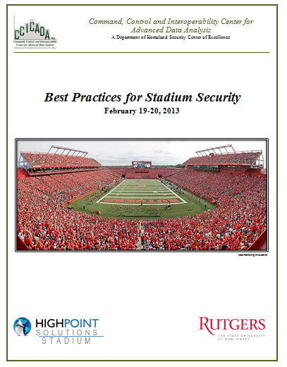
SAFETY Act Project I - Overview
Literature Review
Venue Visits
observational site-visits
Interviews [stadium security directors,
league security directors, other sport
security experts]
Workshop [venues, leagues, private firms, academia, government]
Testing Ideas [MetLife Stadium has been a testbed for us; involvement with other venues as well]
14

Slide 15
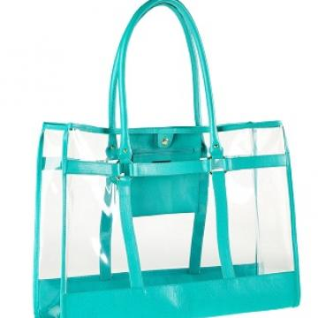
SAFETY Act Project I - Overview
Venue visits
Toured the facility; including perimeter, screening processes, command center, employee access, etc.
Helped inform research for the Best Practices Guide
Tied together information from literature review and interviews through on-site observation
Visiting a broad range of venues gave a broad perspective on types of practices and needs
Informed venue security
15

Slide 16
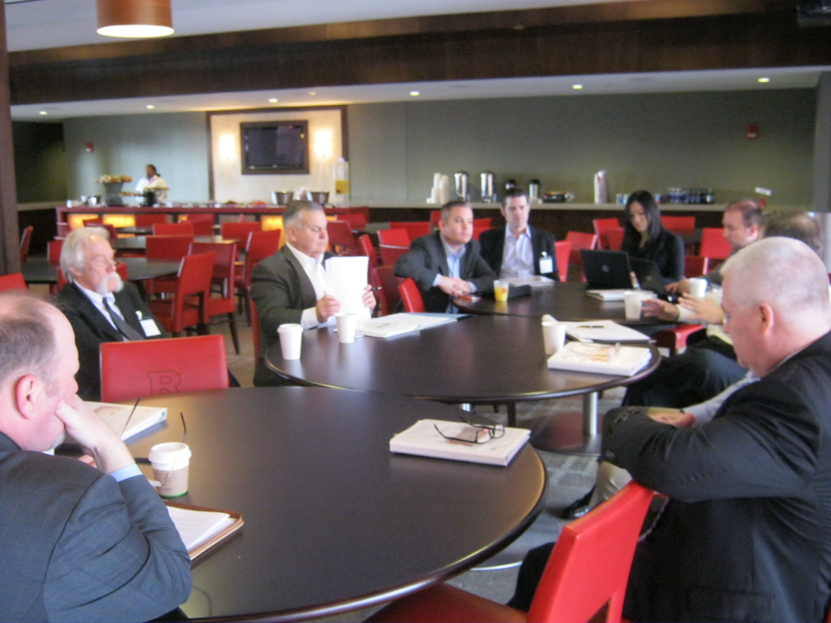
SAFETY Act Project I - Overview
Workshop
              Rutgers Stadium, February 2013
              Representatives from NFL, MLB, NBA, NHL, NASCAR, USTA, MLS – both stadium security directors and league security directors
              NCAA venues
              NJ State Police, NJ OHSP, NJ DHSS, NJ Transit, FBI
              Protective Security Advisors (PSA)
              Professional Association Reps
              Students and Postdoc Researchers
16

Slide 17
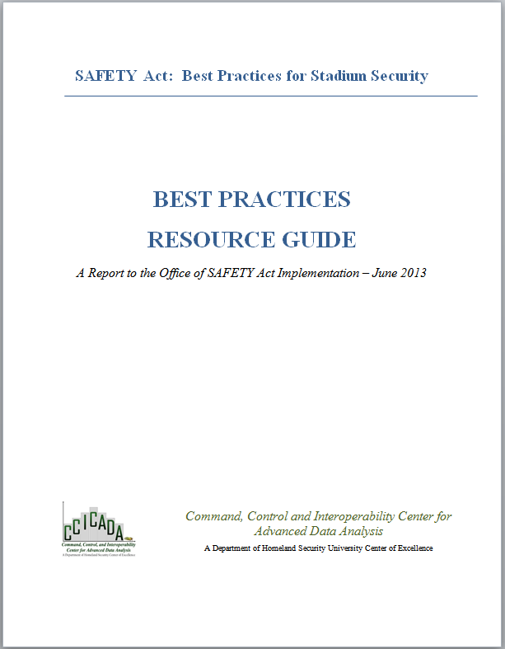
SAFETY Act Project I - Overview
Best Practices Resource Guide
FINAL Submitted to OSAI on July 31, 2013
522 pages
  Final version benefitted from review from range of subject matter experts (venues, leagues, government, legal).
17

Slide 18
New SAFETY Act Projects
a. Metrics.
Looking for better metrics to measure different components of stadium security
Emphasis on metrics for inspection processes and credentialing processes.
Questions | Metric
Were the screeners trained?
Was the training tested before they were allowed to screen?

Slide 19

New SAFETY Act Projects
b. Effectiveness.
A key issue of SAFETY Act certification is how to determine if a component of a venue security plan is effective.
How can we tell if an inspection process is effective? A credentialing process is effective?
Compare what agencies such as TSA, CBP, etc. use as measures of effectiveness of inspection processes, credentialing processes, etc.
Consider the impact of portfolios of security initiatives -- since it is not just one security initiative in isolation we are talking about.

Slide 20

New SAFETY Act Projects
c. Randomization (planned work)
We plan work on randomizing assignment to screening methods, randomizing when and where sweeps are conducted, randomizing the placement of monitoring cameras, randomizing rechecks of employee background
For randomization to be used in practice, we need practical methods for implementing randomization. What are some of these methods?
And how do we develop methods to protect against being accused of profiling/bias?

Slide 21
New SAFETY Act Projects
d. Testing.
Testing a security plan is a key component of venue security. We found that testing after training was a real weakness even at some of the "best" venues.
Can one develop a package of testing protocols, e.g., to test training of wanders?
Is there a best practice for training and testing wanders or those doing other types of inspections?
Is it really easier to train those working with walk-through magnetometers than those using wands?
Could one develop a virtual training environment that could record results and provide corrective feedback?

Slide 22
New SAFETY Act Projects
e. Comparing Test Results.
Comparing the results of similar tests from two different venues can be problematic at times. (Is 70% success at venue A < 80% success at venue B?)
  Different size venues
  Different settings for tests
  Different info for screeners
Need to develop specific guidelines for certain tests for venues to run so that evaluation of the outcomes of these tests could be more uniform.

Slide 23
New SAFETY Act Projects
f. Economic Benefits of Security (planned work)
Providing tools for security directors and management to understand the economic benefits of security enhancement (such as lowered insurance costs) would be very helpful.
Positive (or negative) impact of security on patron satisfaction: Can it be quantified?
More generally, it would be useful to explore methods to understand the economic impacts (costs and benefits) of security initiatives

Slide 24
New SAFETY Act Projects
Input needed with all of these projects:
  Ideas
  Participation in interviews and focus groups
  Venue visits
  More ideas
Let me know if you are interested.

Slide 25


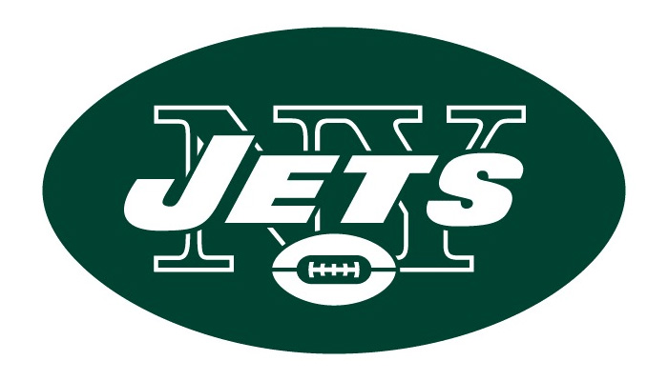
Analysis of Security Screening at Stadiums
Work with MetLife Stadium
Gathered data, tested ideas, developed and tested tools
Tools built being applied to other stadiums in other leagues

Slide 26
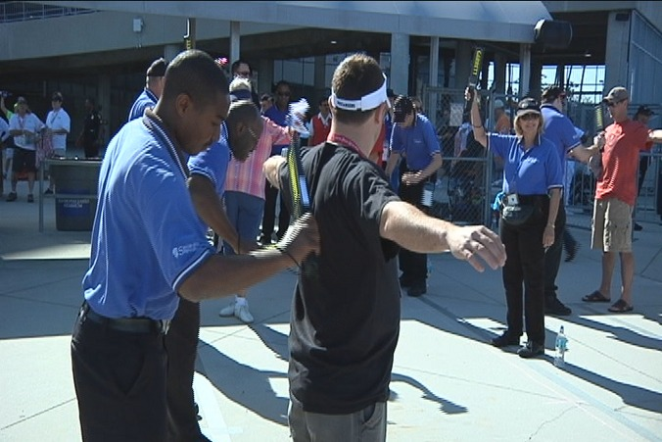
Stadium Security Inspection
Recall that during Fall 2011, NFL asked all stadium security operators to perform 100% wanding of patrons.
This didn’t always work. Close to kickoff time, lines got too long.
Began analysis of security procedures at MetLife Stadium
MetLife used wands until queue got too long, then switched to pat-downs.
Discussed ideas with NFL Security
26

Slide 27
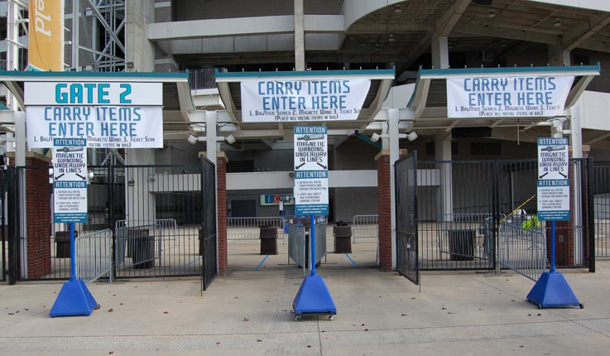
MetLife Project Goals
Improve: Effectiveness, Efficiency & Satisfaction
Maintain and improve the effectiveness of patron inspection procedures and processes
Improve efficiency: reduce resource costs (financial, time, staffing, etc.) associated with the procedures/processes; and speed up throughput
Maintain and improve patron satisfaction as enhanced procedures are applied to individuals attending MetLife events.
27

Slide 28
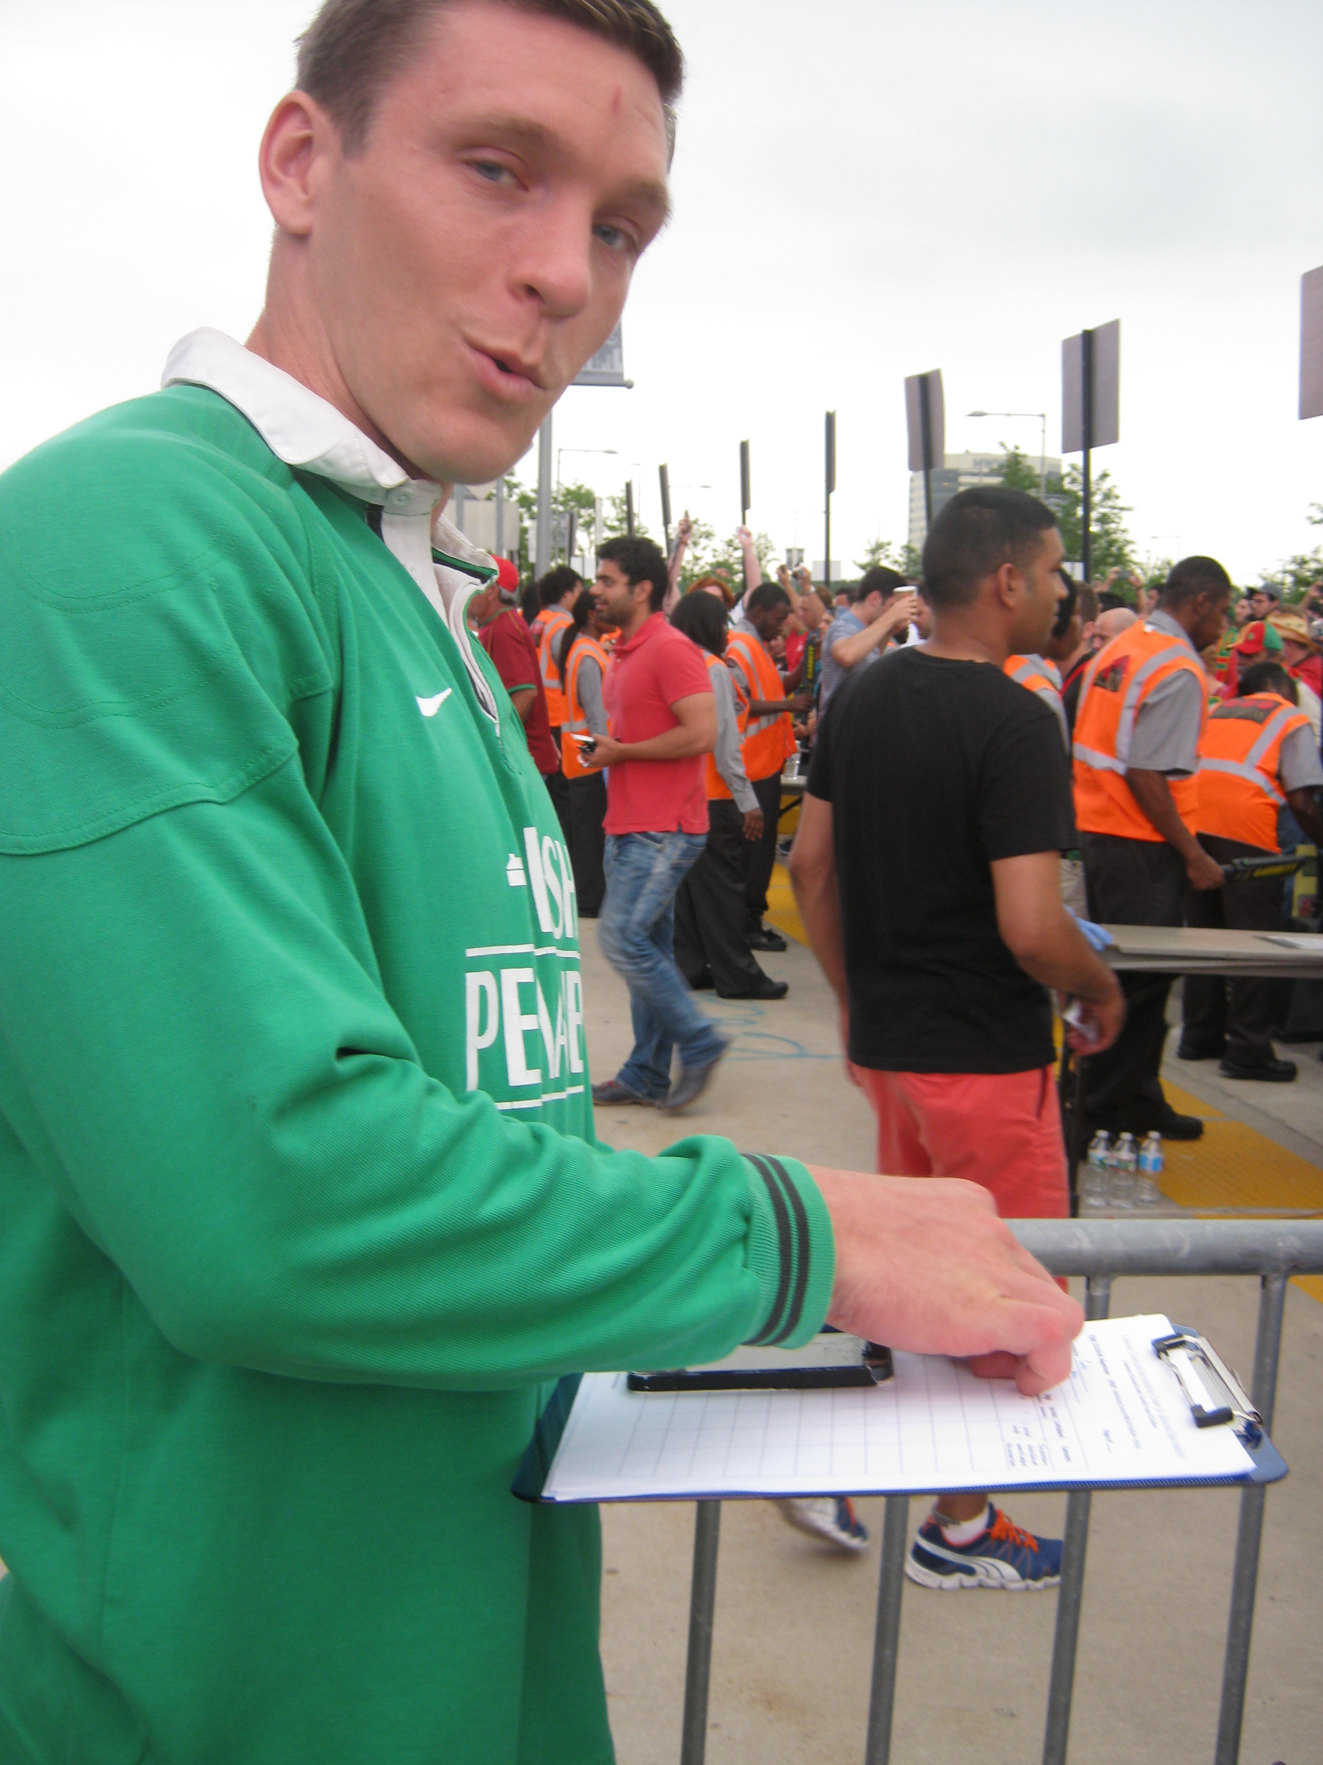
CCICADA-MetLife: Stage I
Data Collection, Examination, and Analysis of:
  Inspection times
  Comparison of pat-down, wanding, and bag check
  Anonymous comparison of different inspectors
  Comparison of different gates
  Physical design of pods
  Ticket scanning process and related data
  Arrival patterns of patrons over time
28

Slide 29
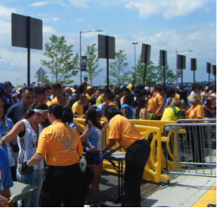
Data Collection
Data were initially collected using two different methods:
  Observation and Video Analysis
Initial Observation on site at 2011 football games plus four 2012 events:
    5/27: International Soccer – Mexico vs. Wales
    6/3: Hot 97 Summer Jam
    6/9: International Soccer: Argentina vs. Brazil
    6/16: Advance Auto Parts Monster Jam
Video analysis from NFL event
Required new Java application to facilitate
the recording of inspection times from video
provided by MetLife.
29

Slide 30
Data Analysis - SUMMARY
We evaluated the effect of several important factors on the inspection times:
  Inspection method (pat-down, wanding, or bag check)
  Location (gate, pod, lane ~ inspector)
  Time before event (early wave vs. late wave)
                Early wave = from time of gate opening until waiting line is cleared
        Late wave = from time of crowd accumulation until event start
  Type of event/crowd demographics (soccer match, monster truck)
30

Slide 31
Data Analysis
Since there is a lot of (random) variation, we analyzed the results using statistical methods.
CONCLUSIONS
Inspection time distributions differ significantly according to:
    Inspection methods
    Gates
    Times
    Events
    Inspectors
  Statistical analysis shows that the differences are much greater than can be explained
  by random chance.
31

Slide 32
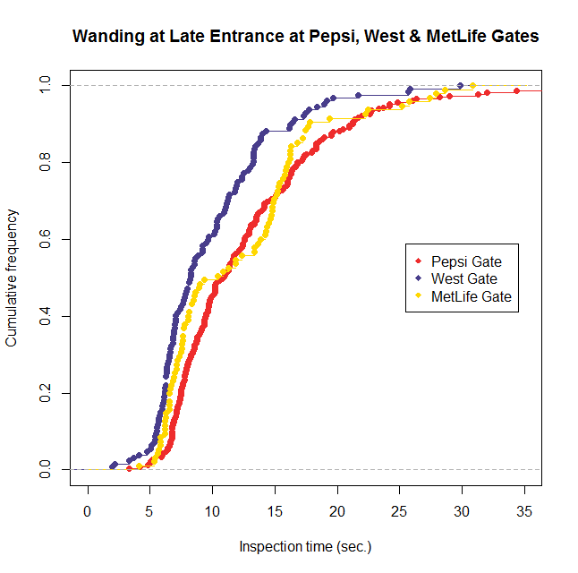
32

Slide 33
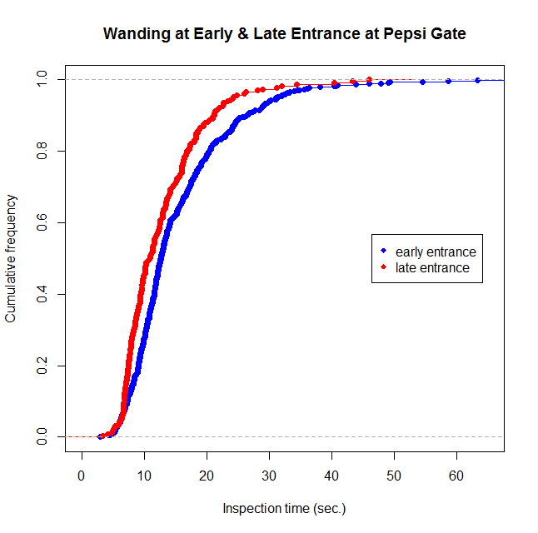
33
33

Slide 34
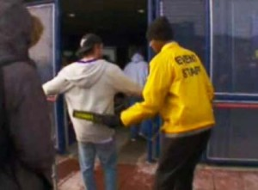
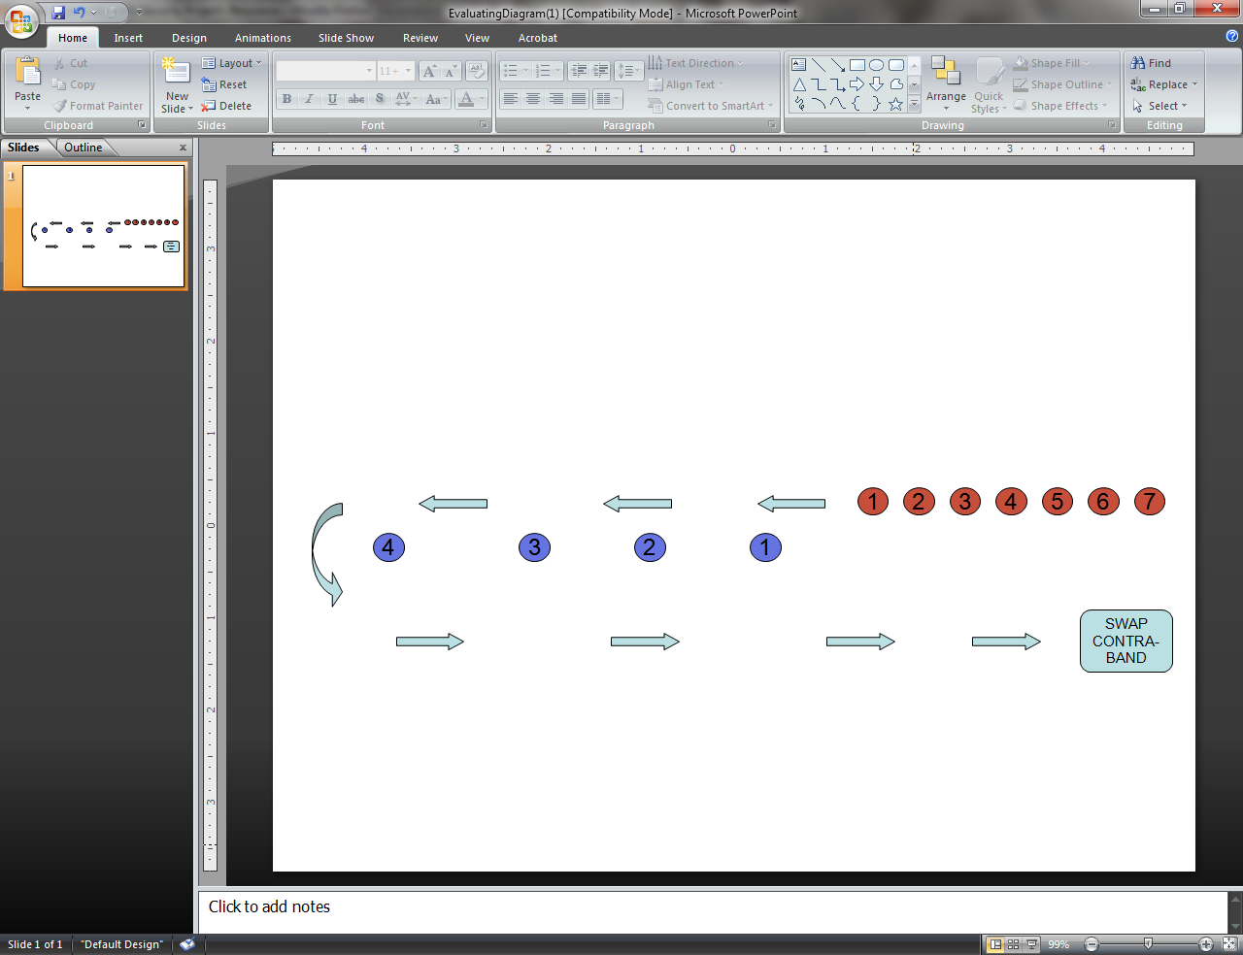
Data Analysis: Training
We designed protocol for evaluating effectiveness of training wanders at MetLife
We observed training of wanders and outcomes of our testing plan
Findings led to more emphasis on training and changes in training and testing of training
34

Slide 35
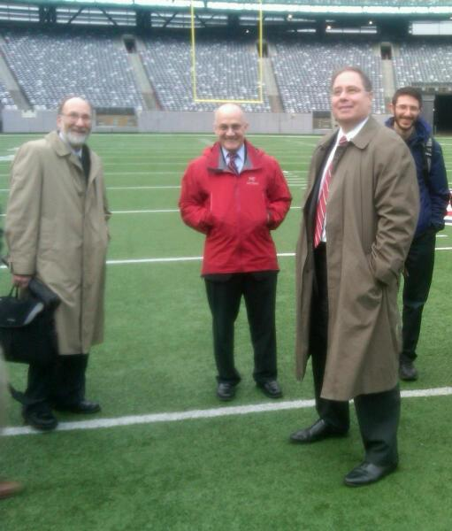
CCICACA-MetLife Stage I: Conclusion
Data Analysis and SAFETY Act work briefed to CEO of MetLife Stadium and other high ranking officials of the Giants and Jets.
Also in Attendance: DHS Deputy Undersecretary Dan Gerstein and Director of DHS Office of University Programs Matt Clark
High-level buy-in from both sides
essential to success of our work
35

Slide 36
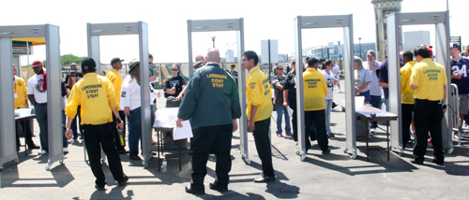
CCICADA-MetLife Stage II
  Because of issues with wanding, NFL started moving to walk-through magnetometers
  Raised questions for stadiums, in particular MetLife:
    Large capital expense
    Require more space
    How will they perform in bad weather?
36

Slide 37
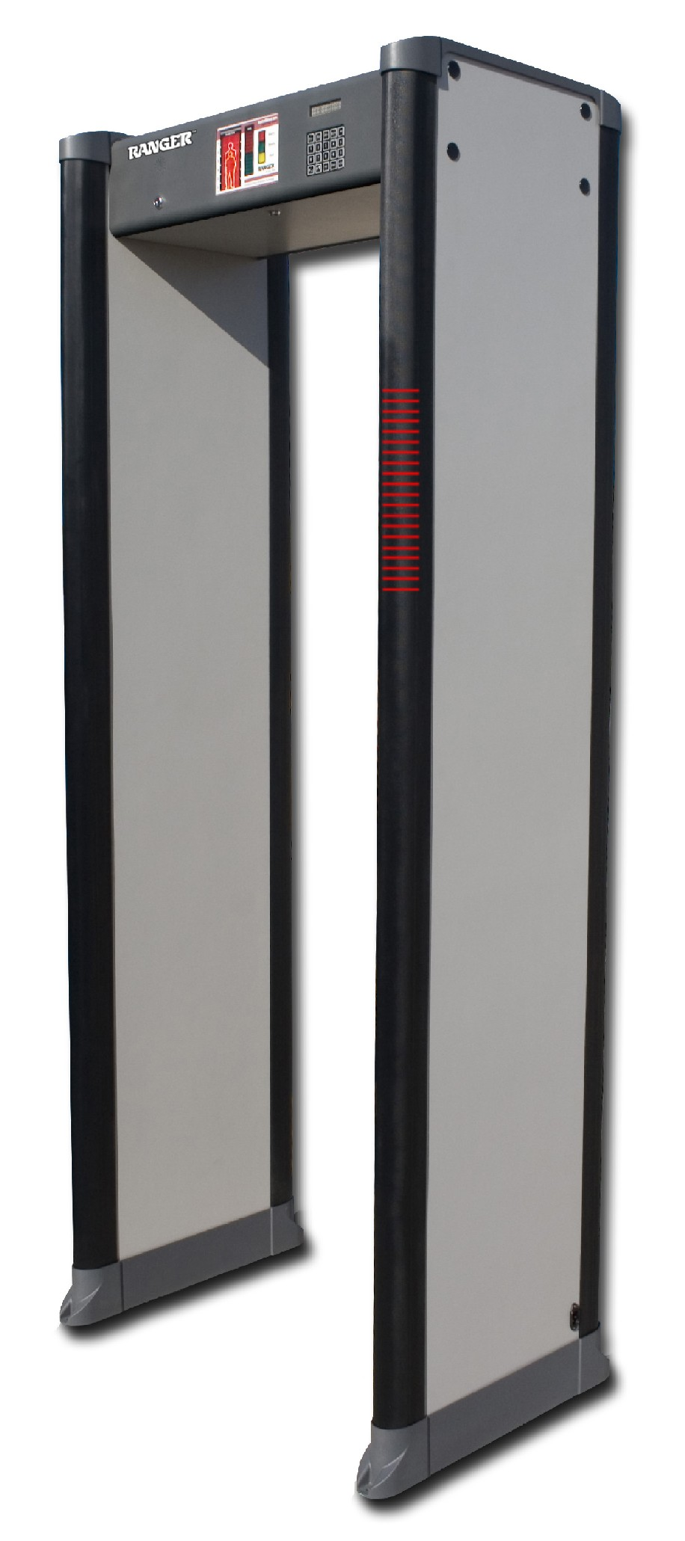
CCICADA-MetLife Stage II
  Magnetometer Issues:
                How many magnetometers needed?
                How many screeners needed?
                What is the “throughput”?
        Performance in bad weather?
        Training
  Observed experimental magnetometer use at MetLife in December 2012
  Repeated same type of analysis we did for wanding
  Preliminary conclusion: Small # of magnetometers unlikely to get everyone through quickly
  enough.
37

Slide 38
CCICADA-MetLife Stage II:
  Designed research project to develop a patron screening tool:
    Variety of inspection methods
    Know for each the “throughput,” the arrival rates at different times, the error rates, etc.
    Have goals such as:
      Getting everyone in by certain time
      Not letting queues get too long – this produces vulnerabilities (and patron dissatisfaction)
      Keeping maximum wait time low
    Can you model which inspection process to use when and for how long?
38

Slide 39
Simulation of Patron Screening
CCICADA’s Patron Screening Tool
CCICADA developed a simulation model to evaluate the effectiveness of various patron screening strategies at MetLife stadium
Usable at many different venues
The model can help answer many questions.
For example:
  How many magnetometers would be needed to ensure the queue clears by 5 minutes after game time?
  If we have 60 lanes of wanding at a gate,
  how long will the queue get?
39

Slide 40
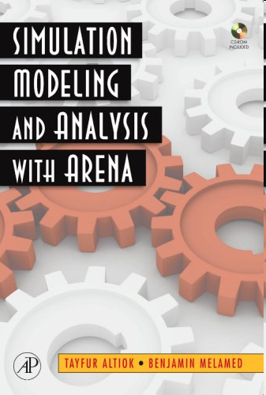
CCICADA’s Patron Screening Tool
Our patron screening model uses simulation software ARENA.
ARENA is commercial software.
CCICADA contribution: use it to build a tool with widespread applicability.
We used this to run “what-if” experiments. For example:
  What would happen if 20 magnetometers were used instead of 30?
  What would happen if there were 40 lines
  using only wanding?

Slide 41
Information from MetLife
Ticket scan (“throughput”) data for 14 home games (Jets + Giants)
  Time at which each ticket was scanned (and which gate)
  Note: No data on patron arrival rates
Estimated average screening times per patron
  Analysis of ticket data
  Observations using stopwatches and clipboards – following up on Stage I work
Discussions with stadium security personnel
  Confirming assumptions and estimates
  Feedback on the model and its output

Slide 42
Sample (Ticket) Throughput Data

Slide 43
Screening Rates
Based on throughput data and site observations, we estimated:
  Wandings took between 12 and 15 seconds
  Patdowns took between 6 and 8 seconds
Preliminary assumptions and simplifications:
  Magnetometers would take between 5 and 7 seconds
  For each patron, the time to screen them will be generated from a uniform distribution: equally likely to take any number of seconds between highest and lowest.
Other venues have obtained different numbers.
Key point: Model allows you to use any numbers that make sense for your arena.

Slide 44
Using CCICADA’s Patron Screening Tool
The parameters inputted into the model:
  Arrival rates (which could differ for each game)
  Number of lanes
  Wanding times (these and other times could depend on type of clothing worn, e.g., function of weather)
  Patdown times
  Magnetometer times
  Number of patrons in line before switching screening processes
The user can specify which screening
method (or combination of methods) to use.
44

Slide 45
Screening Tool Output
The screening tool output file includes the following; each can be used to make decisions about screening policy:
  Total arrivals
  Total arrivals at kick-off
  Max number of patrons in line
  Number of patrons in line at kick-off
  Line “clearance” time
  Screening switch time
  Number of patrons inspected by each method
  Max waiting time per patron
45

Slide 46
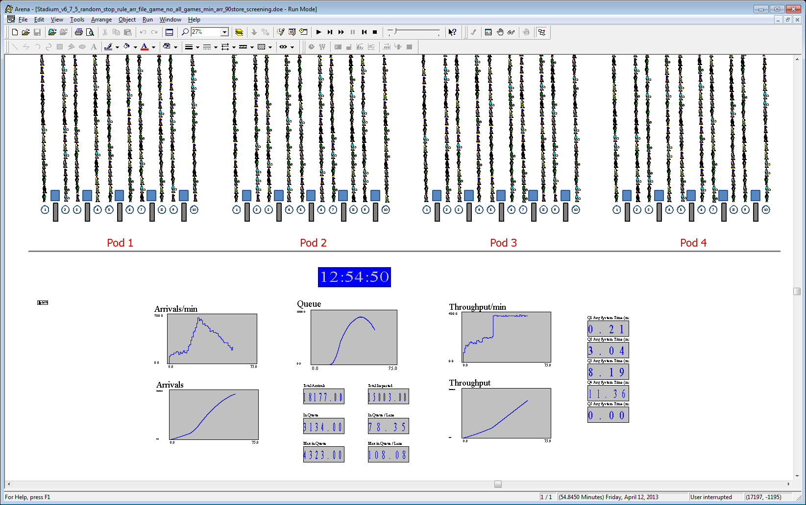
The Simulation Model
Most of the parameters can be obtained by choosing a representative game
Parameters
  Arrival rates
  Number of lanes
  Wanding times
  Pat-down times
  Magnetometer times
Screening Strategy
  Switching inspection type (Y/N)
    Number of patrons in queue to switch the process, or
    Time of switch
  Does phase 2 include randomization? (Y/N)
    Ratio of patrons in each type of inspection in the randomization
The model output file includes:
  Total Arrivals
  Total Arrivals @ kickoff
  Maximum number in Queue
  In Queue @ kickoff
  Queue clearance time
  Screening switch time
  Number of patrons inspected by different procedures
  Max Waiting Time per patron
46

Slide 47
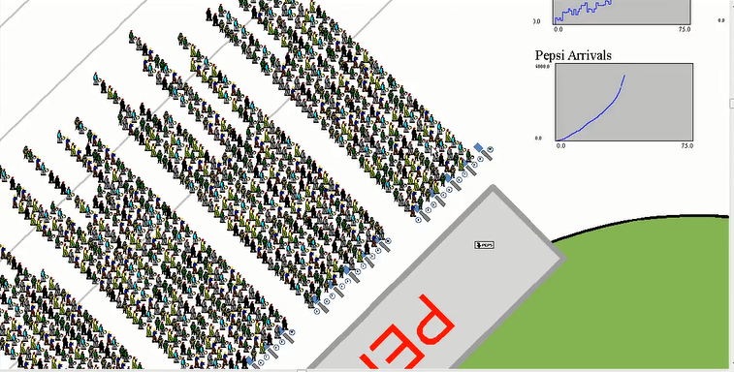
Simulation of Patron Screening
CCICADA’s Patron Screening Tool
  Visual of the SIMULATION MODELS
  Multiple Gates
    Single Gate
47

Slide 48
Simulation Results
CCICADA-MetLife Stage II Cont’d
The model was first used in 2013 to determine if MetLife stadium could switch to magnetometers for screening patrons.
A switch to magnetometers would involve a serious investment, so it was important to make the determination BEFORE purchasing the mags.
48

Slide 49
Simulation Results
CCICADA-MetLife Stage II
Goal: get patrons in by 5 minutes after kickoff; other goals can be modeled
Compared new procedures to the “base case”: wand patrons until queue gets too long, then switch to pat-downs.
We compared queue clearance times with various numbers of magnetometers to the base case.
Model clock starts at 0 at 60 minutes before kickoff, so goal is to clear queue by 65 minutes
49

Slide 50
Magnetometer Scenarios (Queue Clearance)
50

Slide 51
Wanding Only?
CCICADA’s Patron Screening Tool
After determining that a switch to magnetometers would not be feasible unless very large investment, it was asked if screening could be done with wanding only.
(This in contrast to the base case of wanding + switch to pat-downs when queue gets too long)
51

Slide 52
Wanding Scenarios (Queue Clearance)
52

Slide 53
Flexibility of the CCICADA Tool
The process for doing analysis at other venues is straightforward.
For the specific venue, one needs to determine the appropriate fixed parameters and construct an arrival function for specific events for which they have data.
By considering different screening protocols and varying the number of screening lines, one can do what-if experiments for the specific venue.
53

Slide 54
What if you Cannot Get Everyone through with Magnetometers (or Wanding)?
Randomization
  Randomization is a possible policy.
  Various ideas:
    Select some patrons for magnetometers and others for pat-down – at random
    At some point, randomly select lanes to shut down magnetometers and start pat-downs
  CCICADA’s inspection tool allows us to test any of these policies too
54

Slide 55
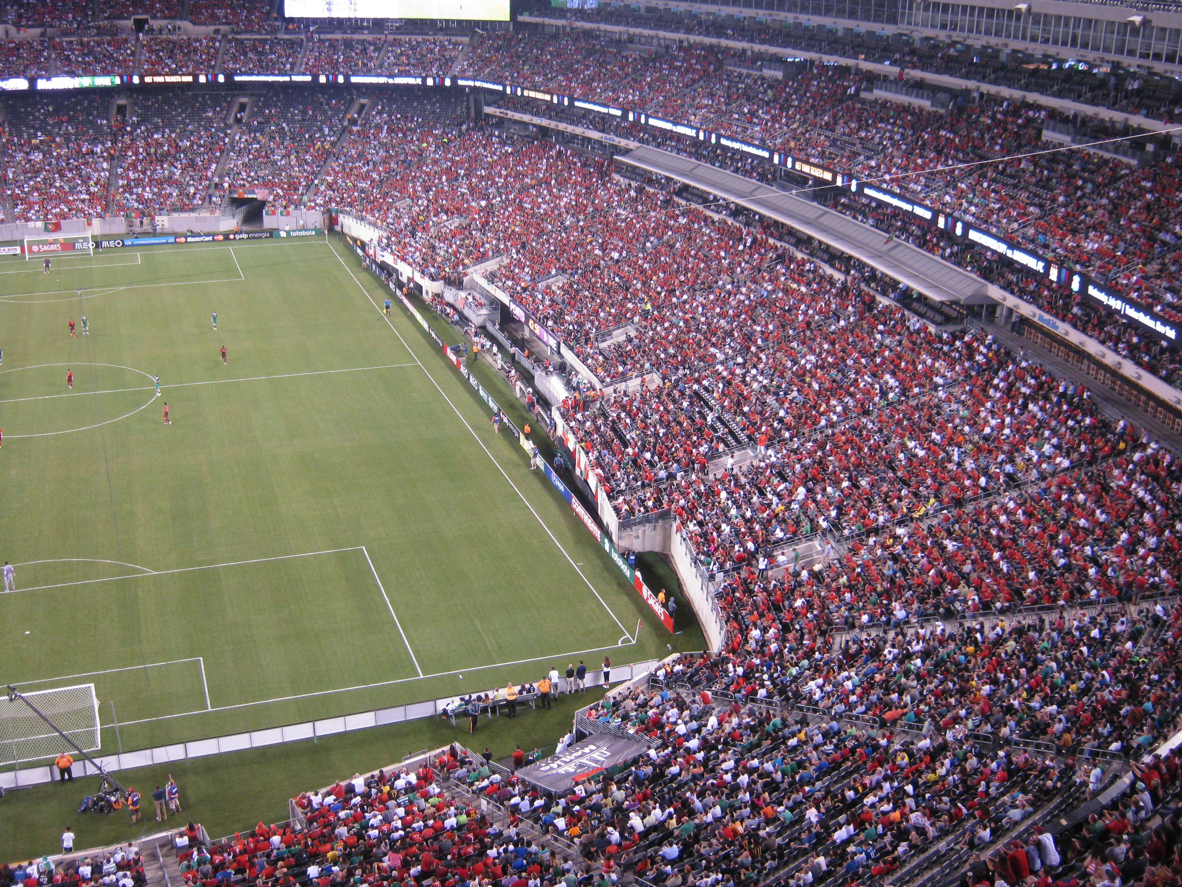
Continuing Work on Magnetomers
CCICADA-MetLife Stage III
  MetLife decides on new experiment with magnetometers in Spring 2014
  CCICADA met with MetLife to help design the protocol – how many screeners per magnetometer, roles of the screeners, physical arrangement of the screening
  CCICADA observed physical set up a few days before experimental use
  June 10, 2014: experimental use of magnetometers at main gate during
  soccer match Portugal vs. Ireland
55

Slide 56
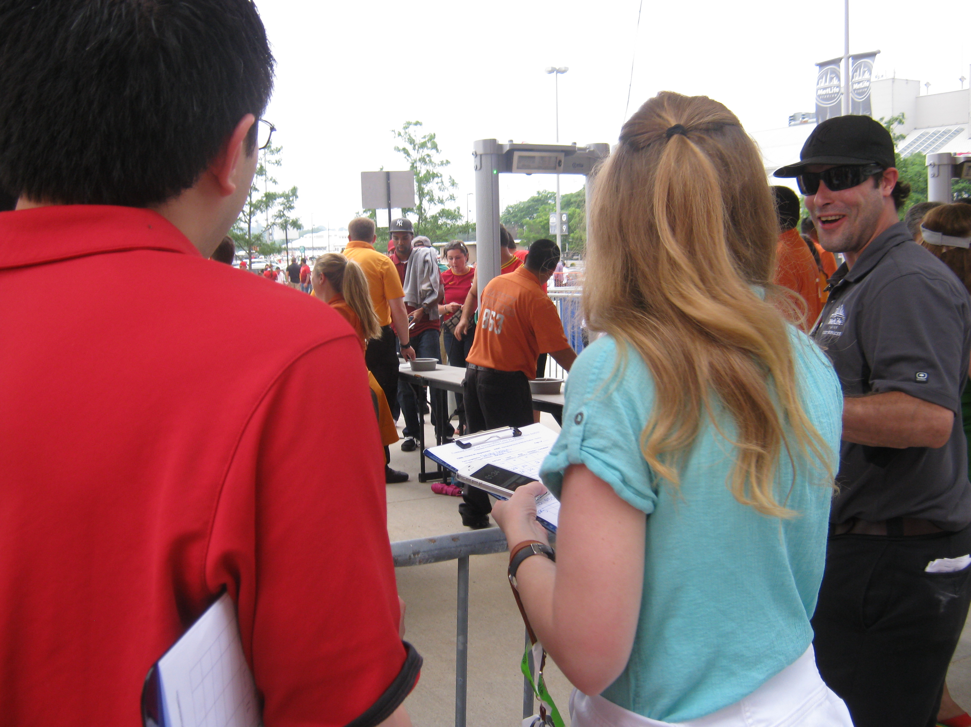
Continuing Work on Magnetomers
CCICADA-MetLife Stage III
  Game Day Observations at Soccer Match June 10:
    Observe training and implementation of training: Supposedly easier to train than wanding
    Calculate throughput
    Observe and comment on problems observed
    Calculate throughput at other gates that used wanding followed by pat-downs
    Compare throughput from both methods
    Data being analyzed
    Already led to plans for new tests
56

Slide 57
Future Research
Analysis of Security Screening Processes: More to Do
  Investigate behavioral issues:
      How does changing screening procedures affect fan behavior/arrival rates?
      Can patrons be encouraged to move to gates with shorter lines?
  Study randomization designs and implementation.
  Study sequential decision protocols similar to the “binary decision tree”methods developed by CCICADA for use at ports of entry.
57

Slide 58
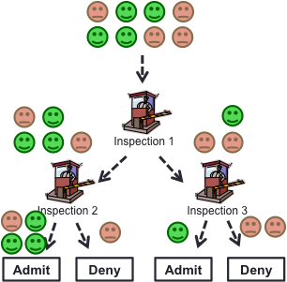
Future Research
Analysis of Security Screening Processes: More to Do
  Model layered screening procedures –
    CCICADA worked on a model for layered defense at stadiums under support from the Domestic Nuclear Detection Office
58

Slide 59
Engaging with the Academic Community
All NFL venues have potential university partners, whether a CCICADA affiliate or other university.
Not every university has researchers with the background to work on stadium security issues.
You may be better off going to a university not in your backyard
Or asking such a university to partner with a local university
It has taken CCICADA a number of years to understand the problems of its stadium partners and to develop tools to work with stadium
security problems.

Slide 60
Engaging with the Academic Community
Engaging with the academic community can lead to some “outside the box” ideas
A fresh set of ideas
A fresh set of eyes
Next: a few things we have observed or learned that at least several people told us were surprising to them

Slide 61
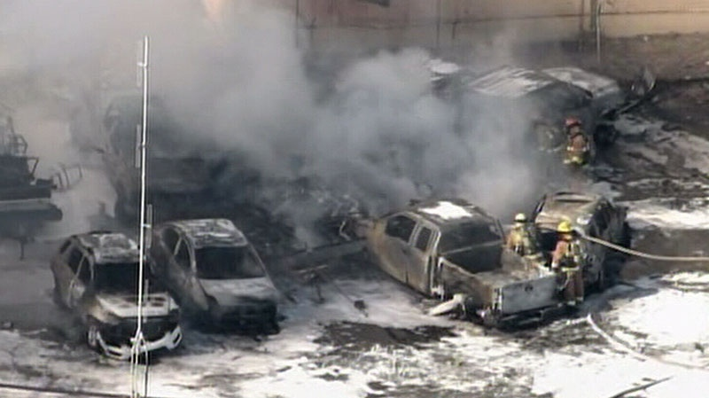
Selection of Surprising Observations
Cyber-physical systems: Physical systems increasingly run by cyber systems. Dangers of hacking into those systems.
We can already hack into a Prius and make it do things the driver can’t control. Nightmare scenario: Hacking into a car in the parking lot
Credit: ctvnews.ca
61

Slide 62
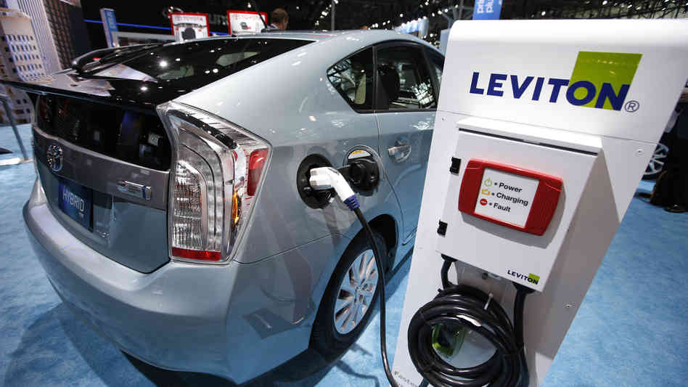
Selection of Surprising Observations
Car Hacking in the Parking Lot
2013: Miller (Twitter) and Valasek (IOActive) demonstrated take control of Toyota Prius and Ford Escape from a laptop.
They were able to remotely control:
  Smart steering
  Braking
  Displays
  Acceleration
  Engines
  Horns
  Lights
Credit: npr.org
62

Slide 63
Selection of Surprising Observations
Having a venue invite a security expert from another venue to visit and observe security procedures could help your venue avoid carelessness or suggest new concepts.
Issues in implementation of magnetometers:
  Mobility: placing on wheels and the impact on effectiveness and certifiability;
  Power source – battery or wire;
  Future development of “wider” magnetometers allowing several people side by side might help throughput and take advantage of theoretical tools such as “combinatorial group testing”
63

Slide 64
Selection of Surprising Observations
Innovative uses of social media: Surprisingly, some of the stadium security officers interviewed were not aware of the extensive use of social media by their own stadiums, e.g., in developing “apps” that would benefit patrons and increase communication with them.
Sharing with Nearby Venues: Right now, venues generally do not share software or hardware. Could they? Could they share magnetometers? Could there be multi-venue CCTV monitoring centers? It could save them funds. However, are there vulnerabilities resulting from this?
64

Slide 65
Selection of Surprising Observations
Rotation of screening jobs to maintain effectiveness. The use, and therefore the effectiveness, of some security procedures, such as wands for metal detection, is very inconsistent, varying from screener to screener. It can also degrade for individuals, as they get tired or bored.
Food security is an issue addressed with widely varying degrees of effectiveness and thoroughness. Effective measures can be as simple as putting out condiments in packets, rather than large dispensers that make targets of opportunity for chemical or biological agents.
65

Slide 66
Selection of Surprising Observations
Information about the physical facilities at a stadium is often available to the public, e.g., when new building plans are filed. This could be a serious vulnerability.
Background checks for employees are a key component of a stadium security plan. But it is very difficult to find out about changes in background after an employee has been hired. How does one find out about new problems with the law, for example? Could repeat of background checks in a randomized way be useful?
66

Slide 67
Selection of Surprising Observations
Domestic violence/workplace violence: Disgruntled spouses and others can be a problem. Does the stadium obtain information about restraining orders that employees are served?
Do employees receive a copy of an emergency plan? Are they required to return it when they leave employment? Do they receive it electronically and, if so, how can we be sure they do not make and/or maintain a copy?
67

Slide 68

What Makes Working with Academics Successful?
68

Slide 69
Why Working with MetLife Succeeded
  Openness to having university folks around
  High-level buy-in from the team/venue
  Willingness to educate university researchers (faculty and students) as to processes and problems
  Each venue is different: sharing venue information
  Sharing of data
    Videos of inspection processes
    Ticket scan data
  Access to facility
  Non-disclosure agreements
  Patience: Relationships take time to develop
69

Slide 70
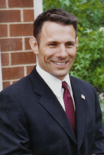
Why Working with MetLife Succeeded
70

