Slide 1
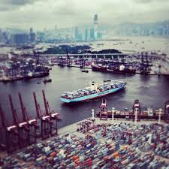


Combined Cyber and Physical Attacks on the Maritime Transportation System
Fred S. Roberts
Director
Command, Control, and Interoperability Center for Advanced Data Analysis (CCICADA)
Source for all images: wikimedia commons
1

Slide 2
Combined Cyber and Physical Attacks
A great deal of discussion about physical security in the maritime transportation system (MTS).
  Leads to standards, regulations, etc.
Increasing interest in cyber security in the MTS.
  Leading to discussion of best practices.
But more sophisticated attacks will be multi-modal.
Could lead to more harm.
Simple example: hacking into security cameras at a port increases vulnerability to a physical intrusion.
Special case: cyber attack as precursor to physical attack, or vice versa.
Will present scenarios and discuss their
likelihood.
2

Slide 3
Combined Cyber and Physical Attacks
Our examples derive from input from a variety of subject matter experts (SMEs):
  CAPT Michael Dickey, USCG
  Mark Dubina, Port of Tampa Bay
  Casey Hehr, Port of Long Beach (USCG – ret)
  CAPT David Moskoff, SUNY Maritime
  VADM Rob Parker, USCG-ret
  Randy Parsons, Port of Long Beach
  Daniel Searforce, Pennsylvania Public Utilities Commission
  Drew Schneider, Port of Long Beach
  CAPT Andrew Tucci, USCG-ret
  CDR Nick Wong, USCG
  Michael Young, TSA and Secret Service – ret
3

Slide 4
A Simple Example: Fake News
Fake news could be spread via social media.
Something is happening at Pier F in the port.
Draws first responders to Pier F.
  “Everyone runs to the soccer ball”
Actual intent is to attack Pier L, which now may have less protection.
Another version: hack into a company’s or agency’s email system and generate an official-looking report about Pier F.
John Smith
@johnsmith
There is a shooter at Pier F
2:23 PM 6 Dec 2017
Tina Jones
@tinajones
People shot at Pier F
2:22 PM 6 Dec 2017
4

Slide 5

A Simple Example: Fake News
Another version: Spread news that a celebrity is at Pier F; draw a crowd; then attack the crowd.
  “Justin Bieber is at Pier F”
Source: wikimedia commons
5

Slide 6
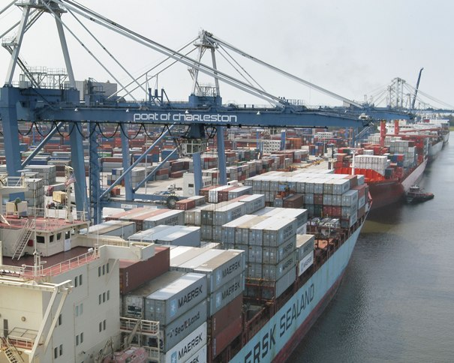
A Simple Example: Fake News
A port facility protection plan should prevent leaving one area unguarded.
How can defenders mitigate a tsunami of false reports? Can they plan for ways to get out their own messages?
Credit: ADM Chuck Michel
6

Slide 7
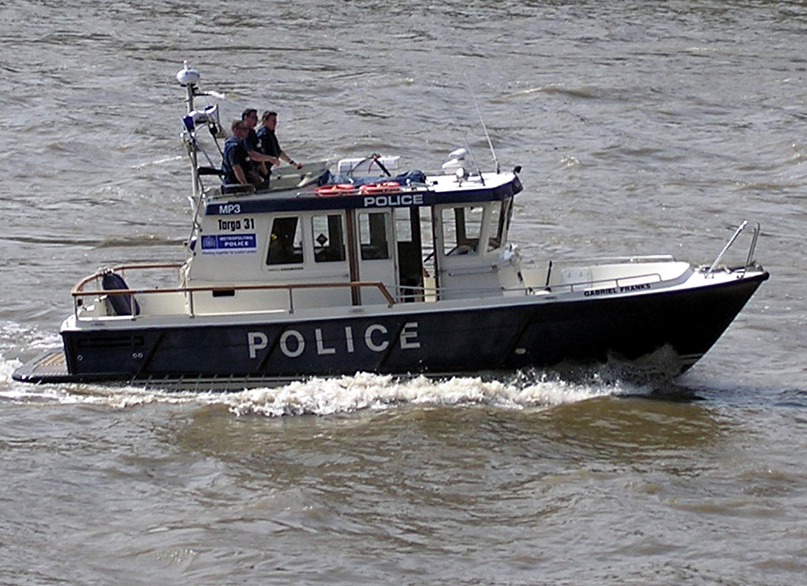
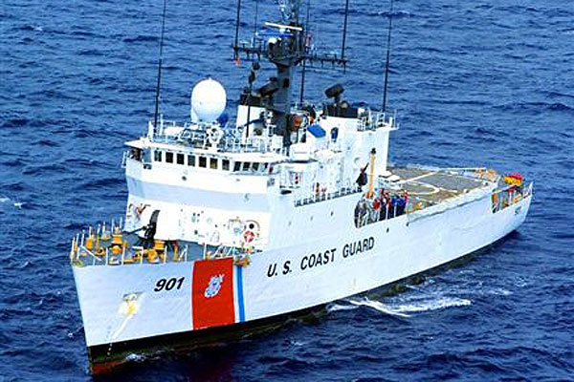
A Simple Example: Fake News
There are physical versions of this idea of using cyber methods to create a distraction.
Hezbollah attacked first responders in Israel
  Set off an IED in a car.
  Draws first responders to a muster point.
  Attacked the muster point with a bigger bomb.
An adversary could create a distraction in the water, drawing police boats and USCG vessels to the area, leaving another part of the port unprotected.
Credit: commons.wikimedia.org
7

Slide 8
More Sophisticated Attacks on a Port
Cyber attack on operating systems in the port making a following physical attack more likely to succeed:
  Shut the gates so people are trapped inside and first responders are trapped outside.
  Turn off the lights – make it easier for physical attackers.
  Turn off the alarms – make it easier for physical attackers to avoid detection.
  Disable the cameras – make it easier to avoid detection.
  Interrupt the power supply.
  Disable cyber-enabled traffic lights to create traffic jams - emergency vehicles unable to respond to a physical attack.
  Hack into emergency communication system and tell first responders to go to a different place.
  Spoof TWIC cards or other access control systems
  to let the “bad guys’ in.
8

Slide 9
More Sophisticated Attacks on a Port
Many of these seem feasible.
But an adversary with this level of sophistication might find it is easier to do a more intrusive physical break-in.
Likelihood of a given scenario needs to be taken into consideration.
More generally, consider threat, vulnerability, and consequence in determining the risk of a given attack scenario.
Not surprisingly, the SMEs we talked to
didn’t always agree as to likelihood or risk.
9

Slide 10
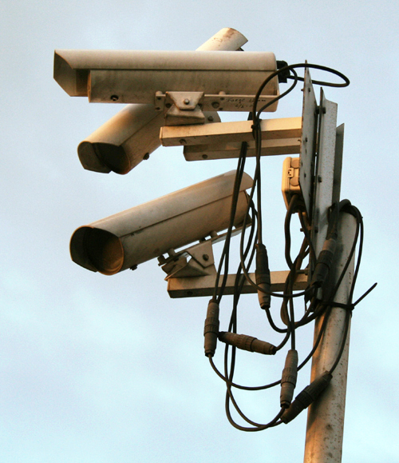
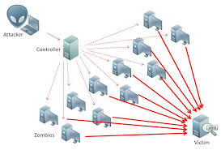
More Sophisticated Attacks on a Port
Disabling cameras may have a high level of risk because they are often add-ons.
Hacking into the emergency communications
system depends upon how it is configured.
  If connected to the Internet, certainly possible.
  Jamming communications might be easier.
  One SME felt that port security would quickly determine that this was a hack and limit first responders going to the wrong place.
A Denial of Service Attack could turn off
the lights or the alarms.
A cyber attack on the power supply could
have significant consequences since many
terminal operations do not have backup
generators.
10
Credit for both images: commons.wikimedia.org

Slide 11
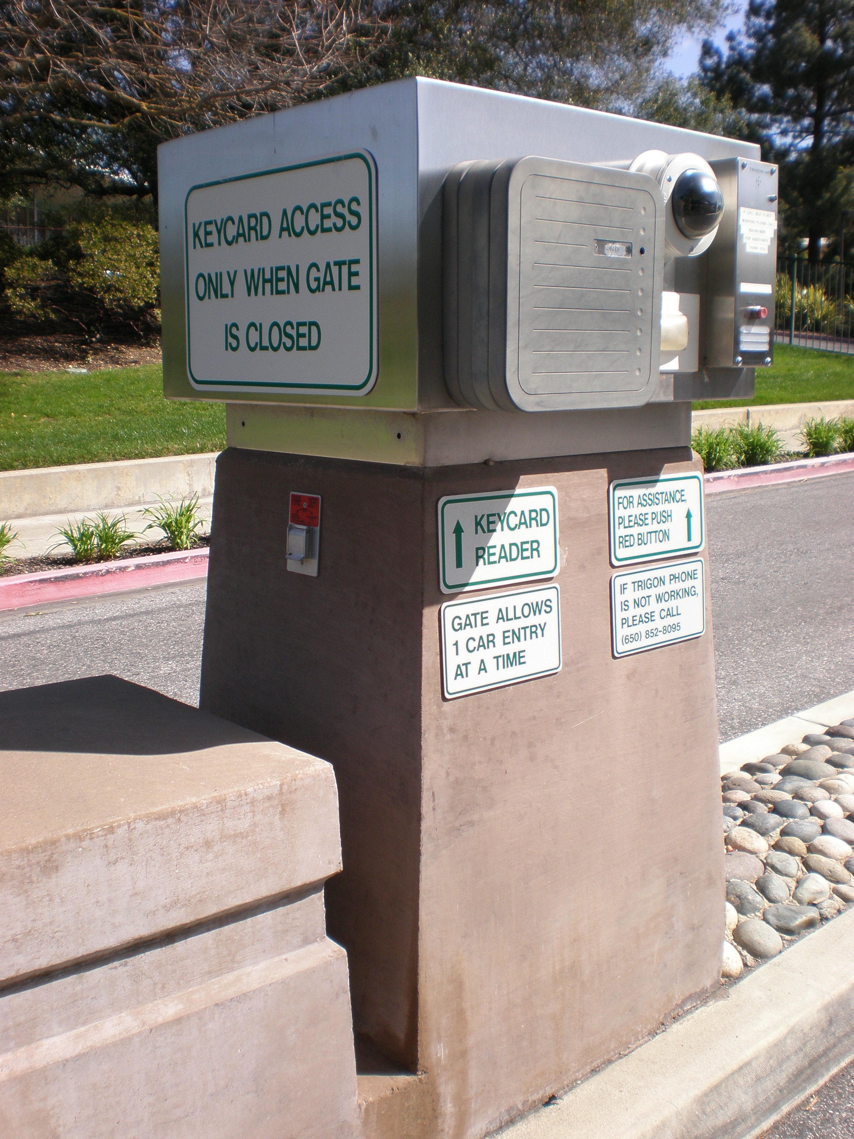
More Sophisticated Attacks on a Port
At some operating ports, one system handles all gates. At others, there are individual gate controls. Which is less vulnerable?
By sheer size, ports might not be so vulnerable to access control hacks; airports or schools or hospitals might be more vulnerable.
Doors or gates locked by access control systems are supposed to have overrides for life safety.
  Typically a mechanism to break the circuit.
  So this scenario might be less likely since the
  “bad guys” wouldn’t buy much time.
Credit: commons.wikimedia.org
11

Slide 12
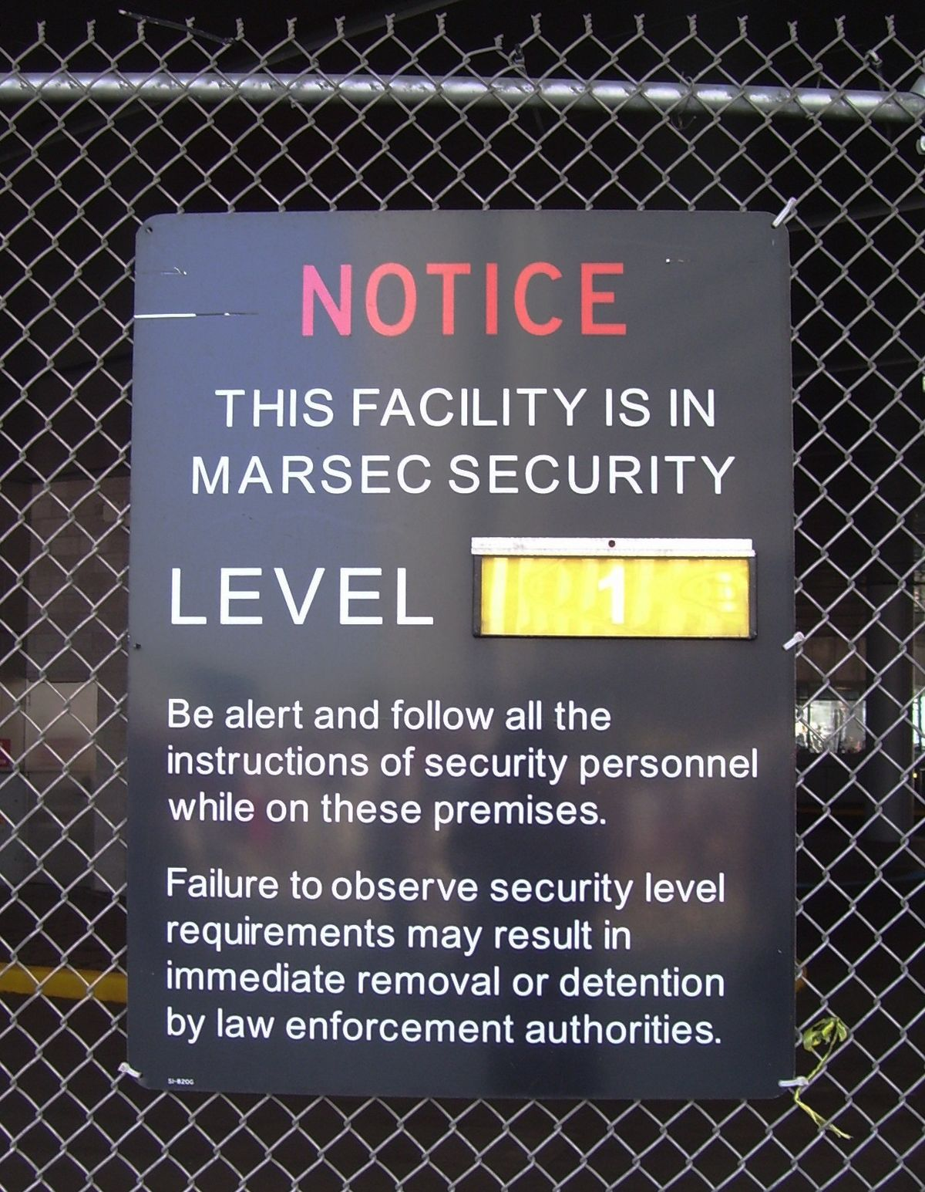
More Sophisticated Attacks on a Port
Do ports have plans to respond quickly to these various cyber scenarios that could be preliminary to a physical attack?
The speed with which first responders could respond would depend upon the port’s Facilities Security Plan.
It might also depend on the MARSEC level.
Source: En.wikipedia.org
12

Slide 13
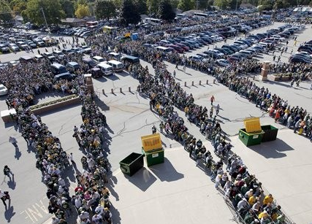
Port Security can Create Vulnerabilities
Large sports and entertainment venues use walkthrough metal detectors or other systems to screen patrons
The long lines waiting to be screened create vulnerabilities.
  After the Boston Marathon attacks, sports stadiums sought to minimize vulnerabilities by creating an outer perimeter with initial screening.
Lambeau Field – Mike Roemer/AP
13

Slide 14
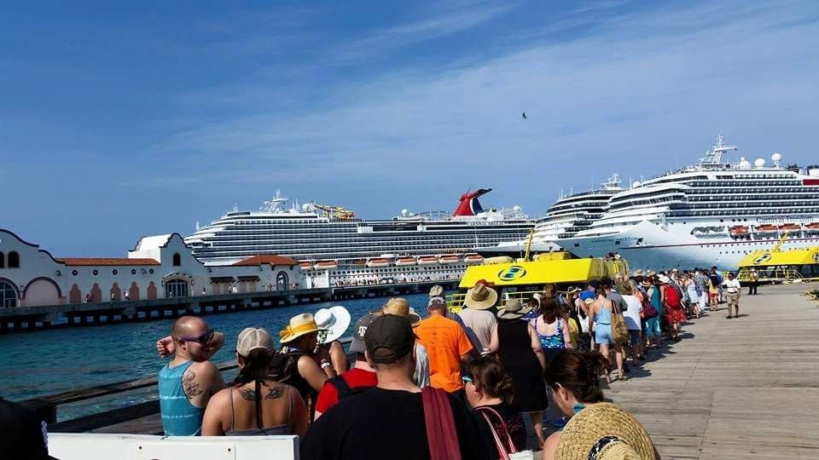
Port Security can Create Vulnerabilities
At a cruise ship terminal with many ships leaving at roughly the same time, lines form outside the building.
  Passengers are initially vetted to see if they have a valid ID and are at the right terminal. An attacker should not get past the screener.
  Unless they bought a cheap ticket …
Credit : commons.wikimedia.org
14

Slide 15
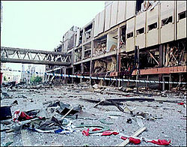
Port Security can Create Vulnerabilities
The 2017 attack at the Ariana Grande concert in the Manchester Arena showed that patrons leaving an arena could be vulnerable.
  What if they were “drawn out” in a group by hacking into the arena’s emergency communication system or “message board”?
In general, debarking at cruise ship terminals does not have as many vulnerabilities as embarking.
  Passengers are released in groups to avoid standing in line at customs.
  There is good departing security.
  Operators think you are ok once you leave the dock.
  But what if a hacker could manipulate an alarm
  system to get them all to debark at the same time?
  There is still an under-appreciation of
  debarking vulnerabilities.
Manchester arena after attack
Credit: en.wikipedia.org BBC picture
15

Slide 16
Port Security can Create Vulnerabilities
Could a hacker manipulate an alarm system (e.g., fire alarm) and perhaps a communication system to get passengers to debark at the same time?
That might depend upon whether the alarm system and communication system were online.
Port fire alarm systems are not too sophisticated
  They are designed to operate over a network and push a signal out to a monitoring agency.
  It might be a challenging hack to get into this system.
Physically setting off the fire alarm might be more likely to succeed.
16

Slide 17
Port Security can Create Vulnerabilities
Even if a “bad guy” could get the fire alarm going, would this create the desired problem?
If a fire alarm goes off in a cruise ship port, there are many people trained to direct passengers where to go.
  Those people would more likely be used than an audible emergency message.
So the scenario of additionally hacking into a communication system is not very likely to have the desired effect.
In some port systems, if a fire alarm goes off, certain doors open up.
Thus a physical attack on the alarm system could create access to an attacker seeking to introduce
malware into a port operations or cargo
handling system.
17

Slide 18
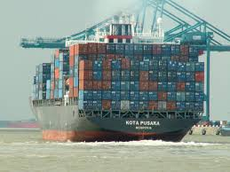
Taking Advantage of Port Congestion
Port congestion is a big problem in all ports.
Large container vessels add to the congestion problem.
  Used to be several smaller vessels in port at the same time – using different terminals.
  Now there is one large one – requiring all of its unloading/loading at one terminal.
The scheduling of trucks picking up or delivering containers is controlled by a cyber system.
A simple denial of service attack could impact the ability to offload a large ship in a timely way
Resulting in traffic jams in the port area.
Creating the possibility of having a serious
impact by throwing a bomb.
18
Credit : commons.wikipedia.org

Slide 19

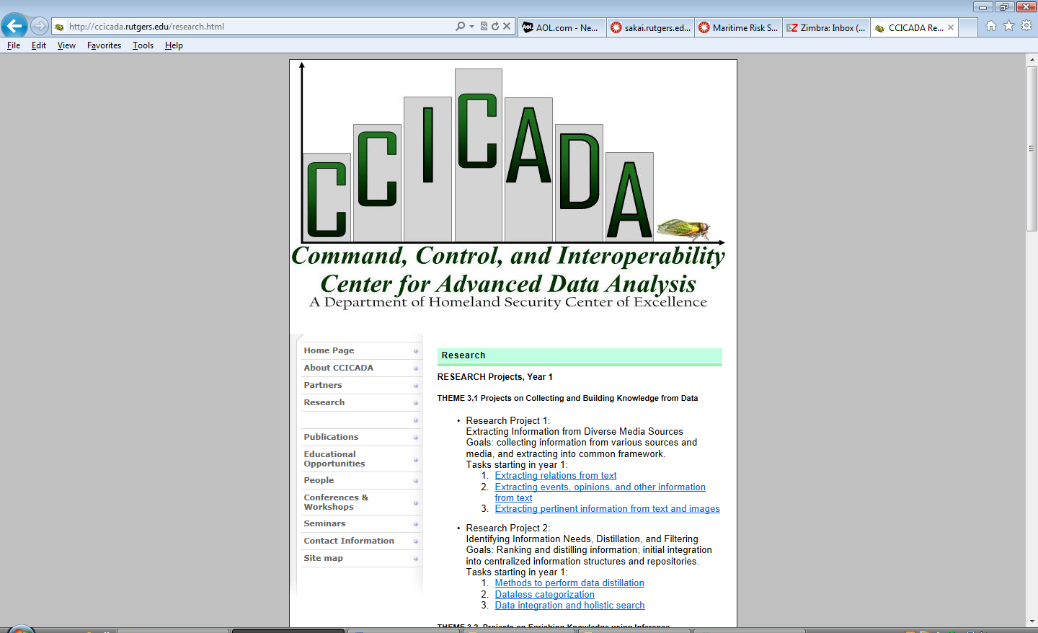
Autonomous Vehicles in Ports
Terror attacks using vehicles on the rise:
  Berlin, Nice, London, New York
The lines of passengers lining up to embark on cruise ships could be vulnerable to this type of attack.
But terrorists ended up dying in the process.
What if they could control a vehicle remotely and not risk dying?
Christmas Market Vehicle Attack, Berlin, Dec. 2016
Credit: wikipedia.org
19

Slide 20

Autonomous Vehicles in Ports
Car hacking: “bad guys” remotely take control of your car
  Steal it.
  Use it as a weapon?
A serious challenge as in-car technology becomes more sophisticated
Already thousands of semi-autonomous cars
  In-car computer systems
  Electronic control units
Coming: fully autonomous cars
  Self-driving cars
Credit: wikipedia.org
20

Slide 21
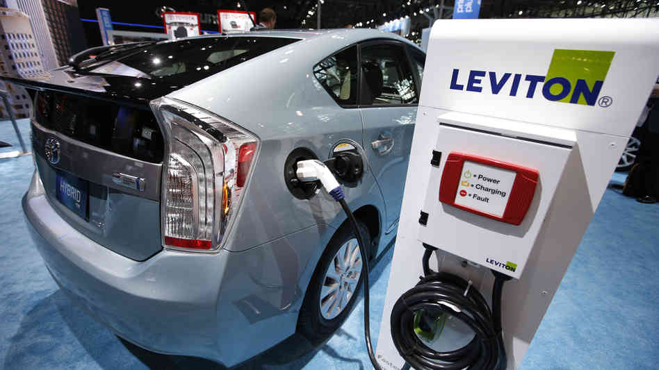
Autonomous Vehicles in Ports
2013: Miller (Twitter) and Valasek (IOActive) demonstrated take control of Toyota Prius and Ford Escape from a laptop.
They were able to remotely control:
  Smart steering
  Braking
  Displays
  Acceleration
  Engines
  Horns
  Lights
Credit: npr.org
21

Slide 22
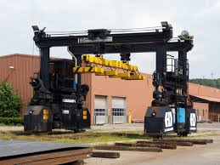

Autonomous Vehicles in Ports
Already, many ports are operating with autonomous vehicles.
At the Long Beach container terminal:
  Gantry crane operator brings container to truck.
  Computer lowers container to autonomous truck.
  Truck takes it to storage area or non-autonomous truck.
  Autonomous trucks even monitor their battery life and drive themselves to charging station for a recharge – operated by a robot.
Credit: Daimler
22
Credit: Wikimedia commons

Slide 23
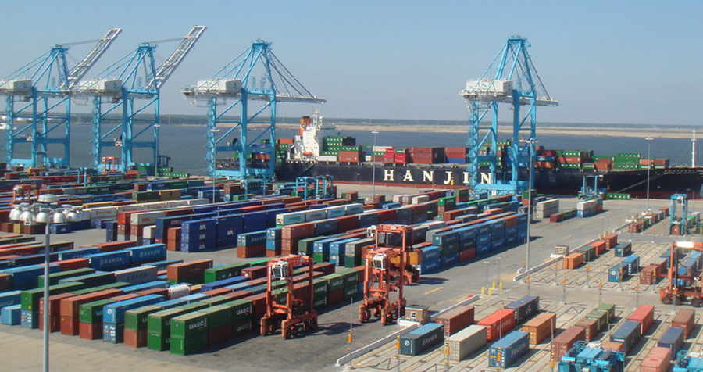
Autonomous Vehicles in Ports
The Hampton Roads container terminal is completely automated, robotic, and intermodal (rails, cars, trucks).
Cranes are run from an office.
All vehicles are autonomous.
Source: virginiaplaces.org
23

Slide 24
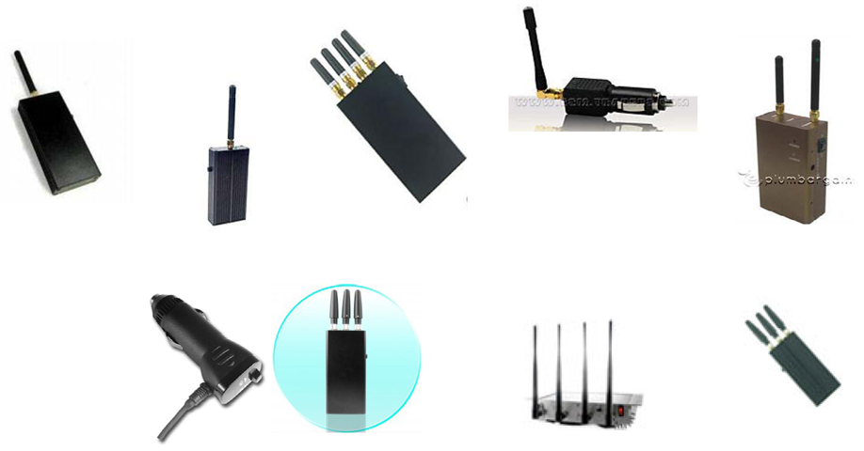
Autonomous Vehicles in Ports
Could an autonomous truck be used as a weapon in a port scenario?
Technically possible. An adversary could use low-cost jammers to jam the GPS that makes the autonomous vehicle work.
GPS jamming is possible with low cost jammers available over the Internet (though illegal).
Many devices are battery-operated or can be plugged into a cigarette lighter and cost as little as $20.
  Credit: CAPT David Moskoff
24

Slide 25
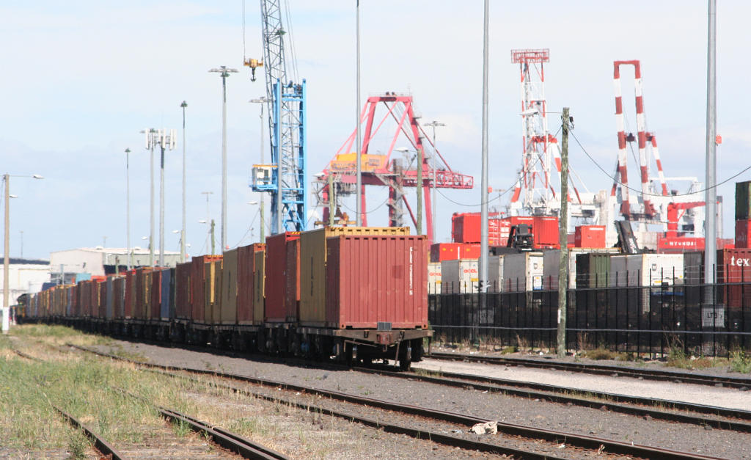
Autonomous Vehicles in Ports
The hacking might seem harder to do than hijacking a truck and driving it into the port to create havoc.
Also, where autonomous trucks operate in a port, they are blocked from people, so would more likely damage infrastructure.
This suggests risk of this scenario is not so high.
But automated vehicles in ports create other problems: could a “bad guy” hack into the control system and arrange to put the “wrong” box on the wrong train, or take it to the storage facility and open it?
Credit: commons.wikimedia.org
25

Slide 26

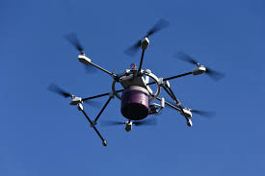
Drones
Unmanned aerial vehicles might be a much bigger risk to a port than unmanned trucks.
Ports have a great deal of hazardous material readily attacked from the air (LNG, gasoline, etc.)
Prof. Todd Humphreys of UT Austin has demonstrated how GPS signals of an unmanned aerial vehicle can be commandeered by an outside source.
How do you mitigate against hackers taking over a drone and dropping it on hazardous material?
You can’t knock it out of the air because that itself could cause it to drop on hazardous material.
Ports don’t have authority to take over a drone and take it down.
Sources: wikimedia commons,
UT Austin Aerospace Engineering
26

Slide 27
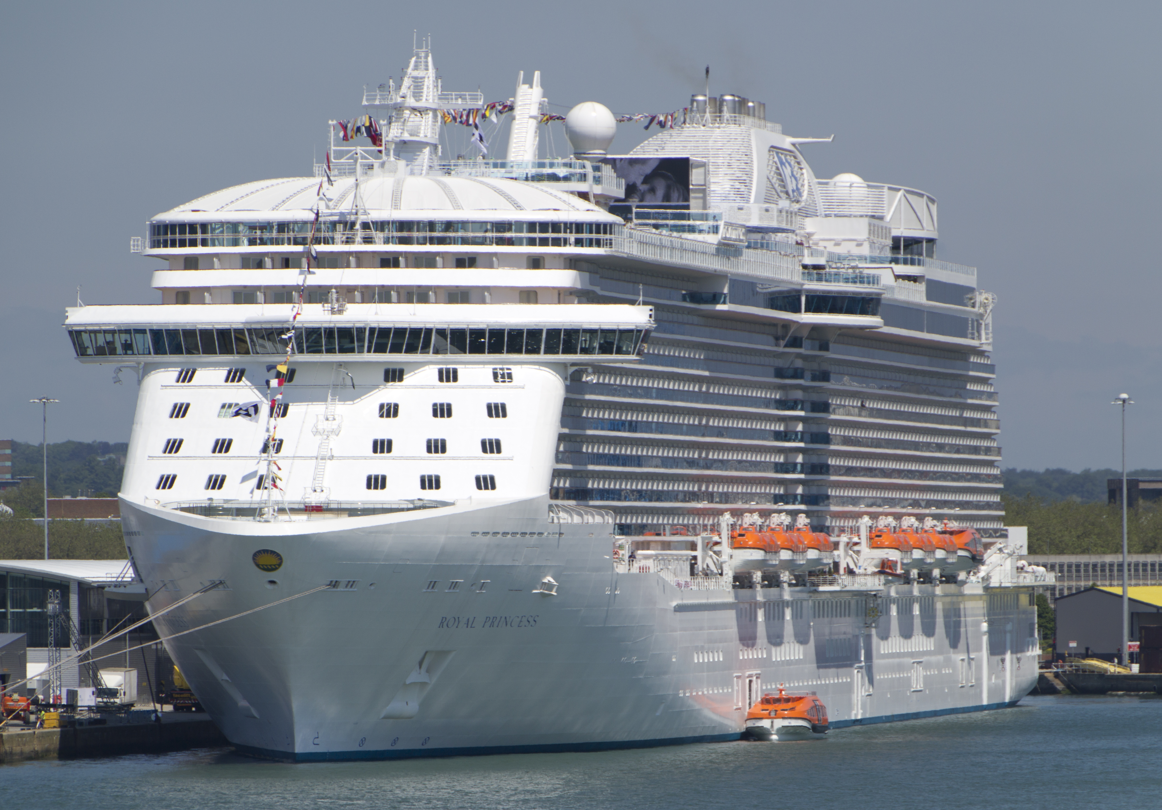
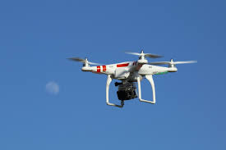
Drones
A drone could also be a threat to a vessel entering or leaving a port.
Could an attacker hack into a drone and have it land on the deck of a nearby cruise ship?
You might cause some panic this way.
A scenario with a large impact would be to load it with explosives and have it land on the deck and then create an explosion.
27
Credit for both images: commons.wikimedia.org

Slide 28
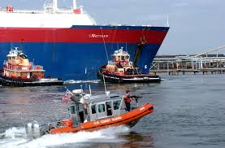
Hazardous Materials
As noted, ports have a lot of hazardous materials.
Gigantic LNG ships enter directly into the city of Boston to dock at the LNG terminals in Boston Harbor.
  One of the few ports in the world (and only one in US) where this happens.
Could a cyber attack on an LNG ship cause it to careen off course and create an explosion?
Not likely – there are tugs on it and and Coast Guard keeps other vessels away.
Credit: commons.wikimedia.org
28

Slide 29
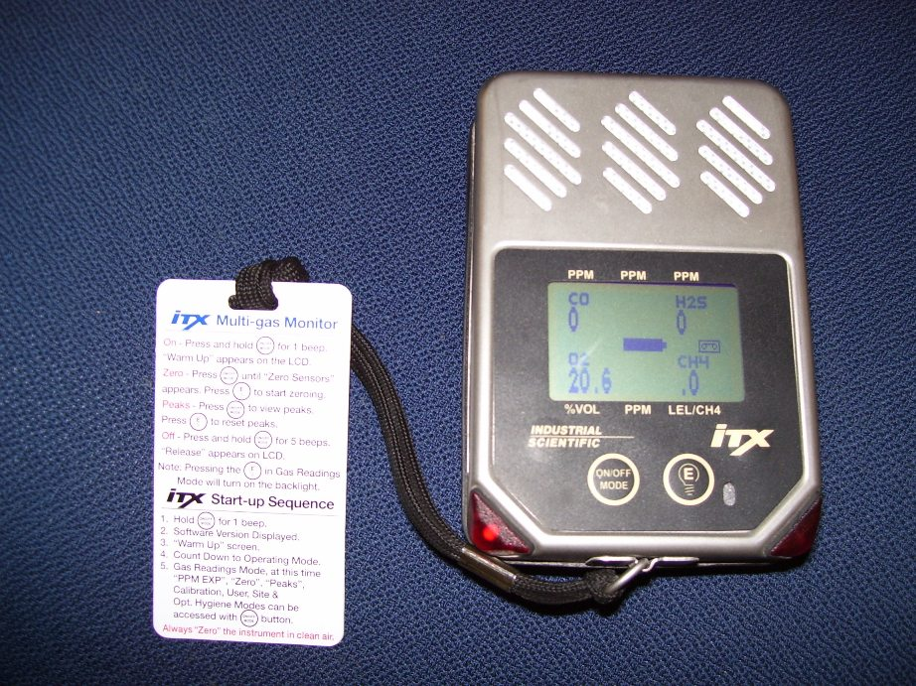
Hazardous Materials
However, once the ship is in the terminal, if an adversary could access its industrial control systems, they could cause a serious problem.
There are pumps, valves, etc. (operational technology – OT) run by software/computers (IT systems).
Hacking into those systems could conceivably lead to an explosion in light of the hazards from LNG.
How likely is this scenario?
At least one of our sources had this as his nightmare scenario.
Credit: en.wikipedia.org
29

Slide 30
Hazardous Materials
Maybe this isn’t so far-fetched.
The Stuxnet is a malicious computer worm that targets industrial computer systems.
It put a virus into a controller running centrifuges and damaged them – causing substantial damage to Iran’s nuclear program.
Similarly, an adversary could hack into a sensor system, e.g., affecting tank level indicators, pressure sensors, temperature sensors, hazardous gas sensors.
A leak or build-up of pressure or a fire might not be detected, thus possibly leading to an explosion.
30

Slide 31

Hazardous Materials
More on hacking into sensor systems:
  Sensor systems other than those used on a vessel could
  also be hacked.
  An explosion or fire started at some other port facility from a hack into a sensor system could serve as a distraction and make it easier to succeed with a physical attack.
  A bad actor could also hack into the system to set off a false alarm that could serve as a distraction.
Could an adversary start a cyber attack by first physically starting some hazardous materials on fire or releasing noxious gases, creating a diversion?
This might allow them to gain access to a facility and hack into it.
31
Image Credit: en.wikipedia.org

Slide 32
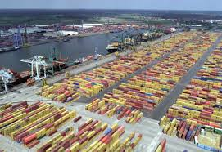
Cargo
Port of Antwerp is one of the world’s biggest.
2011-2013: Hackers infiltrated computers connected to the Port of Antwerp, located specific containers, made off with their smuggled drugs and deleted the records.
Attackers obtained remote access to the terminal systems; released containers to their own truckers without knowledge of the port or the shipping line.
Access to port systems was used to delete information as to the existence of the container after the fact.
Source: Reuters 4/23/14, CyberKeel
Credit: wikipedia.org
32

Slide 33
Cargo
The hackers began by emailing malware to the port authorities and/or shipping companies.
After the infection was discovered and a firewall installed to prevent further infections, the criminals broke into the facility housing cargo-handling computers and fitted devices allowing wireless access to keystrokes and screen shots of computer screens.
The first part of this was a cyber attack preceding a physical attack (stealing cargo).
The second part was a physical attack (breaking in) preceding a cyber attack, which in turn preceded a physical attack (stealing cargo).
Source: Bell 2013, Mulrenan 2014, Woodland Group
33

Slide 34

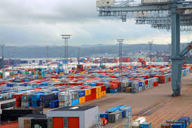
Cargo
In 2012 it was revealed that crime syndicates had penetrated the cargo systems operated by the Australian Customs and Border protection.
The penetration of the systems allowed the criminals to check whether their shipping containers were regarded as suspicious by the police or customs authorities.
The consequence was that containers with contraband were abandoned whenever such attention was identified by the criminals.
Others could be handled without worrying about the police.
Credit: CyberKeel
Credit: commons.wikimedia.org and en.wikipedia.org
34

Slide 35
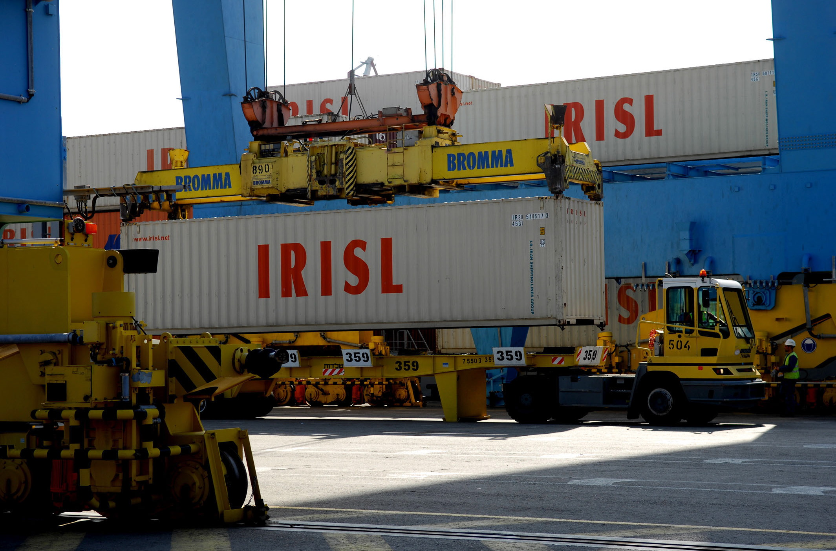
Cargo
The Iranian shipping line IRISL suffered from a successful cyber attack in 2011.
The attacks damaged all the data related to rates, loading, cargo number, date and place.
This meant that no one knew where containers were, whether they had been loaded or not, which boxes were onboard the ships or onshore.
Even though the data was eventually recovered, it led to significant disruptions in operations and resulted in sending cargo to wrong destinations causing severe financial losses.
Additionally, a considerable amount of
cargo was lost.
Credit: CyberKeel
Credit: commons.wikimedia.org
35

Slide 36
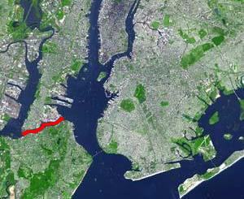
Blocking the Port Entryway
Could an adversary block entry to a port from the water through a cyber attack?
The chokepoint for a port is the channel. Blocking it could create a big problem.
Consider for example the Kill van Kull in New York – if an adversary could cause a vessel to run aground there, this would create a huge problem.
If an adversary could do this, they could create a great deal of economic damage if the port remained closed for a period of time.
Kill van Kull
Credit: en.wikipedia.org
36

Slide 37
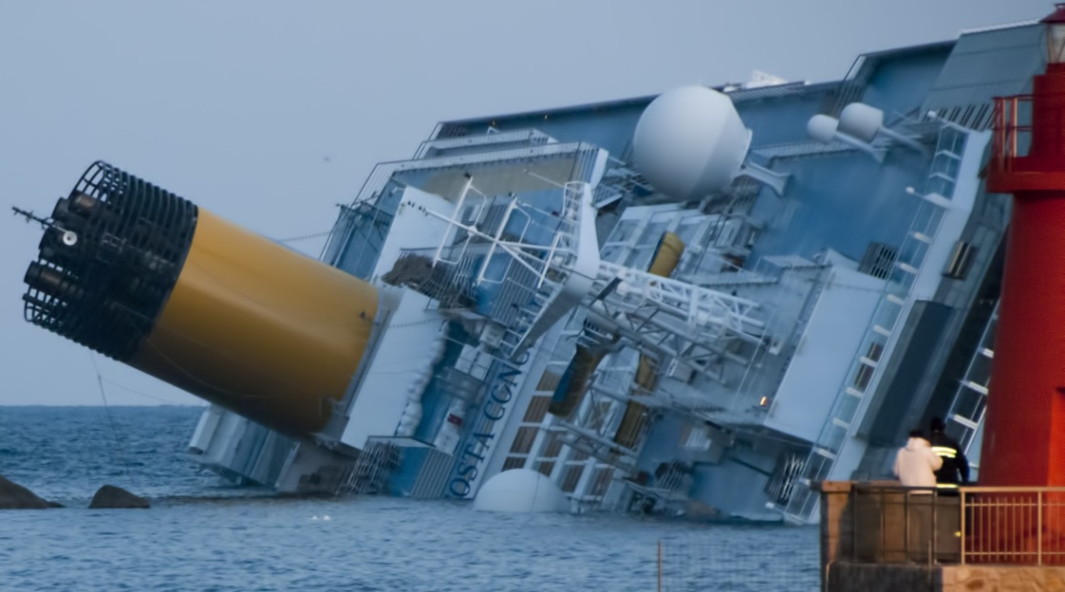
Blocking the Port Entryway
In a bad case, the port could remain closed for a year or more.
  Look how much time it took to get the grounded Costa Concordia cruise ship off the rocks.
An adversary could also divert port resources to clearing the blockage, and possibly create an opening for a following physical attack e.g., through a bomb in the port.
At the least, they might create huge traffic jams, not allowing emergency vehicles to enter to counter that physical attack.
Costa Concordia
Credit: en.wikipedia.org
37

Slide 38
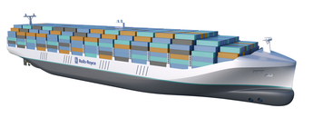
Blocking the Port Entryway
Autonomous vessels are coming.
Could an adversary hack into such a vessel as it approaches a port and cause it to ram into another vessel or a bridge?
Or run it aground, thereby blocking the entryway to a port?
Could they choose one loaded with LNG for maximum damage?
Rolls Royce Autonomous Ship Concept
Credit: Rolls Royce, iecetech.org
38

Slide 39
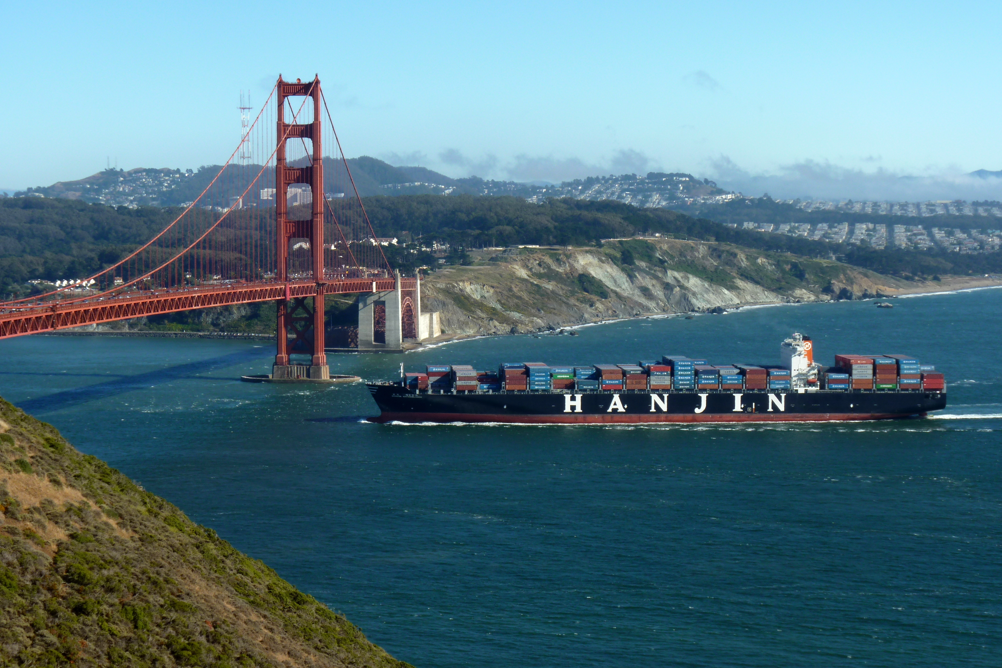
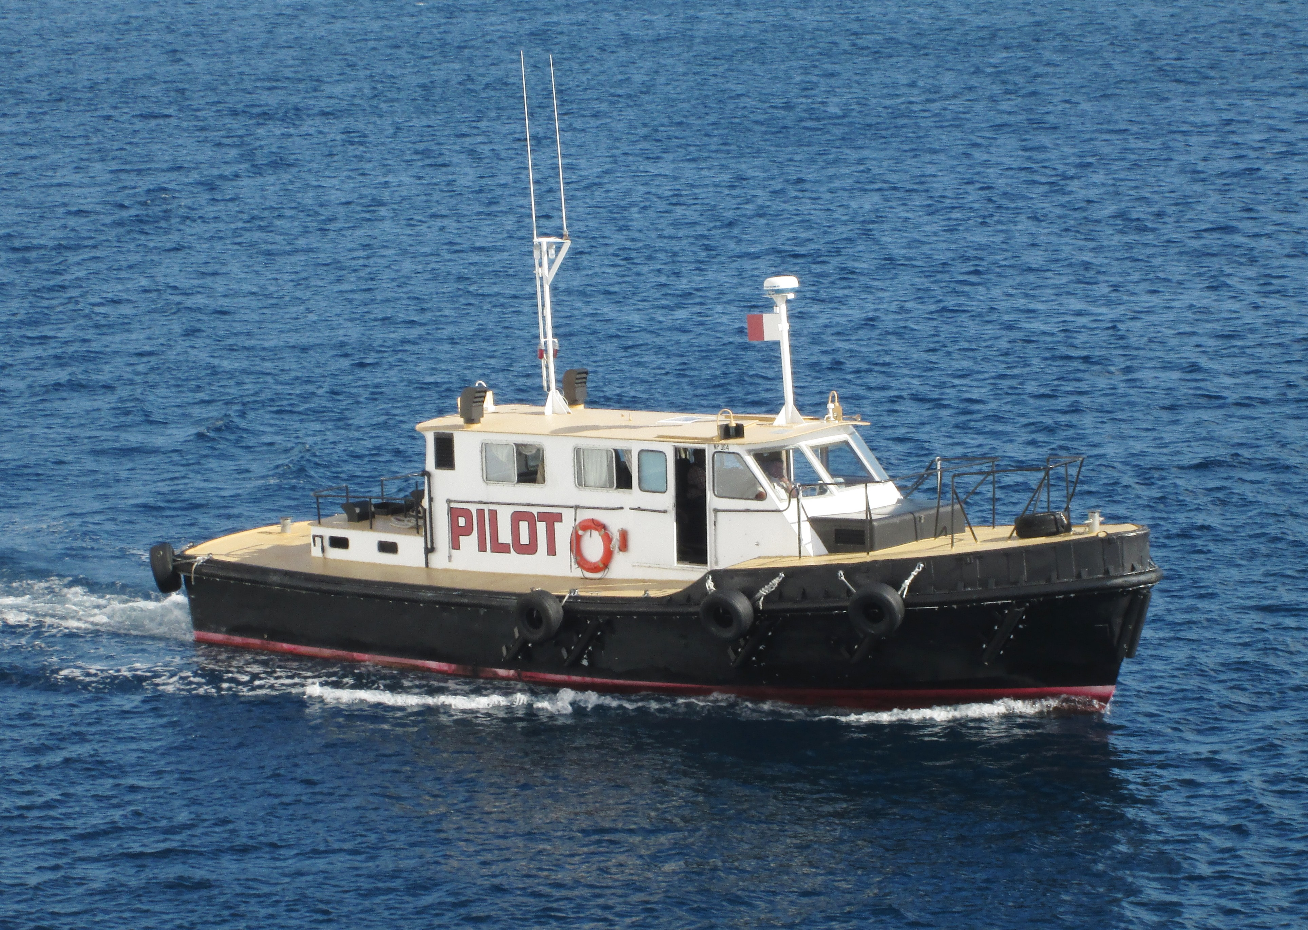
Blocking the Port Entryway
One SME told us this was not likely:
  There are alarms and warnings that you would have to bypass.
  Would port authorities overcome mistrust of automated systems to allow an autonomous vessel to operate in congested or treacherous waterways?
    In San Francisco, the eddy current can make your bow veer towards a bridge abutment and there is not much tolerance for variance from the intended path.
  Would the pilots union allow the vessel to enter the port without a pilot?
Credit: Both: commons.
wikipedia.org
39

Slide 40
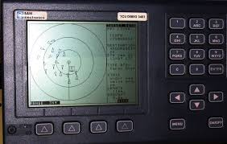
Blocking the Port Entryway
Another SME thought this was feasible.
One complex attack would be to spoof a ship’s Automatic Identification System (AIS) to arrange it so awareness systems are not transmitting a problem.
This could allow a “bad guy” to take over an autonomous vessel and run it hard aground.
It is unlikely defenders could mitigate the impact of such an event if they saw it happening.
  You can’t interdict very well on the water.
  There are few options except to ram the vessel running out of control – which could also cause an
  explosion.
Credit: wikipedia.org
40

Slide 41
Blocking the Port Entryway
However, an adversary might be able to block the port entryway without attacking a particular vessel.
All ports operate at full capacity.
Due to amount of incoming vessel traffic, only way to schedule arrivals at a modern port is by computer.
An adversary could attack the port traffic management system or the AIS on many of the incoming vessels.
  A few $500 portable devices placed in a few areas around the port could jam the AIS of incoming ships.
  Ships would anchor in place.
  Even if the authorities identified the jamming signal, it could be repeated the next day.
  The port would be closed.
  The adversary might even follow up by physically
  attacking one of the ships at anchor.
41

Slide 42
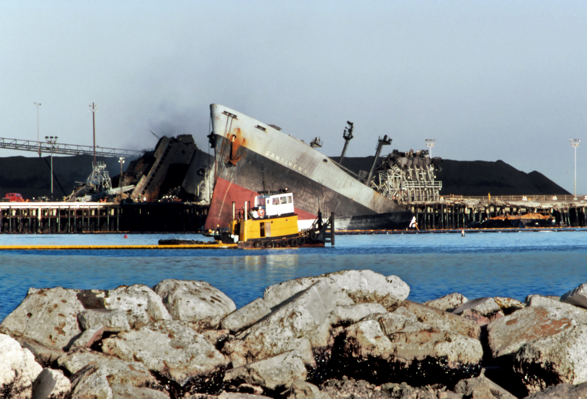
Blocking the Port Entryway
Not everyone agrees that the taking out of the AIS scenario would be a big problem
  There are tertiary systems to replace AIS, e.g., radar.
  And especially in a port where the weather is usually good, even line of sight would allow vessels to operate and enter the port.
An adversary might also stop traffic by setting a terminal on fire, or setting a moored ship on fire or causing an explosion at a berthed ship.
Could an adversary accomplish this by hacking into the fire control system?
Could they accomplish this by initiating
the fire by taking over a drone and fitting
it with a taser?
Credit: commons. wikimedia.org
S.S. Sansinena explosion – Port of LA
42

Slide 43
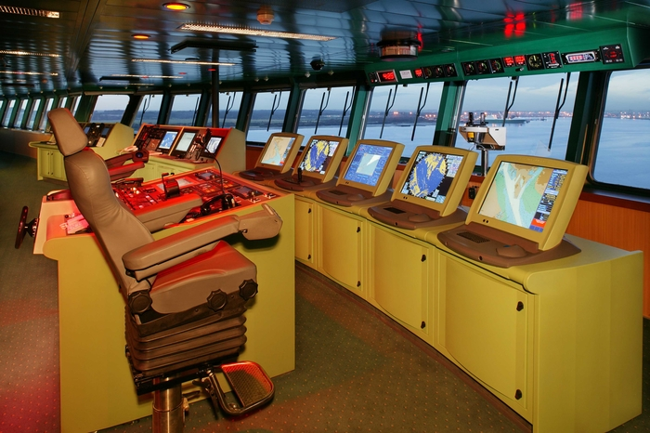
What about Vessels?
Today’s vessels are highly dependent on cyber-physical systems.
Vessels are less tightly regulated than facilities.
On a vessel, just the number of control systems make it difficult to defend against an attack.
In cyber security awareness, navigation systems and control systems and their vulnerabilities are gaining increasing attention.
Queen Mary 2 Communication and
Navigation Equipment
Credit: Cunard, iecetech.org
43

Slide 44
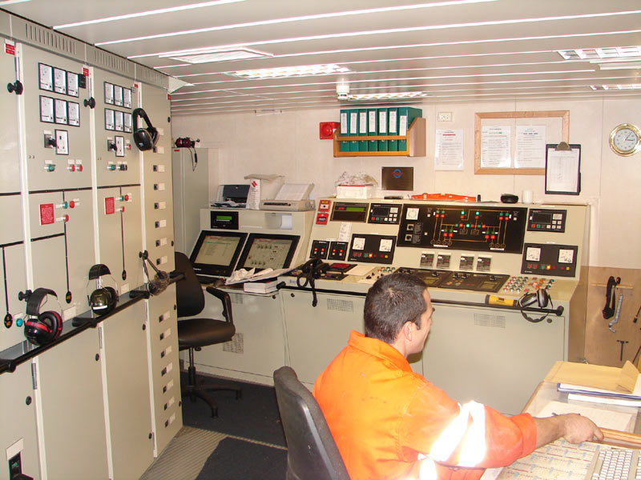
What about Vessels?
For modern ships: dependence on a proliferation of sophisticated technology – that is subject to cyber attack:
  ECDIS (Electronic Chart Display and Information System)
  AIS (Automatic Identification System)
  Radar/ARPA (Radio Direction and Ranging) (Automatic Radar Plotting Aid)
  Compass (Gyro, Fluxgate, GPS and others)
  Steering (Computerized Automatic Steering System)
  VDR (Voyage Data Recorder –”Black Box”)
  GMDSS (Global Maritime Distress and Safety
  System)
  Numerous other advanced units and systems
Engine Control Room
Credit: commons.wikipedia.org
44

Slide 45
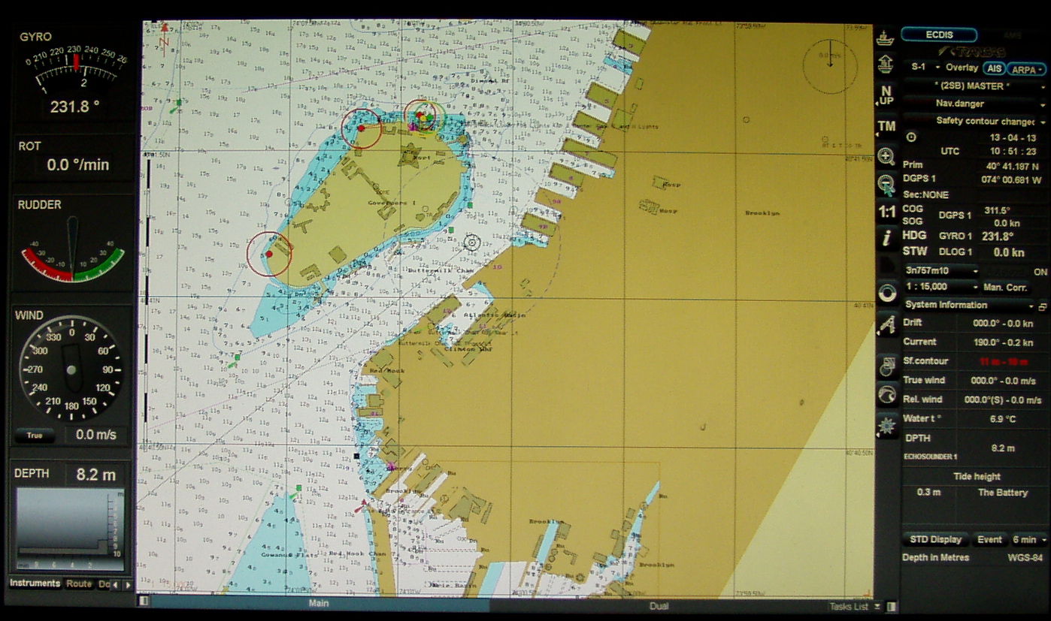
What about Vessels?
For example, ECDIS flaws might allow an attacker to access and modify files and charts on board or on shore.
Once such unauthorized access is obtained, attackers could be able to interact with the shipboard network and everything to which it is connected.
Attack could be made through something as basic as insertion of USB key or download from Internet.
An adversary doesn’t need physical access to cause damage; they can get in via cellphones or satellite.
Credit: commons.wikimedia.org
45

Slide 46
What about Vessels?
Recent demonstration by Naval Dome (Israeli company) showed what could be accomplished by an attack on ECDIS.
Designed an attack to change the vessel’s position during a “night-time passage through a narrow canal.”
Attack left ECDIS display looking completely normal.
If fully implemented, would have sent the vessel aground.
The position, heading, depth and speed all looked different from what they really were.
Attack took place through the captain’s computer, which was regularly connected to the internet through a satellite link, which is used for chart updates and regular logistic updates.
46

Slide 47
What about Vessels?
Earlier cyber attack on the ECDIS system of a ship in an Asian port.
Malware was introduced into the computers of a large 80,000 ton tanker when a crew member used a USB stick to print some paperwork.
Later, a second crew member used a USB stick to update the ship’s charts, and the ECDIS was infected.
Luckily, this was caught and the main damage was delayed departure.
47

Slide 48
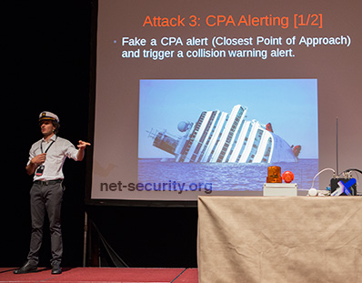
Automatic Identification System
In Oct. 2013 Trend Micro demonstrated how easy it is to penetrate a ship’s AIS.
A recent Coast Guard Academy team used commercially available software to hack into AIS and turn it off.
Per Cyberkeel, 2014, such a hack could allow an attacker to impersonate marine authorities to trick the vessel crew into disabling their AIS transmitter.
This would render the vessel invisible to anyone but the attackers themselves.
Dr. Marco Balduzzi of Trend Micro
discussing potential scenario
Credit: Help Net Security

Slide 49
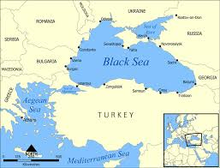
Automatic Identification System
There were suspected cases of mass-spoofing of AIS in the Black Sea in June 2017, with more than 20 ships affected.
The GPS were giving false locations, some inland and some at airports.
Source: Fairplay 11-22-17
Credit: commons.wikimedia.com

Slide 50
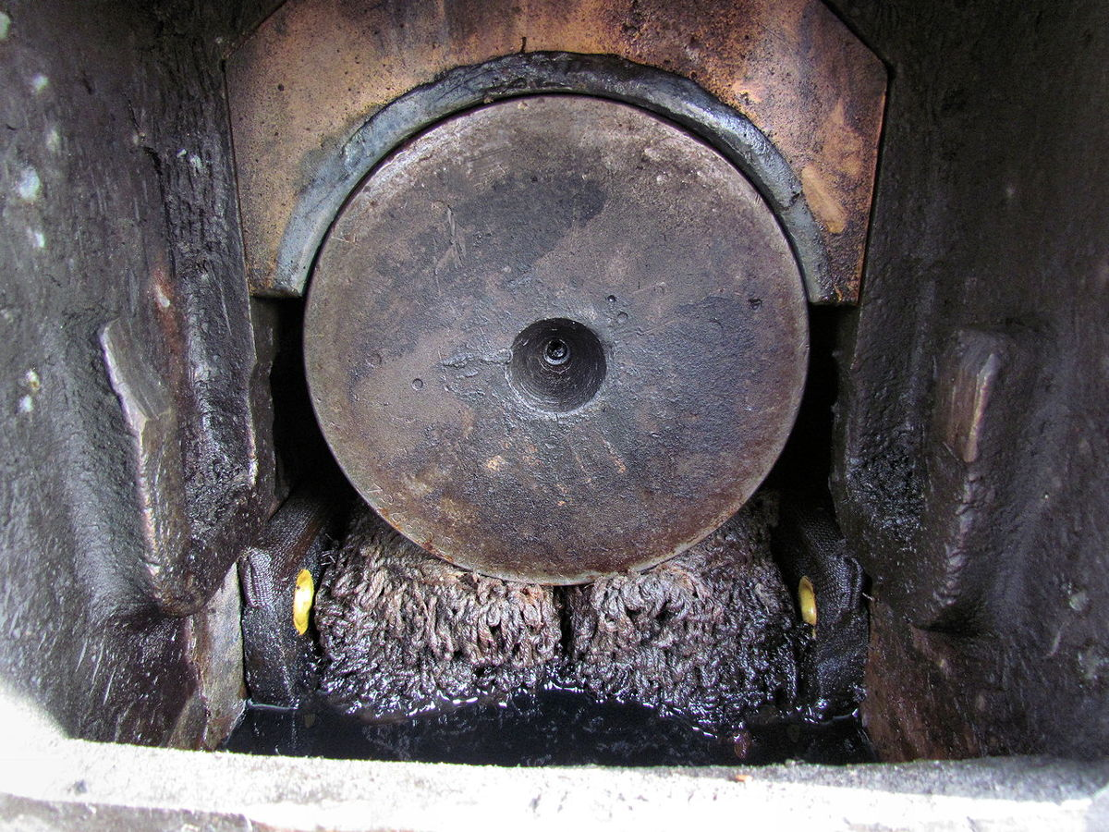
What about Vessels?
There is increasing interest in being able to monitor the behavior of shipboard systems from elsewhere, e.g., company HQ.
Now, engine manufacturers can monitor their engines for reliability, but also to make sure they are not being abused - which would void a warranty.
  They might be watching sensors that give advance notice that something isn’t working right.
  E.g., you might detect vibrations before a bearing goes bad.
Bottom line: many outsiders have access to vessel systems.
A bad actor could hack into your system from outside, especially if your shipboard systems are
networked.
Credit: En.wikipedia.org
Corroded bearing
50

Slide 51
What about Vessels?
For HQ or engine manufacturer to monitor your vessel systems, you might send telemetry from the ship.
As soon as you create the network connection, there could be a problem.
  You could try to completely separate a sensor network.
  But it is easier to put everything on the same network – thus causing potential problems.
This opens you up to ransomware attacks – pay ransom to get some shipboard system working again.
Monitoring from elsewhere also leads to a different combined attack scenario: Start with a physical attack on the remote monitoring facility that allows the adversary to take over the facility and send
malicious code to your vessel.
51

Slide 52

What about Vessels?
Could you inject ransomware and actually stop a vessel?
Something like this actually happened to a commercial freight operator.
They had their administrative system separate from their machine control system; the attack impacted the former.
Economic effect (the ransom) was the desired outcome.
But what if the desired outcome was physical: stop the vessel in its tracks, making it easier to board it with a physical attack?
52
Credit: commons.wikimedia.org

Slide 53
Aside: Ransomware
June 2017 cyber attack on Maersk with NotPetya virus gives small indication of economic impact of ransomware.
Affected operations at Maersk terminals in 4 countries, for weeks.
Cost of delays/disruptions estimated at $200M to $300M.
July 2018 cyber attack on Costco Shipping Lines caused network failures in 8 countries.
Not as successful as Maersk attack presumably because Costco learned from Maersk and isolated its internal networks.
53
Credit: commons.wikimedia.org

Slide 54
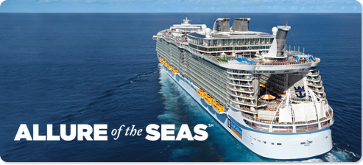
Cruise Ships
Today’s cruise ship passengers want communication and entertainment systems.
Cruise ship operators are increasingly aware of the interplay between these systems and the critical IT systems on the vessel.
There is a “tug of war” between reliability (which passengers demand of their systems) and vulnerability.
A knowledgeable actor could take advantage of the vulnerabilities in the former to attack the latter.
Today’s cruise ship operators are fire-walling the servers for the passengers and those for the ship’s operation, control, and hotel functions.
There could be several hundred
of the latter.
Credit: royalcaribbean.com/
54

Slide 55
Cruise Ships
Disrupting hotel services (water, power, AC) could make life unacceptable for passengers – a physical attack of sorts on passengers and a definite economic attack on the cruise ship industry.
The industry thinks it understands how a “bad guy” might do this.
Of most concern was that an attack like this could come through the passenger email system.
But that has been largely dismissed because firewalls have been set up.
There remains a vulnerability through authorized services that handle things remotely, e.g., desalinators and other
equipment with lots of computer controls.
55

Slide 56
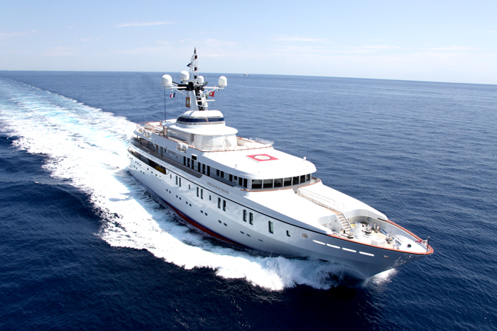
Hacking into a Cruise Ship’s Navigation System
A 2012 demonstration by a UT Austin team showed how a potential adversary could remotely take control of a vessel by manipulating its GPS.
The yacht “White Rose of Drax” was successfully spoofed while sailing on the Mediterranean.
The team’s counterfeit signals slowly overpowered the authentic GPS signals until they ultimately obtained control of the ship’s navigation system.
“The ship actually turned and we could all feel it, but the chart display and the crew saw only a straight line.”
Source: UT Austin “Know”
56

Slide 57
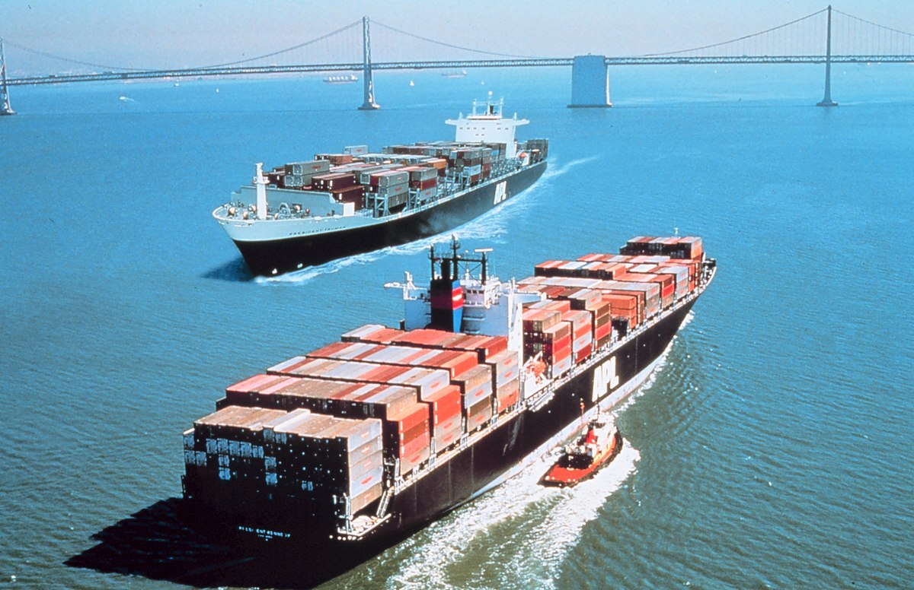
Hacking into a Cruise Ship’s Navigation System
February 2017: hackers reportedly took control of the navigation systems of a container vessel en route from Cyprus to Djibouti for 10 hours.
“Suddenly the captain could not manoeuvre. … The IT system of the vessel was completely hacked.”
Attack was carried out by “pirates” who gained full control of the vessel’s navigation system intending to steer it to an area where they could board and take over.
Source: Fairplay 11-22-17
57
Credit: commons.wikimedia.com

Slide 58
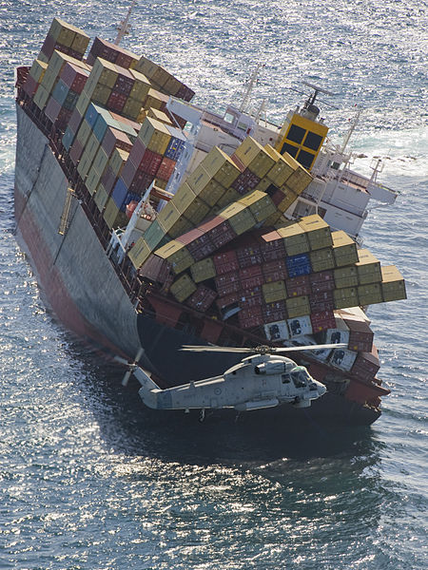
Hacking into a Cruise Ship’s Navigation System
A bad actor could hack into the navigation system on a cruise ship and cause it to change direction imperceptibly, eventually running it aground.
This could be the precursor for a physical attack on the ship.
Is this scenario feasible?
Several of our SMEs described a failed GPS off of Cape Cod leading to the grounding of the Royal Majesty, heading from Bermuda to Boston in mid 1990s.
It resulted from failing to reconnect the
navigation system to the GPS after maintenance.
Jamming a ship’s navigation system takes
almost no sophistication.
Spoofing it takes more.
Credit: commons.wikimedia.org
Grounded Ship Rena - NZ
58

Slide 59
Hacking into a Cruise Ship’s Navigation System
One SME pointed out that if a bad actor spoofed a ship’s GPS so that there are small changes in course, it is possible the crew would not notice.
  Especially at night if there were no visual cues.
  (There were such cues for the Royal Majesty.)
They would need intimate knowledge of where the vessel is and reasonably close access.
They would need to transmit false data.
Each time they told it it was off course to the left (though not true), it would compensate by moving to the right.
However, another SME pointed out that with modern ECDIS, the radar overlay would show your GPS is off.
One SME said that a physical attack is unlikely to be very successful since first responders would be there
quickly.
59

Slide 60
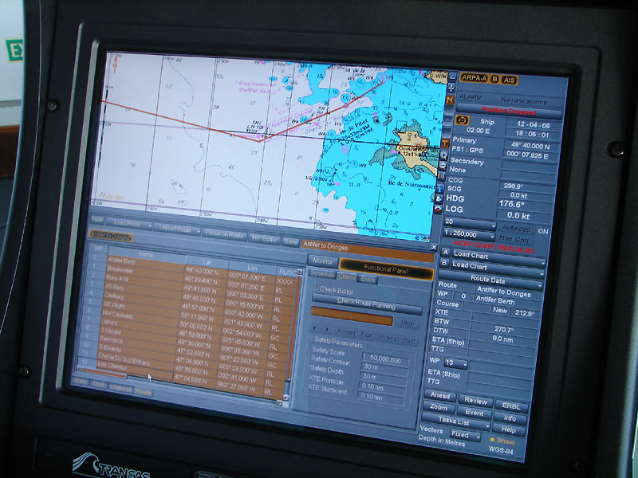
Hacking into a Cruise Ship’s Navigation System
Another SME pointed out that it would be a challenge for the bad actor to predict where the vessel would hit and therefore prepare for a physical attack.
However, they could move the vessel to go into a shipping lane they want it to go into - perhaps making the physical attack easier.
Another SME pointed out that an attacker could alter charts, hiding what shoal waters exist, leading to grounding of the vessel in a desired area.
Just being able to run a cruise ship aground would have a major psychological impact.
The result could be a major economic blow
to the cruise ship industry.
60
Credit: commons.wikipedia.org

Slide 61
Combined Attack on a Cruise Ship
Could a “bad guy” hack into the fire alarm system on a cruise ship, leading passengers to gather at mustering boat stations as a prelude to a physical attack there?
  Through a planted explosive or attack by group arriving by boat or a suicide bomber on board cruise ship.
Is this a plausible scenario?
It seems feasible to hack into a fire alarm system on a ship, at least in some cases.
But wouldn’t it be easier to let an inside actor attack a large group of passengers already in one place – e.g., dining room?
Or easier for a group of attackers to come alongside by boat and just start shooting at miscellaneous passengers?
One SME doubted this kind of combined attack would work because security on cruise ships is so good.
61

Slide 62
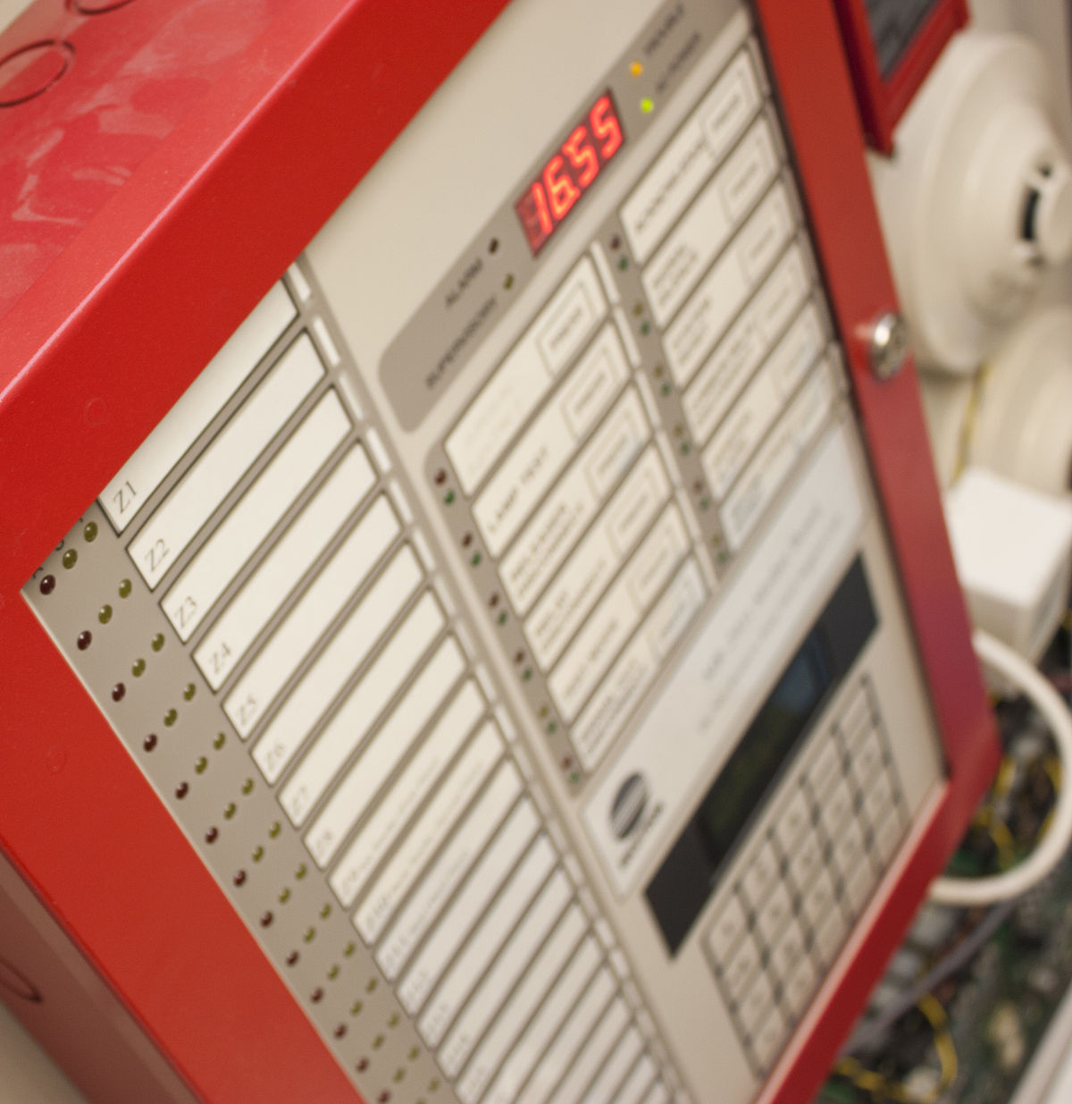
Combined Attack on a Cruise Ship
Side comment: To maximize impact, an attacker would not have to follow the fake fire alarm with a physical attack.
Simply fake a fire alarm, announce they were responsible and say they could do it again.
This could create psychological impact and potential economic damage to the cruise industry.
Doing it multiple times would
create an even bigger impact.
Credit: en.wikipedia.org
62

Slide 63
Combined Attack on a Cruise Ship
An attacker could also avoid the challenge of hacking into the fire alarm system on the vessel by starting a real fire to activate the fire alarm.
However, this would require physical presence, whereas the precipitating cyber attack to set off the fire alarm could be done from a distance.
Could a fire alarm arising from a hack or a physical act be just a distraction for a cyber attack – loading something on a server to use later?
Conceivably, according to an SME, but not likely because servers would be locked down and because fire drills don’t take very long.
However, another SME felt that attackers could move crew where they want them and away from the location of a desired cyber attack, which could be to any of a number
of control systems on the vessel.
63

Slide 64
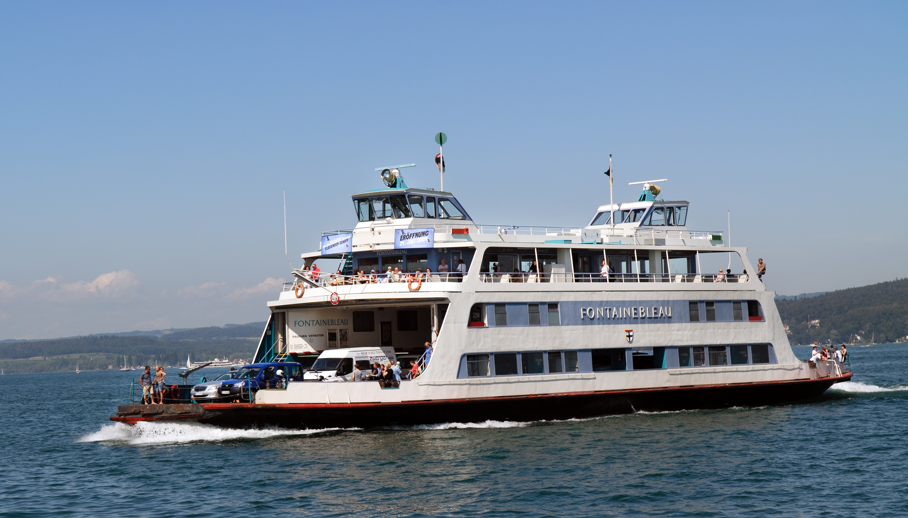
Ferries
Many of the cyber attacks described for cruise ships are also relevant for ferries.
The combined attacks we have described might have another component, since passenger screening on ferries is less stringent than on cruise ships and vehicle screening is inconsistent.
This allows for the possibility of a cyber attack followed by a physical attack through a passenger or a vehicle.
Credit: commons.wikimedia.org
64

Slide 65
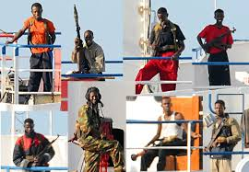
Pirates and Cargo
Pirates have been reported to have hacked into a cargo management system and identified where on a vessel valuable cargo is located.
This enabled them to make a very fast and efficient raid on a vessel, going right to the container of interest.
Is this feasible?
One of our SMEs felt that it was feasible to hack into the cargo system and identify containers of interest and their location, but wondered how this would help the pirates since it is only the topmost containers they could access.
Credit: wikipedia.org

Slide 66
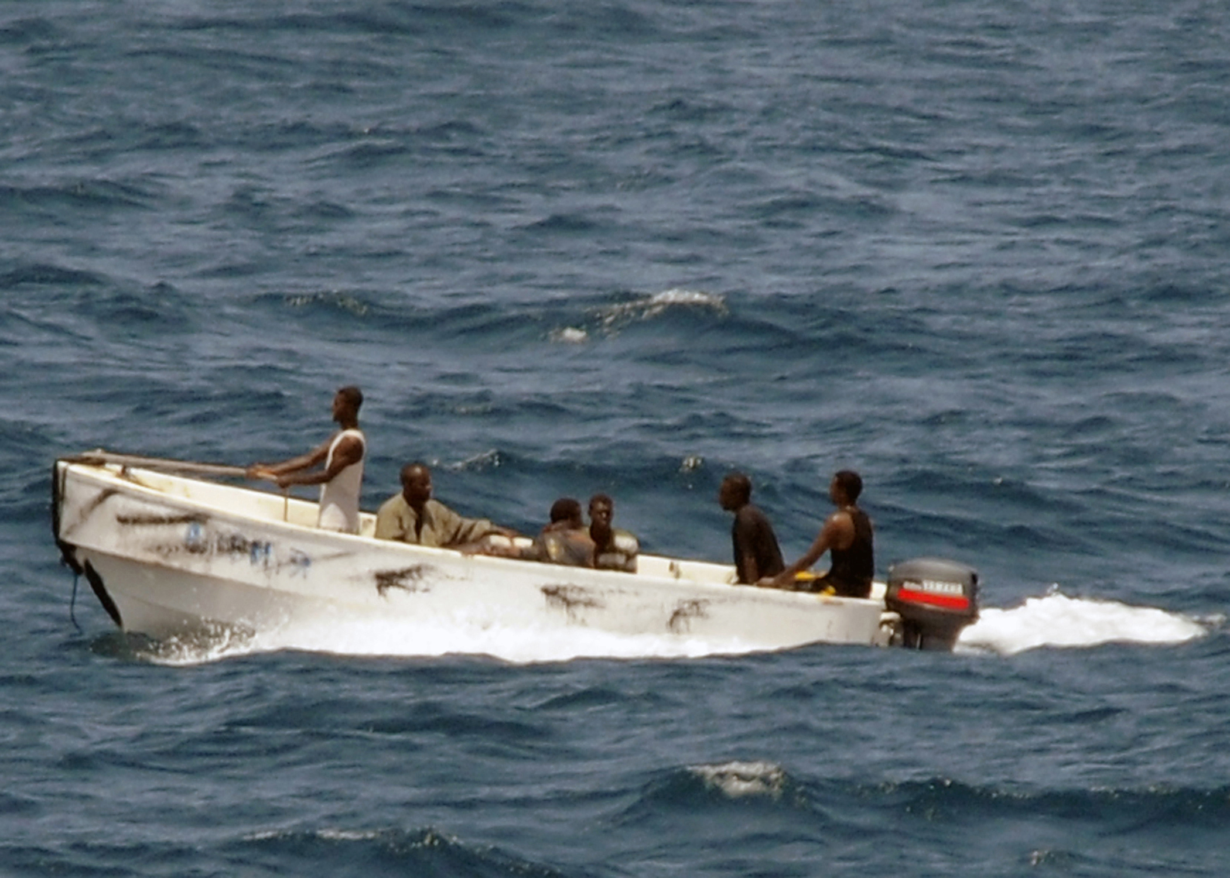
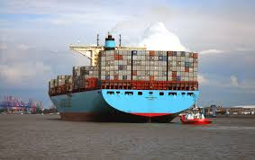
Pirates and Cargo
Another of our SMEs pointed out that the USCG had gotten quite good at getting into containers upon boarding a ship.
Still another SME pointed out that the adversary could influence the loading of containers so that those of interest were placed to be accessible.
Credit both images: commons.wikimedia.org

Slide 67
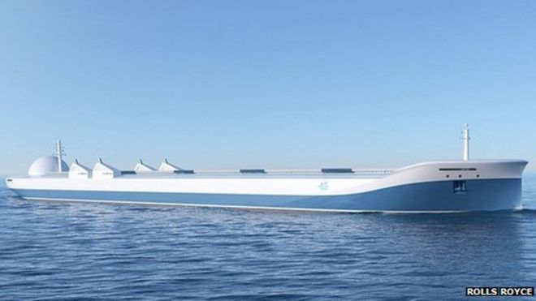
Autonomous Vessels
Our SMEs all felt that autonomous vessels were coming, soon.
Such vessels:
  Will be programmed to decide where to go.
  Will be tracked and monitored using diagnostics from HQ.
  Will put out a problem message if unable to solve a problem, resulting in HQ sending instructions on where to go for repair.
Do we trust the technological solutions so such vessels can go alone on the seas?
Could a hacker take over the HQ computer and instruct the vessel to go to a place where it could be boarded by attackers?
Credit: Rolls Royce

Slide 68

Autonomous Vessels
You are saving on crew costs but accepting some risk.
One SME told us that shipboard systems & shipboard industrial control systems are much harder to patch or have their software updated than many other systems.
These systems might not be updated in real time, and hence become vulnerable to ransomware.
WannaCry Ransomware
Credit: En.wikipedia.org

Slide 69
Autonomous Vessels
An attacker could jam or spoof the GPS or do a more sophisticated attack on the control system of the internal diagnostics of such a vessel.
Could this affect heat or pressure or gas sensors, leading to an explosion?
This could cause economic damage.
And possibly loss of life as well.
If the goal of the attacker is psychological impact, they wouldn’t do it in the middle of the ocean, where there is no media to film things.
But near a port, the vessel might not be entirely autonomous.

Slide 70
Closing Comments
Ultimately, the weak link in defense against combined cyber-physical attacks is still the human being.
A successful attacker tries to influence behavior, leading to bad decisions.
  Introduce doubt.
  E.g. through false aids to navigation showing up on an electronic chart. Spoofing a vessel track that may not correlate with radar.
  Creating a chain of things initiated by influencing the thinking of the bridge operator.

Slide 71
Closing Comments
Our discussion has been limited to a single pair of events, one cyber, one physical. But there could be multiple, cascading events.
  More work is needed to develop scenarios for those.
  Example: An adversary could attack a cruise ship in a port and announce their intention to attack other cruise ships in other ports.
  What would the Coast Guard do?
  Would it close down those other ports, creating a vulnerability with large crowds waiting to embark?

Slide 72


Closing Comments
Examples of other areas to discuss include combined attacks on:
  Locks
  Drawbridges
  Barges
  Oil rigs
  Inter-modal landside connections
Source for both: wikimedia commons

Slide 73

Closing Comments
Fundamentally, there is nothing special you would do to prevent a cyber attack intended as a precursor to a physical attack that you wouldn’t do to prevent any cyber attack.
Credit: commons.wikimedia.org

Slide 74
Thanks to my Collaborators from CCICADA
  Dr. Dennis Egan
  Dr. Christie Nelson
  Mr. Ryan Whytlaw
74

Slide 75
Combined Cyber and Physical Attacks on the Maritime Transportation System
  For More Information:
  Dr. Fred Roberts
  froberts@dimacs.rutgers.edu
  CCICADA Center
  www.ccicada.org
75

