Slide 1
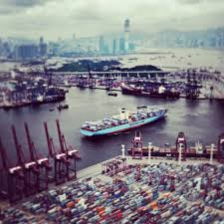
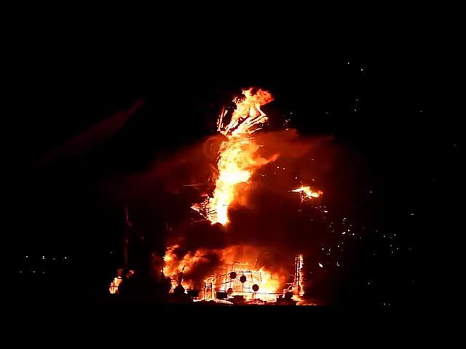

Combined Cyber and Physical Attacks on the Maritime Transportation System
Fred S. Roberts
Director
Command, Control, and Interoperability Center for Advanced Data Analysis (CCICADA)
Source for all images: wikimedia commons
1

Slide 2
Combined Cyber and Physical Attacks
More than 90% of the world’s commerce goes by sea.
A great deal of discussion about physical security in the maritime transportation system (MTS).
  Leads to standards, regulations, etc.
Interest in cyber security of MTS has lagged other sectors (banks, power grids, cars, airplanes), but has increased.
  2017 cyber attack on Maersk Lines cost the company $200M to $300M due to delays/disruptions.
But more sophisticated attacks will be multi-modal.
Could lead to more harm.
Next big war could start with a cyber attack on the power grid followed by a physical attack.
Simple MTS example: hacking into security cameras at a port increases vulnerability to a physical intrusion.
Special case: cyber attack as precursor to physical attack, or vice versa.
Will present scenarios and discuss risk.
2

Slide 3
A Simple Example: Fake News
Fake news could be spread via social media.
Something is happening at Pier F in the port.
Draws first responders to Pier F.
  “Everyone runs to the soccer ball”
Actual intent is to attack Pier L, which now may have less protection.
Another version: hack into a company’s or agency’s email system and generate an official-looking report about Pier F.
John Smith
@johnsmith
There is a shooter at Pier F
2:23 PM 6 Dec 2017
Tina Jones
@tinajones
People shot at Pier F
2:22 PM 6 Dec 2017
3

Slide 4

A Simple Example: Fake News
Another version: Spread news that a celebrity is at Pier F; draw a crowd; then attack the crowd.
  “Justin Bieber is at Pier F”
Source: wikimedia commons
4

Slide 5
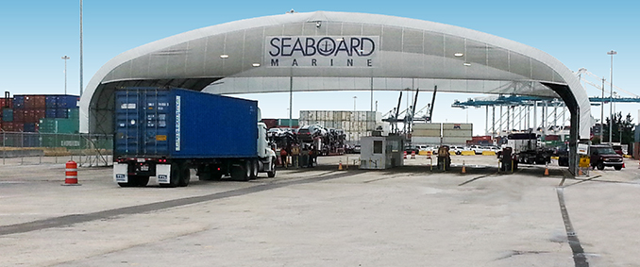
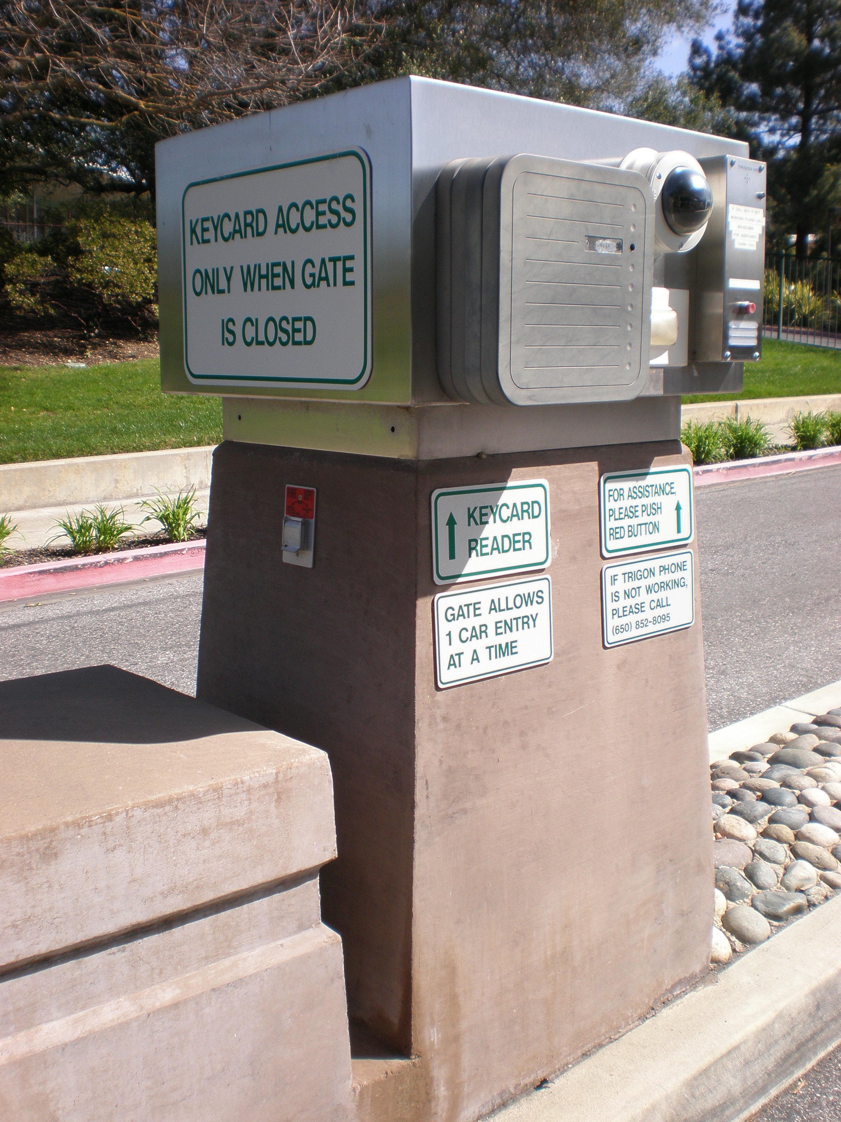
More Sophisticated Attacks on a Port
Cyber attack on operating systems in the port making a following physical attack more likely to succeed:
  Shut the gates so people are trapped inside and first responders are trapped outside.
  Turn off the lights – make it easier for physical
  attackers.
  Turn off the alarms – make it easier for physical attackers to avoid detection.
  Disable the cameras – make it easier to avoid detection.
  Interrupt the power supply.
  Disable cyber-enabled traffic lights to create traffic jams - emergency vehicles unable to respond to a physical attack.
  Hack into emergency communication system and tell first responders to go to a different place.
  Spoof TWIC cards or other access control systems
  to let the “bad guys’ in.
5
Credits: seaboardmarine.com, commons.Wikimedia.org

Slide 6
Risk Assessment
Many of these seem feasible.
But an adversary with this level of sophistication might find it is easier to do a more intrusive physical break-in.
Would like to consider threat, vulnerability, and consequence in determining the risk of a given attack scenario.
But:
  Not many examples (as yet) of cyber attacks on MTS, making threat hard to estimate
  Estimates of probability attack will succeed (vulnerability) are essentially speculation
  Consequences could be large, making it important to be able to estimate probabilities accurately, which is difficult.
We will approach the problem qualitatively.
6

Slide 7
Risk Assessment
J = joint attack, started with cyber attack A, following by physical attack B.
T = non-joint attack.
Compare probability of success P_{J} and P_{T}, where
P_{J} = P_{A} x P_{B/A} (prob. of success of A times prob. success of B given A)
Compare costs K_{J} and K_{T} of attacks.
Compare consequences C_{J} and C_{T} of attacks.
Risk assessment for combined attacks – not well developed.
  FEMA provides guidance about complex, coordinated attacks – but these are synchronized and at different locations and risk assessment is very generic.
  Event tree analysis deals with risk of one natural
  event triggering another (earthquake triggers
  landslide).
7

Slide 8
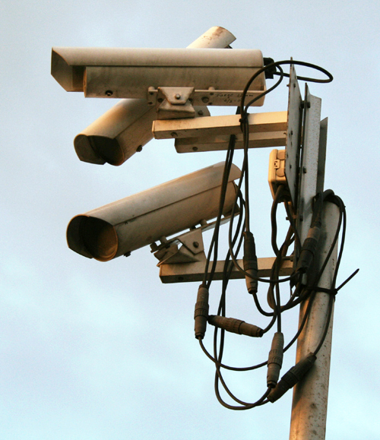
Disabling Cameras
Consider disabling cameras to make it easier to
do a physical attack on a port.
Cameras are often add-ons.
Thus, P_{A} is high.
P_{B/A} > P_{T}: that is whole point of joint
attack. If sufficiently large, then P_{J} > P_{T}.
It could be that cost of the physical attack set up by cyber attack is less than cost of physical attack alone, but in any case |K_{J} – K_{T}| is small.
Almost surely C_{J} > C_{T}.
Even if K_{J} > K_{T}, it seems reasonable to conclude that J is of higher risk than T.
8
Credit for image: commons.wikimedia.org

Slide 9
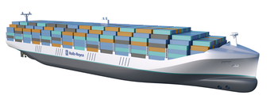
Autonomous Vessels
Autonomous vessels are coming, soon.
Such vessels:
  Will be programmed to decide where to go.
  Will be tracked and monitored using diagnostics from HQ.
  Will put out a problem message if unable to solve a problem, resulting in HQ sending instructions on where to go for repair.
Do we trust the technological solutions so such vessels can go alone on the seas?
Could a hacker take over the HQ computer and instruct the vessel to go to a place where it could be boarded by attackers?
Rolls Royce Autonomous Ship Concept
Credit: Rolls Royce, iecetech.org

Slide 10
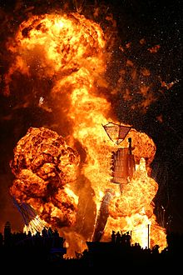
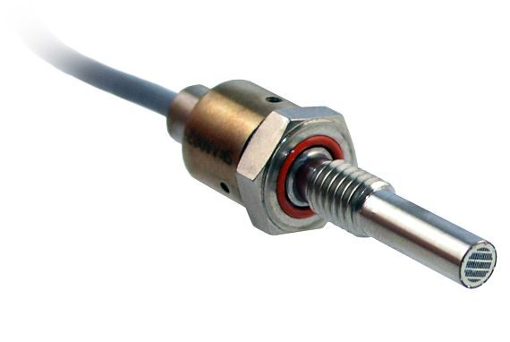
Autonomous Vessels
Could a hacker attack a vessel control system through a HQ computer and disable a sensor designed to identify increasing temperature, pressure, or hazardous gas? (This is A.)
Leading to an explosion. (This is B.)
Not farfetched.
The Stuxnet is a malicious computer worm that targets industrial computer systems.
  It put a virus into a controller running centrifuges and damaged them – causing substantial damage to Iran’s nuclear program.
Not the same, but: Naval Dome has demonstrated ability to penetrate a vessel’s machinery control system and stop valves and pumps from working.
Image Credits: militaryaerospace.com,n en.wikipedia.org
10

Slide 11
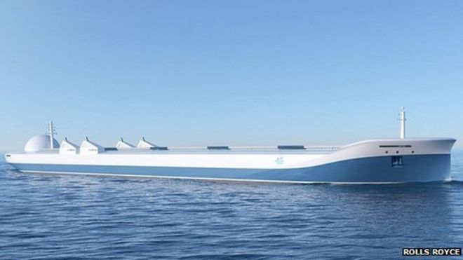
Autonomous Vessels
Compare J to an attack T where a physical attack X disables a sensor leading to an explosion B.
It is likely that P_{B/A} and P_{B/X} are similar.
P_{A} may be quite a bit higher than P_{X}.
K_{J} might also be much less than K_{T}.
C_{J} and C_{T} are likely to be similar.
This suggests that the risk of there being a joint attack J is higher, and maybe considerably higher, than the risk of the attack T.
Credit: Rolls Royce
11

Slide 12
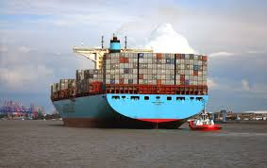
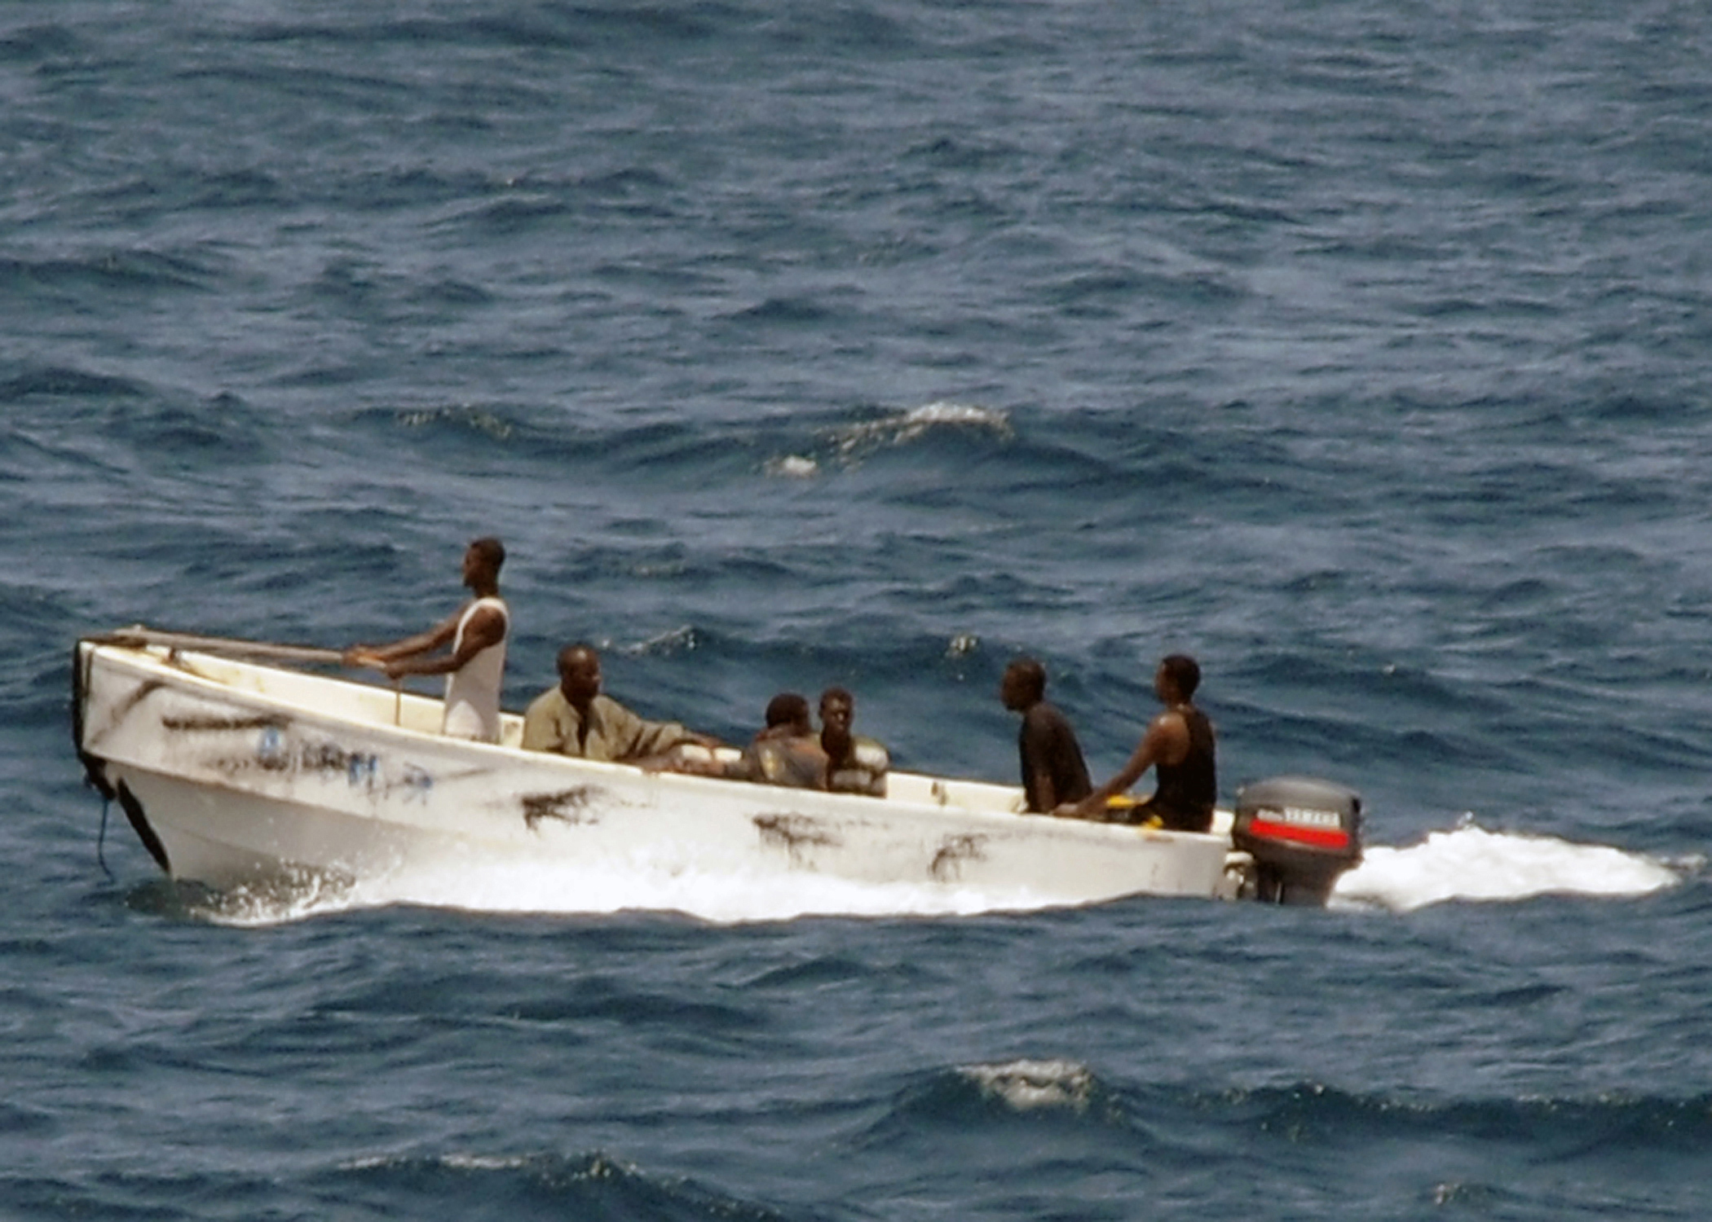
Pirates and Cargo
Pirates have been reported to have hacked into a cargo management system and identified where on a vessel valuable cargo is located.
This enabled them to make a very fast and efficient raid on a vessel, going right to the container of interest.
How feasible is this?
Credit both images: commons.wikimedia.org

Slide 13
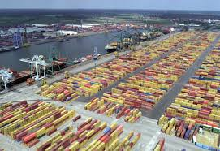
Pirates and Cargo
Hacking into a cargo handling system is feasible.
Port of Antwerp is one of the world’s biggest.
2011-2013: Hackers infiltrated computers connected to the Port of Antwerp, located specific containers, made off with their smuggled drugs and deleted the records.
Attackers obtained remote access to the terminal systems; released containers to their own truckers without knowledge of the port or the shipping line.
Access to port systems was used to delete information as to the existence of the container
after the fact.
Source: Reuters 4/23/14, CyberKeel
Credit: wikipedia.org
13

Slide 14
Pirates and Cargo
The hackers began by emailing malware to the port authorities and/or shipping companies.
After the infection was discovered and a firewall installed to prevent further infections, the criminals broke into the facility housing cargo-handling computers and fitted devices allowing wireless access to keystrokes and screen shots of computer screens.
The first part of this was a cyber attack preceding a physical attack (stealing cargo).
The second part was a physical attack (breaking in) preceding a cyber attack, which in turn preceded a physical attack (stealing cargo).
Source: Bell 2013, Mulrenan 2014, Woodland Group
14

Slide 15
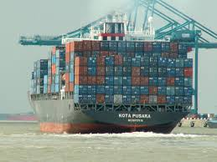
Pirates and Cargo
Even if it is feasible to hack into the cargo system and identify containers of interest and their location, how would this help the pirates since it is only the topmost containers they can access?
Pen Test Partners have shown that hackers can manipulate the cargo handling system to impact placement of cargo (in their case to cause an imbalance).
Compare J to T = board a ship and physically steal cargo.
Increasingly, pirates have the sophistication to pull off cyber attacks, so P_{A} might be relatively high. Still, P_{J} might be smaller than P_{T}.
Even if P_{J} is less than P_{T}, most likely K_{J} is not much more than K_{T}, and C_{J} is much higher than C_{T}.
So, again, we conclude that the risk of J
is higher than the risk of T.
15
Credit : commons.wikipedia.org

Slide 16
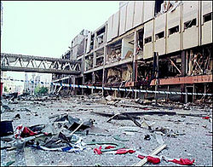
Debarking a Cruise Ship
The 2017 attack at the Ariana Grande concert in the Manchester Arena showed that patrons leaving an arena could be vulnerable.
  What if they were “drawn out” in a group by hacking into the arena’s alarm system or emergency communication system or “message board”?
In general, disembarking at cruise ship terminals is generally not thought to be very risky.
  Passengers are released in groups to avoid standing in line at customs.
  There is good departing security.
  Terminal operators think you are ok once you leave the dock.
  But what if a hacker could manipulate an alarm
  system to get them all to debark at the same time
  and attack them outside the gates?
  There is still an under-appreciation of debarking
  vulnerabilities.
Manchester arena after attack
Credit: en.wikipedia.org BBC picture
16

Slide 17
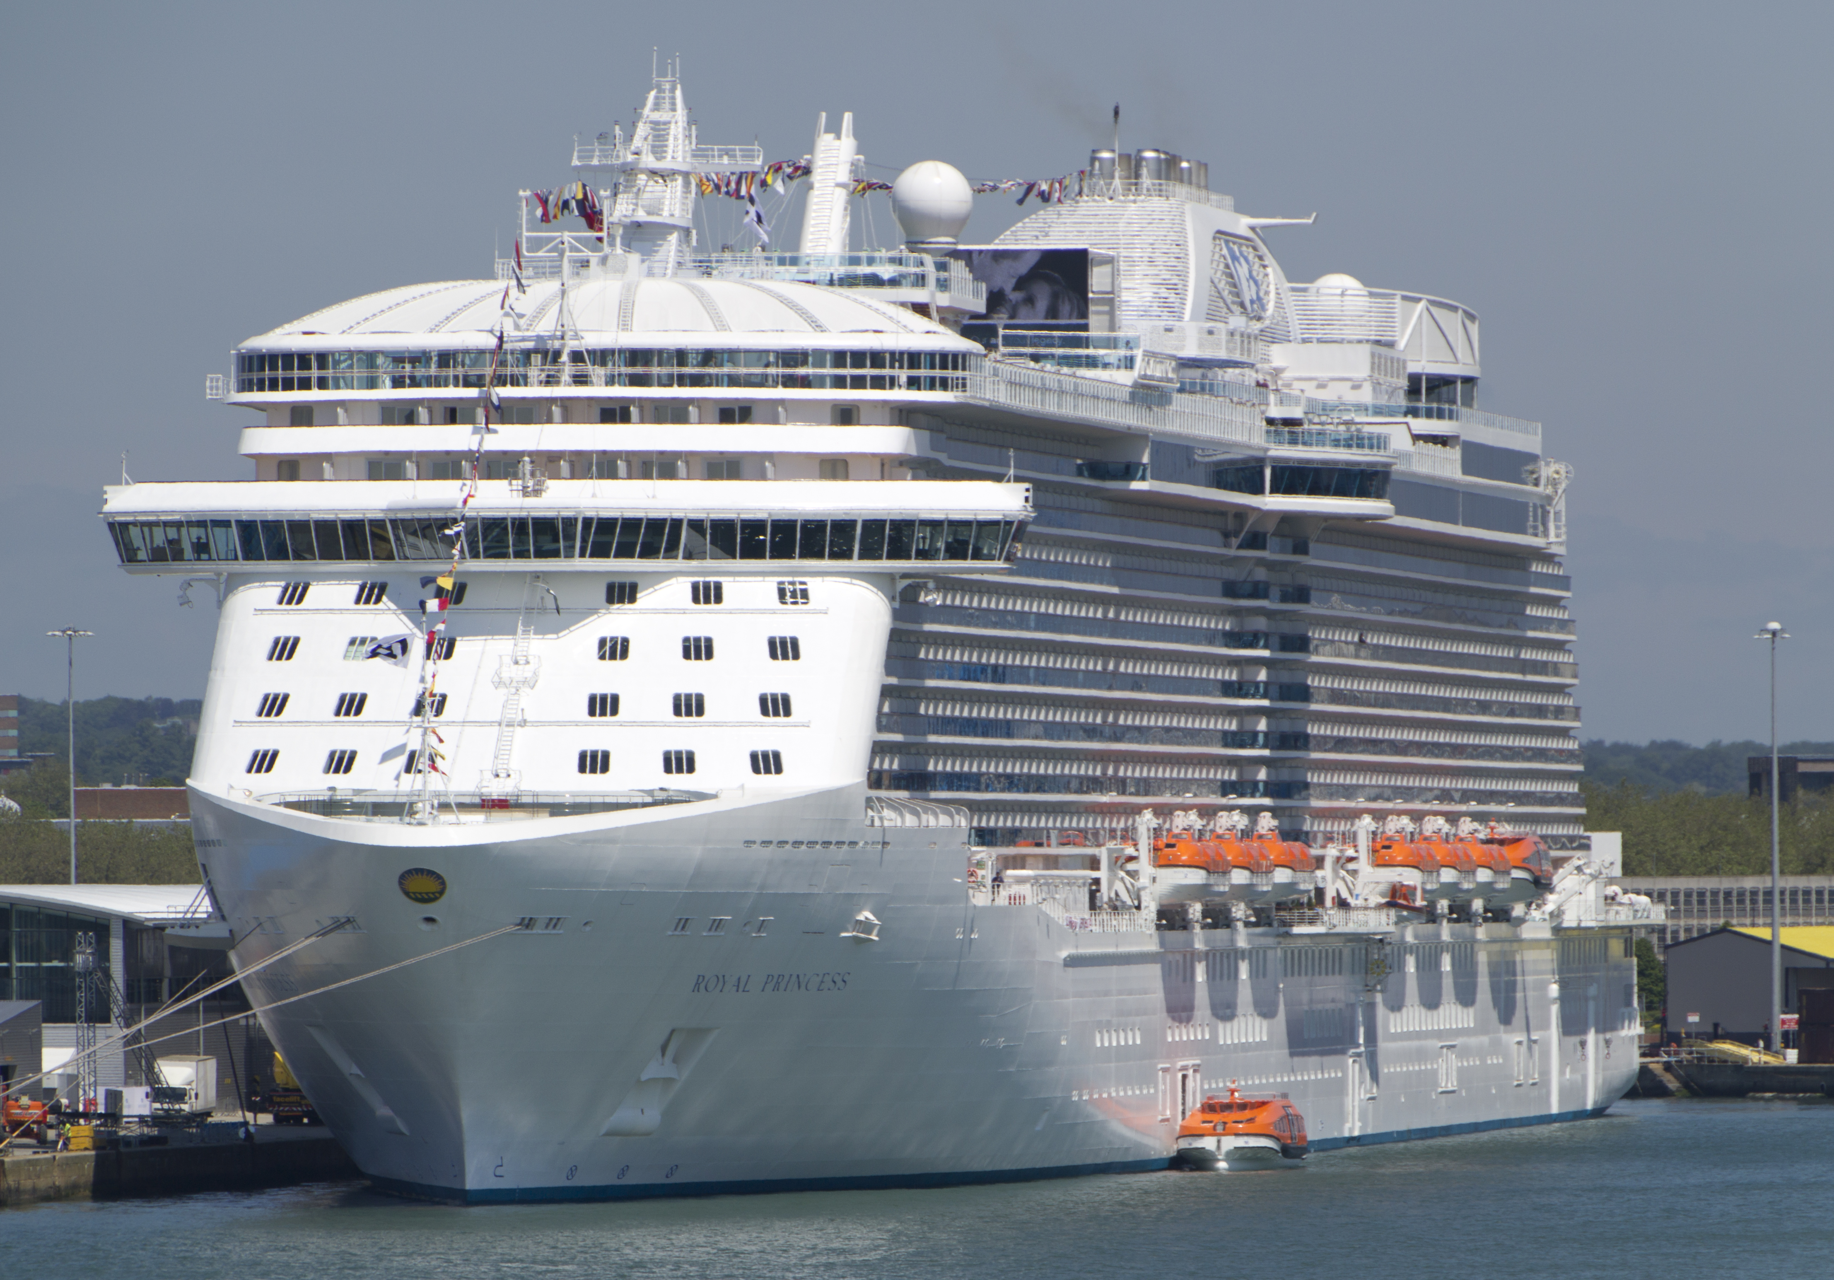
Debarking a Cruise Ship
Could a hacker manipulate a port alarm system (e.g., fire alarm) to get passengers to debark at the same time?
That might depend upon whether the alarm system were online.
Port fire alarm systems are not too sophisticated.
  They are designed to operate over a network and push a signal out to a monitoring agency.
  It might be a challenging hack to get into this system.
Physically setting off the fire alarm might be more likely to succeed.
Credit: commons.wikimedia.org
17

Slide 18
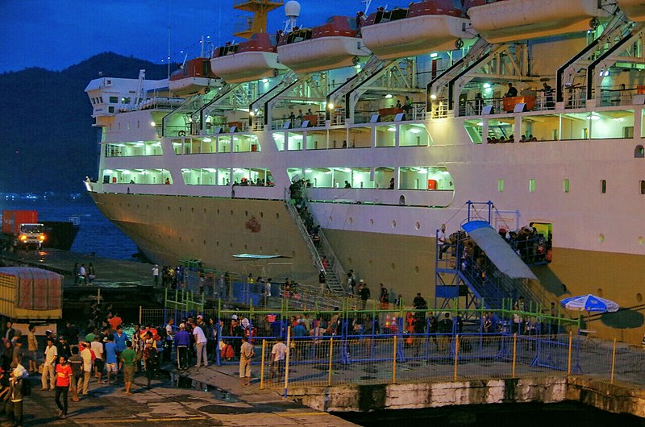
Debarking a Cruise Ship
Compare a joint cyber and physical attack J that starts with a cyber attack A on an alarm system to a two-part attack that starts with a physical attack X on the alarm system. Each would end with the same physical attack B on debarking passengers.
Since P_{A} < P_{X} and P_{B/A} and P_{B/X} are similar, we have P_{J} < P_{T}.
It is hard to tell if K_{J} < K_{T}, but most likely C_{J} and C_{T} are close.
Because security is trained to tell passengers where to go in case of an alarm, it is likely that neither C_{J} nor C_{T} are very large.
Thus, neither J nor T has a very high risk,
and the risk of J is smaller than the risk of T.
Credit: Wikimedia commons
18

Slide 19
Debarking a Cruise Ship
On the other hand, an adversary might rethink the scenario if they reach a conclusion like this.
What if they only did the fire alarm attack, didn’t follow with a physical attack, but made a public statement that they have demonstrated their ability to hack into the fire alarm in a port and next time it would be while the vessel was at sea?
That alone could lead to significant economic cost to the cruise ship industry.
If E is the new one-phase attack, P_{E} > P_{J}, probably P_{E} > P_{T}, and C_{E} could (at least if loss of life is small) might be close to C_{T} and C_{J}.
Thus, the risk of E might be higher than the risk of either J or T.
19

Slide 20
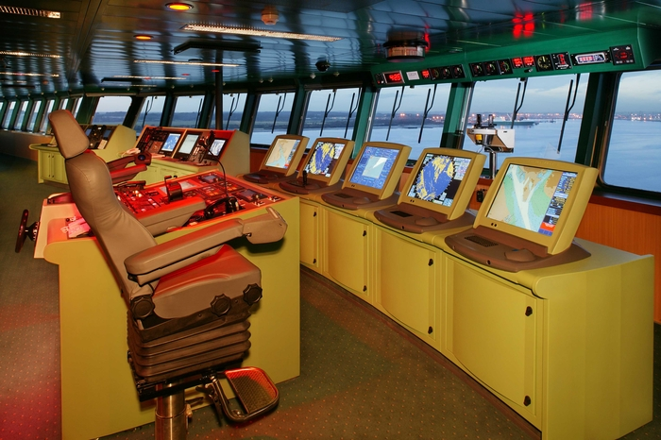
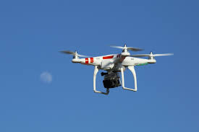
Other Interesting Combined Attacks
Hacking into the Automatic Identification System of a vessel so it doesn’t transmit information about a problem, then taking over the vessel and running it aground to block a harbor.
Hacking into the Electronic Chart and Display Information System on a cruise ship, running it aground, and then physically attacking it.
Hacking into the fire alarm system on a cruise ship, having passengers go to boat stations, where they are vulnerable to a physical attack.
Hacking into a drone at a port and landing it on an LNG tank.
And many more.
Queen Mary 2 Communication &
Navigation Equipment
Credit: Cunard, iecetech.org
Credit: commons.
wikimedia.org
20

Slide 21
Thanks to my Collaborators from CCICADA
  Dr. Dennis Egan
  Dr. Christie Nelson
  Mr. Ryan Whytlaw
21

Slide 22
Combined Cyber and Physical Attacks on the Maritime Transportation System
  For More Information:
  Dr. Fred Roberts
  froberts@dimacs.rutgers.edu
  CCICADA Center
  www.ccicada.org
22

