Slide 1

DIMACS BioMath Connection
Q&A
Field Tester Workshop
July 10, 2009
Holly Gaff

Slide 2
Regression and Least Squares
Test to see if data fit some defined empirical model
Objective is to adjust parameters so the model has the best fit to the data
We focus on fitting line to the data

Slide 3
Sample data set
Age | DBH
97 | 12.5
93 | 12.5
88 | 8
81 | 9.5
75 | 16.5
57 | 11
52 | 10.5
45 | 9
28 | 6
15 | 1.5
12 | 1
11 | 1

Slide 4
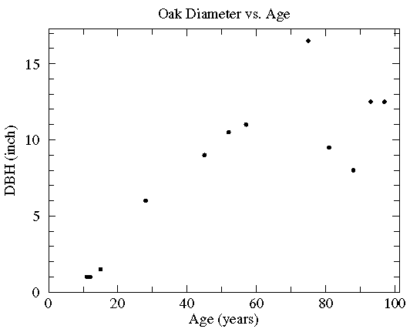
Plot the data

Slide 5
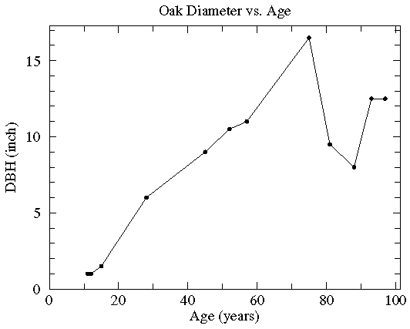
What about the following line?

Slide 6
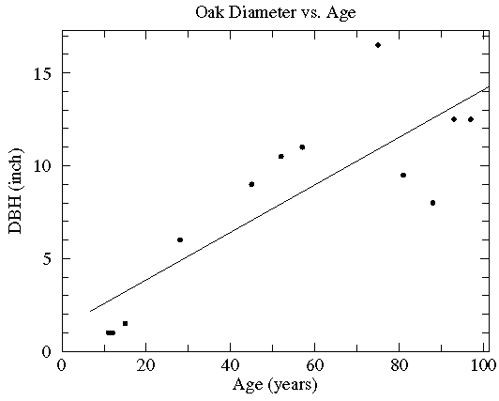
Find the best line

Slide 7
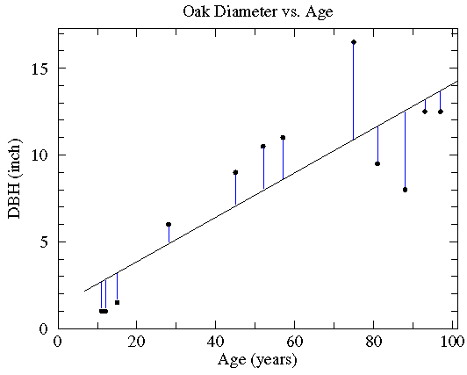
How we found that

Slide 8
How we found that
(math version)
Assuming y = m x + b
Want to solve overdetermined linear system, i.e., can’t solve problem exactly
Calculate minimum of:

Slide 9
Linear Regression
Note that correlation does not imply causation!!
Play with applet at:
http://www.dartmouth.edu/~chemlab/info/resources/linear/linear.html

Slide 10
Log Plots
Why use log plots?
Can transform data into linear relationships so you can use linear fit we just talked about!
Helps see trends that are lost when data sets are on different scales
Puts number back into ranges we can understand

Slide 11
Logarithms
Definition

Slide 12
Semi-log plots
Useful to transform data that is exponentially growing or decaying into a linear relationship
Only one axis is transformed into a log scale

Slide 13
Semi-log plots

Slide 14
Log-log plots
Useful to transform functions that have the form:
Both the y-axis and the x-axis are transformed to a log scale

Slide 15
Log-log plots

Slide 16
Carrying capacity
Number of individuals who can be supported in a given area within natural resource limits, and without degrading the natural social, cultural and economic environment for present and future generations.
Not a fixed value can change with a variety of factors, e.g., weather, technology, humans

Slide 17
Source-sink dynamics
Source
  Component of ecosystem that is a net exporter of matter (nutrients) and energy e.g., a supplier.
Sink
  Component of ecosystem that is a net importer of matter (nutrients) and energy e.g., a storage "pool".

Slide 18
Source-sink dynamics
Any population at carrying capacity can be a source of organisms who emigrate out in search of resources
Black bears in the Smoky Mountains

Slide 19
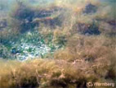
Drift algae
Drift algae is a generic term for unattached algae that can accumulate and grown on the bottom of protected embayments. Cladophora is one of the more common species, especially in eutrophic embayments where it has the appearance of balls of green steel wool.
http://cmer.ecu.edu.au/news/news-2008.php

Slide 20
Drift algae
Can be red tides
Has been found to smother sessile invertibrates

Slide 21
Other questions?

