Slide 1
Competition Graphs and the Dimensions of Biodiversity
Midge Cozzens, Rutgers University
NIMBIOS August 16-18, 2010

Slide 2
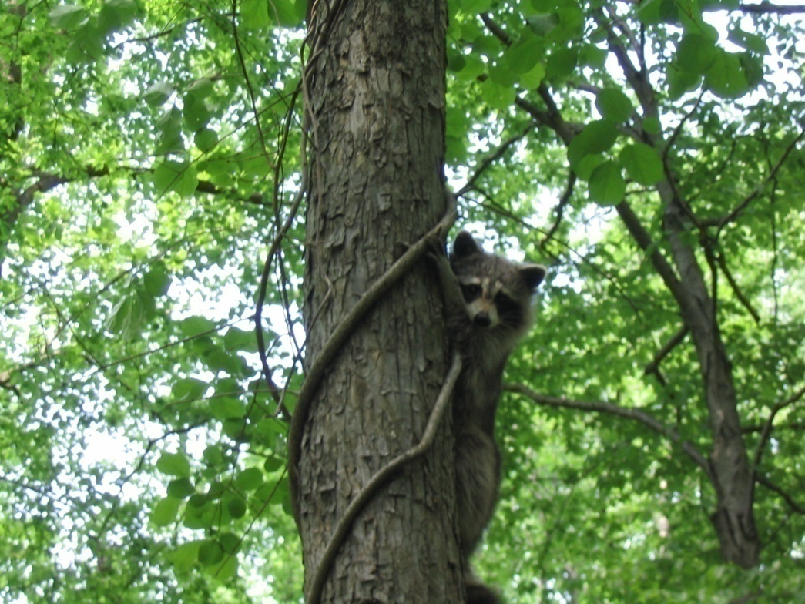
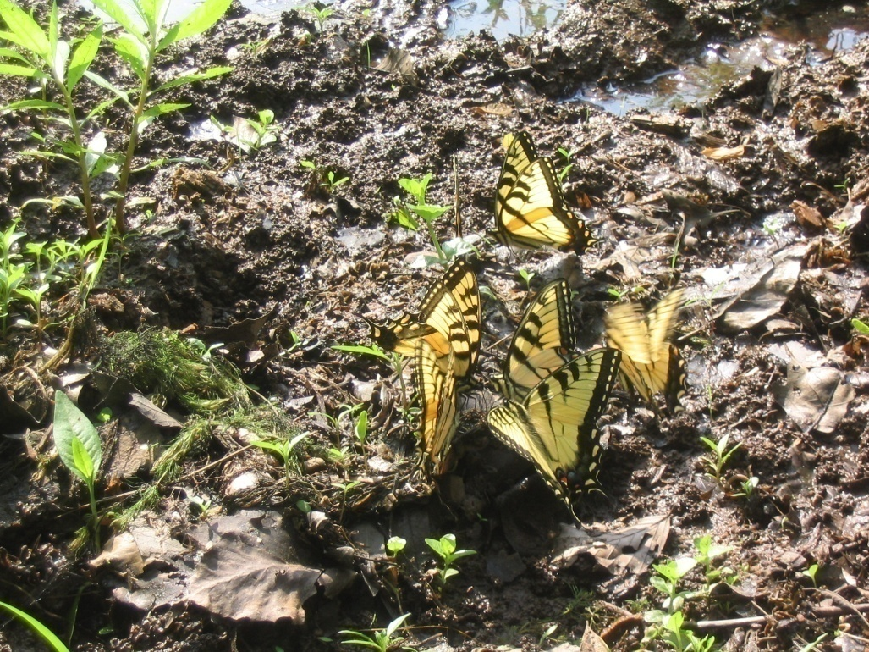
Indicators of Biodiversity
One of the key goals of conservation biology is preservation of biodiversity.
But what is biodiversity?
Long history of trying to define it.
It is a multidimensional concept.

Slide 3
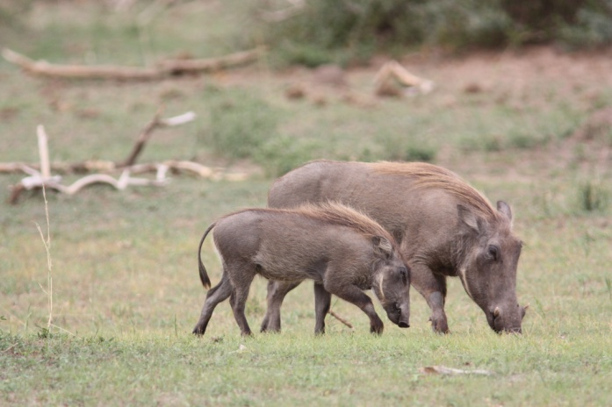
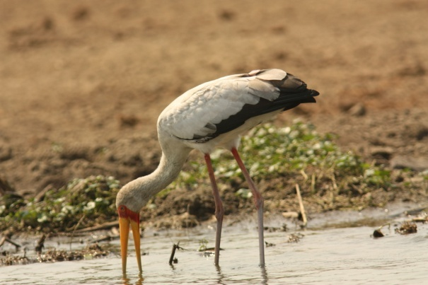
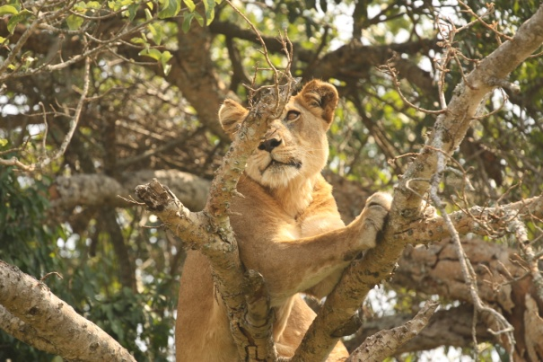
Indicators of Biodiversity
Traditional approaches to biodiversity consider:
  Richness = number of species
  Evenness = extent to which species are equally distributed
  Indicator species = organism that serves as a measure of environmental conditions

Slide 4
Competition Graphs
We will try to derive the “dimensions” of biodiversity starting from properties of ecosystems, in particular normal, healthy competition between species.
Based on idea of competition graph
  Arose from a problem of ecology.
  Joel Cohen 1968
Key idea: Two species compete if they have a common prey.

Slide 5
Competition Graphs of Food Webs
Food Webs
Let the vertices of a directed graph (digraph) be species in an ecosystem.
Include an arc from x to y if x preys on y.
Usual assumption for us: no cycles.
owl
fox
ant
speargrass
deer

Slide 6
Competition Graphs of Food Webs
Consider a corresponding undirected graph.
Vertices = the species in the ecosystem
Edge between a and b if they have a common prey, i.e., if there is some x so that there are arcs from a to x and b to x.

Slide 7
owl
fox
ant
speargrass
deer
owl
ant
fox
deer
spear grass

Slide 8
Competition Graphs
More generally:
Given a digraph D = (V,A)
(Usually assumed to be acyclic.)
The competition graph C(D) has vertex set V and an edge between a and b if there is an x with arcs (a,x) ε A and (b,x) ε A.

Slide 9
Mathematical Aside: Interval Graphs
A key idea in the study of competition graphs is the notion of interval graph. It arose from a problem in genetics posed by Seymour Benzer.
Benzer’s Problem (1959): The problem was: How can you understand the “fine structure” inside the gene without being able to see inside?

Slide 10
Benzer’s Problem
Classically, geneticists had treated the chromosome
as a linear arrangement of genes.
Benzer asked in 1959: Was the same thing true
for the “fine structure” inside the gene?

Slide 11
Benzer’s Problem
At the time, we could not observe the fine structure
directly.
Benzer studied mutations.
He assumed mutations involved “connected
substructures” of the gene.
By gathering mutation data, he was able to surmise
whether or not two mutations overlapped.

Slide 12
Benzer’s Problem
 | S₁ | S₂ | S₃ | S₄ | S₅ | S₆
S₁ | 1 | 1 | 0 | 0 | 0 | 0
S₂ | 1 | 1 | 1 | 1 | 0 | 0
S₃ | 0 | 1 | 1 | 1 | 0 | 0
S₄ | 0 | 1 | 1 | 1 | 1 | 0
S₅ | 0 | 0 | 0 | 1 | 1 | 1
S₆ | 0 | 0 | 0 | 0 | 1 | 1
i,j entry is 1 if mutations S_{i} and S_{j} overlap, 0 otherwise.

Slide 13
Benzer’s Problem
 | S₁ | S₂ | S₃ | S₄ | S₅ | S₆
S₁ | 1 | 1 | 0 | 0 | 0 | 0
S₂ | 1 | 1 | 1 | 1 | 0 | 0
S₃ | 0 | 1 | 1 | 1 | 0 | 0
S₄ | 0 | 1 | 1 | 1 | 1 | 0
S₅ | 0 | 0 | 0 | 1 | 1 | 1
S₆ | 0 | 0 | 0 | 0 | 1 | 1
S₄
S₆
S₂
S₃
S₁
S₅

Slide 14
Benzer’s Problem
If we represent the tabular (matrix) information
as a graph, we say that the graph is an interval graph if it is consistent with a linear arrangement.
That is: A graph is an interval graph if we can find intervals on the line so that two vertices are joined by an edge if and only if their corresponding intervals overlap.
Interval graphs have been very important in genetics. Long after Benzer’s problem was solved using othermethods, interval graphs played a crucial role in physical mapping of DNA and more generally in the mapping of the human genome.

Slide 15
Benzer’s Problem
Given a graph, is it an interval graph?
c
a
b
d
e
We need to find intervals on the line that have the same overlap properties
a
b
e
d
c

Slide 16
Benzer’s Problem
The following is not an interval graph.
a
x
b
c
y
z

Slide 17
Benzer’s Problem
The following is not an interval graph.
a
x
b
c
y
z
a
b
c

Slide 18
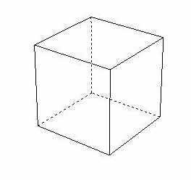
Intersection of Boxes
More generally, we can study ways to represent graphs where the edges correspond to intersections of boxes in Euclidean space.
The boxicity of G is the smallest p
so that we can assign to each vertex
of G a box in Euclidean p-space
so that two vertices are neighbors
iff their boxes overlap.
Well-defined (Roberts 1968) but hard to compute (Cozzens 1980).

Slide 19
Intersection of Boxes
Interval graphs are the graphs of boxicity 1.
Consider the graph C₄.
It is not an interval graph.
However, it can be represented as the intersection graph of boxes in 2-space.
So, boxicity of C₄ is 2.
a
b
G = C₄
d
c

Slide 20
Intersection of Boxes
C₄ can be represented as the intersection graph of boxes in 2-space.
So, boxicity of C₄ is 2.
a
b
G = C₄
d
c
b
a
c
d

Slide 21
Factors Affecting Biodiversity
Different factors determine a species’ normal healthy environment.
  Moisture
  Temperature
  pH
  …
We can use each such factor as a dimension.
Then the range of acceptable values on each dimension is an interval.
Each species can be represented as a box in Euclidean space.
The box represents its ecological niche.

Slide 22
Factors Affecting Biodiversity
The ecological niche is a box.
Moisture m
m₁
m₀
t₀
t₁
Temp t

Slide 23
Factors Affecting Biodiversity
Simplifying assumption: acceptable ranges on each dimension are independent of values on other dimensions.
Moisture m
m₁
m₀
t₀
t₁
Temp t

Slide 24
Factors Affecting Biodiversity
The ecological niche is a box.
Moisture m
pH p
m₁
p₁
m₀
p₀
t₀
t₁
Temp t

Slide 25
Competition
Old ecological principle: Two species compete if and only if their ecological niches overlap.
Joel Cohen (1968):
  Start with an independent definition of competition
  Map each species into a box (niche) in k-space so competition corresponds to box overlap (niche overlap)
  Find smallest k that works.

Slide 26
Competition
Specifically, Cohen started with the competition graph as defined before.
The question then becomes: What is the boxicity of the competition graph?

Slide 27
owl
fox
ant
speargrass
deer
owl
ant
fox
deer
spear grass

Slide 28
owl
ant
fox
deer
spear grass
This is an interval graph. Thus, boxicity is 1.
owl
fox
ant
spear grass
deer

Slide 29
1
Key:
Juvenile Pink Salmon
P. Minutus
Calanus & Euphasiid Barcillia
Euphasiid Eggs
Euphasiids
Chaetoceros Socialis & Debilis
Mu-Flagellates
3
2
4
5
6
7
Strait of Georgia, British Columbia, Canada
Due to Parsons and LeBrasseur
From Joel Cohen, Food Webs and Niche Space
Princeton University Press, 1978

Slide 30
1
Competition graph
3
1
4
2
4
3
5
2
5
6
7
7
6
Strait of Georgia, British Columbia, Canada

Slide 31
Competition graph
What is the boxicity of the competition graph?
1
4
3
5
2
6
7
Strait of Georgia, British Columbia, Canada

Slide 32
Competition graph
This is an interval graph. Thus, its boxicity is 1.
1
4
3
5
1
3
4
5
2
2
6
6
7
7
Strait of Georgia, British Columbia, Canada

Slide 33
Key
Canopy – leaves, fruits, flowers
Canopy animals – birds, bats, etc.
Upper air animals – insectivores
Insects
Large ground animals – large mammals & birds
Trunk, fruit, flowers
Middle-zone scansorial animals
Middle-zone flying animals
Ground – roots, fallen fruit, leaves
Small ground animals
Fungi
Key
Canopy – leaves, fruits, flowers
Canopy animals – birds, bats, etc.
Upper air animals – insectivores
Insects
Large ground animals – large mammals & birds
Trunk, fruit, flowers
Middle-zone scansorial animals
Middle-zone flying animals
Ground – roots, fallen fruit, leaves
Small ground animals
Fungi
5
5
2
2
3
3
10
8
10
8
7
7
4
6
6
4
1
1
11
11
9
9
Malaysian Rain Forest
Due to Harrison
From Cohen, Food Webs and Niche Space
Malaysian Rain Forest
Due to Harrison
From Cohen, Food Webs and Niche Space
33

Slide 34
Competition Graph
5
Competition Graph
5
2
2
3
3
10
8
10
8
7
7
11
11
4
4
5
6
6
5
4
4
1
1
10
11
10
11
2
9
2
9
3
7
3
7
8
8
Malaysian Rain Forest
Malaysian Rain Forest
34
9
1
9
1
6
6

Slide 35
Competition Graph
What is the boxicity of the competition graph?
11
4
5
10
2
7
3
8
Malaysian Rain Forest
35
1
6
9

Slide 36
Competition Graph
This is an interval graph. Thus, its boxicity is 1.
11
4
5
10
11
4
5
2
7
2
8
3
7
3
10
1
6
9
8
Malaysian Rain Forest
36
1
6
9

Slide 37
Structure of Competition Graphs
In the first 12 years after this problem was introduced, every food web studied was found to have a competition graph that was an interval graph.
In 1976, a Rutgers undergraduate, Gordon Kruse, found the first example of a food web whose competition graph was not an interval graph.
It arose from a complex set of habitats.
Generally: Food webs arising from “single habitat ecosystems” (homogeneous ecosystems) have competition graphs that are interval graphs.

Slide 38
Structure of Competition Graphs
The remarkable empirical observation of Cohen’s that real-world competition graphs are usually interval graphs has led to a great deal of research on the structure of competition graphs and on the relation between the structure of digraphs and their corresponding competition graphs, with some very useful insights obtained.
Competition graphs of many kinds of digraphs have been studied.
In most of the applications of interest, the digraphs studied are acyclic.

Slide 39
Structure of Competition Graphs
The explanations for the empirical observation have taken two forms:
  Statistical
  Graph-theoretical

Slide 40
Structure of Competition Graphs
Statistical Explanations:
  Develop models for randomly generating food webs
  Calculate probability that the corresponding competition graph is an interval graph
  Much of Cohen’s Food Webs and Niche Space takes this approach.
  Cascade model developed by Cohen, Newman, and Briand. But Cohen and Palka showed that under this model, the probability that a competition graph is an interval graph goes to 0 as the number of species increases.

Slide 41
Structure of Competition Graphs
Graph-theoretical Explanations:
  Analyze the properties of competition graphs that arise from different kinds of digraphs.
  Characterize the digraphs whose corresponding competition graphs are interval graphs.
  Much known about the former problem.
  Latter problem remains the fundamental open problem in the subject.

Slide 42
The Competition Number
Suppose D is an acyclic digraph.
Then its competition graph must have an isolated vertex (a vertex with no neighbors).
Theorem: If G is any graph, adding sufficiently many isolated vertices produces the competition graph of some acyclic digraph.
Proof: Construct acyclic digraph D as follows. Start with all vertices of G. For each edge {x,y} in G, add a vertex α(x,y) and arcs from x and y to α(x,y). Then G together with the isolated vertices α(x,y) is the competition graph of D.

Slide 43
The Competition Number
a
b
b
c
a
d
G = C₄
D
α(a,b)
α(b,c)
α(c,d)
d
c
α(a,d)
a
b
α(a,b)
α(b,c)
C(D) = G U I₄
α(c,d)
α(a,d)
d
c

Slide 44
The Competition Number
Thus, D as shown in previous slide has a competition graph that is not an interval graph.
In fact, there are examples of competition graphs of acyclic digraphs that have arbitrarily high boxicity.
  Just start with a graph of boxicity b.
  Add sufficiently many isolated vertices to make the graph into a competition graph.
  (Adding isolated vertices does not change the boxicity.)
Thus, the empirical observations tracing back to Joel Cohen are truly surprising.

Slide 45
The Competition Number
If G is any graph, let k be the smallest number so that G U I_{k} is a competition graph of some acyclic digraph.
k = k(G) is well defined.
It is called the competition number of G.
Thus k(C4) = 4 from the previous example

Slide 46
The Competition Number
Competition numbers and boxicity are known for many interesting graphs and classes of graphs.
However:
Theorem (Cozzens 1980): It is NP-complete to determine the boxicity of a graph, even if a graph has boxicity greater than or equal 2.
Theorem (Opsut 1982): It is an NP-complete problem to compute k(G).

Slide 47
The Competition Number
Characterization of which graphs arise as competition graphs of acyclic digraphs comes down to the question: Given a graph, how many isolated vertices is it necessary to add to make it into a competition graph?
There has been extensive work over the years on algorithms for calculating the competition number.

Slide 48
Data Gathering: Community Food Webs, Sink Food Webs, Source Food Webs
How one gathers data about food webs can influence your conclusions about competition graphs, biodiversity, etc.
A community food web includes all predation relations among species.
In practice, we don’talways get all this data. We might start with some species, look for species they prey on, look for species they prey on, etc.

Slide 49
Data Gathering: Community Food Webs, Sink Food Webs, Source Food Webs
Suppose F is a community food web.
Let W be a set of species in F (ones we start with).
Let X be the set of all species that are reachable by a path in F from vertices in W.
  So, we start with vertex of W, find its prey, find prey of the prey, etc.
Let Y be the set of all species that reach vertices of W by a path in F.
  So we start with vertex of W, find its predators, find predators of those predators, etc.

Slide 50
Data Gathering: Community Food Webs, Sink Food Webs, Source Food Webs
Suppose F is a community food web.
Let W be a set of species in F (ones we start with).
Let X be the set of all species that are reachable by a path in F from vertices in W.
  The subgraph induced by vertices of X is called the sink food web corresponding to W.
Let Y be the set of all species that reach vertices of W by a path in F.
  The subgraph induced by vertices of Y is called the source food web corresponding to W.

Slide 51
Data Gathering
a
b
c
d
y
x
z
Community
food web F
e
f

Slide 52
Data Gathering
a
b
c
d
y
x
z
Community
food web F
e
f
W = {a,y}
What is the sink food web?
X = {a,x,e,f,y}
Sink food web from W
a
y
x
e
f

Slide 53
Data Gathering
a
b
c
d
y
x
z
Community
food web F
e
f
W = {a,y}
What is the source food web?
Y = {a,b,c,y}
Source food web from W
b
c
a
y

Slide 54
Data Gathering: Community Food Webs, Sink Food Webs, Source Food Webs
Theorem (Cohen): A community food web has a competition graph that is an interval graph if and only if every sink food web contained in it does.
However: A community food web can have a competition graph that is an interval graph while some source food web contained in it has a competition graph that is not an interval graph.

Slide 55
Data Gathering
a
b
c
d
y
x
z
Community
food web F
e
f
a
b
x
a
x
y
b
d
y
z
e
z
c
e
f
f
The competition graph of F
is an interval graph.
d
c

Slide 56
Data Gathering
a
b
c
d
y
x
z
Community
food web F
e
f
W = {e,f,y,z}
What is the competition graph of the source food web of W?
Y = {a,b,c,d,e,f,y,z}
a
b
y
z
Competition graph of the source food web from W
e
f
This is not an interval graph.
d
c

Slide 57
Data Gathering: Community Food Webs, Sink Food Webs, Source Food Webs
This surprising result points up some of the difficulties involved in understanding the structure of competition graphs.
It also leads to interesting caveats about general conclusions using models that are tested with data.

Slide 58
The Interval Graph Competition Graph Problem
It remains a challenge (dating back to 1968) to understand what properties of food webs give rise to competition graphs of boxicity 1, i.e., interval graphs.
In a computational sense this is easy to answer:
  Given a digraph, compute its competition graph (easy)
  Determine if this is an interval graph (well known to be solvable in linear time)

Slide 59
The Interval Graph Competition Graph Problem
More useful would be results that explain the structural properties of acyclic digraphs that give rise to interval graph competition graphs.
However, such results might be difficult to find:
There is no list L (finite or infinite) of digraphs such that an acyclic digraph D has an interval graph competition graph if and only if does not have an induced subgraph in the list L.

Slide 60
Open Problems
There are, however, results with extra assumptions about the acyclic digraph D.
Example: It is useful is to place limitations on the indegree and outdegree of vertices (the maximum number of predator species and maximum number of prey species for any given species in the food web). Is this reasonable however? Then there are some results with forbidden lists L. (e.g., Hefner, et al., 1991).

Slide 61
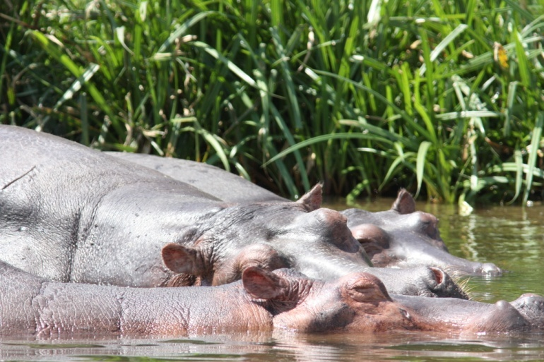
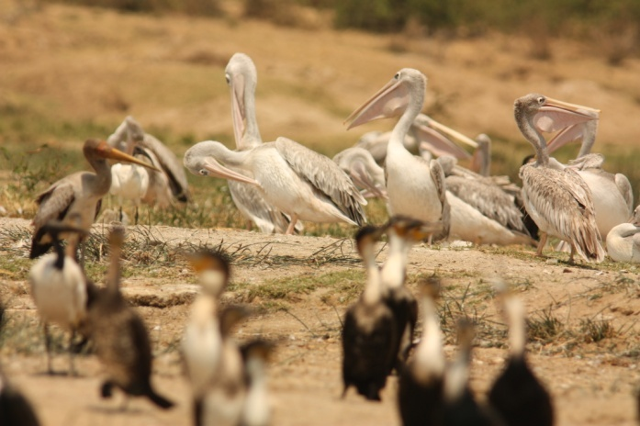
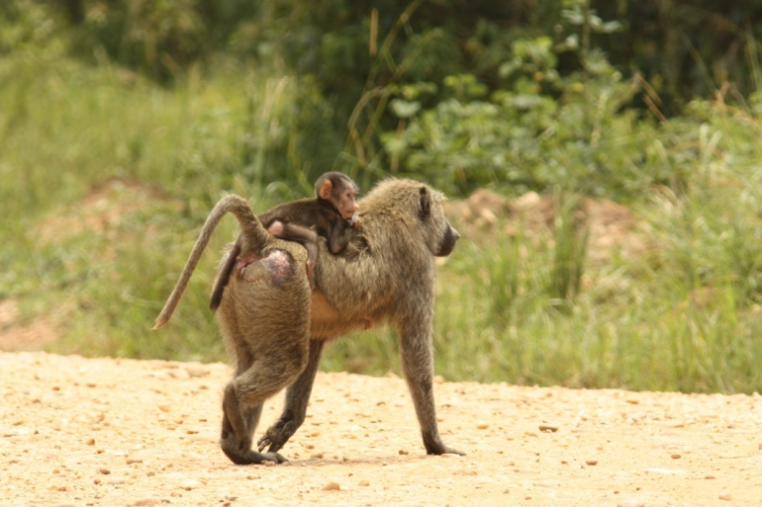
Biodiversity
What are the implications of this work for the measurement of biodiversity?
General Challenge: Can we “derive” “dimensions” of biodiversity from other important properties of ecosystems?

Slide 62
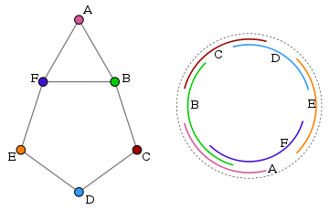
Circular Arc Graphs
A graph is a circular arc graph if we can find arcs on a circle so that two vertices are joined by an edge if and only if their corresponding arcs overlap on the circle.

Slide 63
Key Results
Computing the circular dimension of a graph is an NP complete problem. It is easy for many classes of graphs, however.
A co-circular arc graph is a graph whose complement is a circular arc graph.
Proving that the circular dimension of a graph is k is equivalent to proving its complement can be covered by k co-circular arc graphs.

Slide 64
Applications of
Circular Arc Graphs
Scheduling sets of repetitive cyclical tasks, such as mowing of fields, phasing traffic lights, etc.;
Once thought to be appropriate for DNA mapping, but Watson and Crick showed otherwise.
Are there other applications in ecology or more generally biology?

